Slide 1
Module 9
Collaborating for Success

Slide 2
Module 9
Collaboration Culture
Working together, sharing space, ideas, and cultivating a creative, collaborative atmosphere
An entrepreneur with a vision can start a new business, but it takes a collaboration of many people to make it a success.
This modules takes you through how forging partnerships can strengthen your Engineering start up, disrupt industries and invigorate your brand.
Co Working & Clusters
Co working and clusters can be a ‘smart’ way to work for start up female engineering entrepreneurs. What does this mean for you?
Collaboration Tech Tools
How to use them to bring your teams/workers together, work more efficiently and ultimately elevate your Start up Engineering business

Slide 3
SECTION 1:
Collaboration Culture
We all know innovation is key to sustainable success, and the one way to accelerate innovation is through collaboration.
The idea that start-ups and their key stakeholders excel better together isn’t new. But it is a key part of your business evolution. This module is suitable for those already working with others or thinking about collaborations with others for start up success.

Slide 4
What is Collaboration ?
Collaboration is the process of two or more people or organisations working together to realize mutual advantage.
Options range from informal networks and alliances, through joint delivery of projects to full merger.
Collaborative working can last for a fixed length of time or can form a permanent arrangement. What these options have in common is that they involve some sort of exchange.
Collaboration is essentially;
Fostering a positive collective attitude.
Encouraging a new acceptance of ‘process’.
Remaining enthusiastic and curious about new tools and technology.

Slide 5
It is really about finding your tribe…
“If you want to go fast, go alone. If you want to go far, go together.”
African proverb

Slide 6
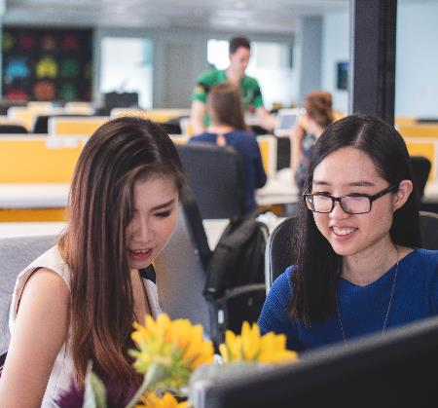
Why is a tribe important ?
As a start up in Engineering entrepreneur, you may sometimes feel alone, without any resources to utilise but your own. Finding your tribe means having a built-in coalition of collaborators, a ready-made group to provide support and encouragement.
The tribe begins with you, believing and trusting in yourself. From there, you attract your tribe. The seeds you plant are what you’ll end up harvesting.
Having a tribe can make all the difference in which one you will do.
Are you working/surrounded by the right people for you? If not, what can you do to attract your tribe?

Slide 7
Why collaborate ?
Collaborating with others can provide you with the additional skills and resources to do things that you couldn’t achieve on your own. This could be anything from developing a new product or using new material in your design process, to securing a new client or gaining access to significant funding.
Getting collaboration right though, takes effort and a culture open to change. Collaborations require serious effort to make the collaboration work. Some people are natural collaborators, while others may not be.
Let’s explore this a little further…

Slide 8
Why collaborate ?
When you bounce ideas off someone, or lean on someone for their ideas and critiques, you magnify your own abilities in several ways.
Momentum: Someone else is supporting you to move to the next step
Sources: You add more ideas to project, more research, another lifetime of knowledge
Perspective: You see angles and flaws you may not have seen
Speed: You are able to work faster, identify the best ideas more quickly
Decisions: A sounding board helps you talk through your own decisions, understand your own thinking more easily.
Validation: A good collaboration partner not only sees the flaws in your work, but can help support your best ideas and spur you forward in the right direction.

Slide 9
Why collaborate ?
We know the saying - a problem shared is a problem halved. Research shows that discussing problems with people in similar situations reduces stress levels. Problems don’t seem as overwhelming when you talk about them, and two people are more likely to find a solution than one.
Cindy White once described the shifting roles that great collaboration partners play for each other.
“When you start coming up with great ideas, you’re like a kite caught in a creative wind and you just want to go with it, get lost in it…fly free,” she says.
Read more: www.dailymail.co.uk/sciencetech/article-2548917/A-problem-shared-really-IS-problem-halved-Study-finds-discussing-problems-people-situation-reduces-stress-levels.html

Slide 10
Why collaborate ?
“A great partner lets you soar without drifting away. Sometimes they are the wind that’s hoisting you up. Sometimes they are the ones on the ground, holding the kite string. We need to play all of these roles for each other.”
Cindy White
Read more: www.dailymail.co.uk/sciencetech/article-2548917/A-problem-shared-really-IS-problem-halved-Study-finds-discussing-problems-people-situation-reduces-stress-levels.html

Slide 11
Why collaborate ?
True collaboration is more than an activity, however. It is a process that leverages the collective intelligence of everyone involved. It is the way in which people collectively explore ideas to generate solutions that extend beyond the limited vision of a single person.
Organizations have conventionally applied collaboration to teams or organizational levels (such as senior leadership) to break down silos, to foster cross-functional activities, and to encourage better innovation. This type of collaboration can yield positive results. In addition to increasing innovation, collaboration increases employee energy, creativity, and productivity, which generally leads to less stressed, happier, and more engaged workers.

Slide 12
Collaboration Culture
Creating a collaborative start-up culture starts from the top, and is heavily influenced by the early decisions you make when your start-up is scaling. Develop a culture that rewards innovation and disagreement and empowers its employees.
That’s how a high-paced start-up fuses collaboration into all areas of its culture to ultimately create an environment where everyone can thrive. Source: Singularity Hub
More than half of the attempts to collaborate still fail due to a clash of mind-sets between passionate, entrepreneurial start-ups, and more process oriented and risk-averse corporates. Source: Collaboration between Start-ups and Corporates/Europe/January 2018

Slide 13
Collaboration Culture
Bringing people together to arrive at a solution faster and easier than had it been done alone: That’s collaboration in a nutshell!
You innovate, solve problems together, bring together cross-functional expertise and knowledge to see a new solution, or tackle a challenging issue. That’s how most start-ups see collaboration. But it’s also the ability to bring people together to talk about difficult topics. Conflict is inevitable, and in start-ups, where you’re bringing different people together to work on projects, personality clashes are all too common. So building that collaborative start-up culture also requires seeing conflict as a positive thing, building out the values and processes necessary to leverage its beneficial qualities.
Conflict leads to better solutions, higher-quality work, and motivated employees, because disagreement can be seen as a way of generating solutions that may not be readily available.

Slide 14
Collaboration Culture
You recognise that working well together and sharing knowledge will help achieve much more than what each person could create on their own.
You approach collaboration with a creative problem solver outlook
You value diverse viewpoints, the expertise of others, and communicate well to get the job done.
You take pride in your own work and are keen to develop your practice.

Slide 15
Top 8 characteristics of a great collaborator…
Team focused. To successfully collaborate, you need to be a team player and think about "we" rather than "I". A great collaborator is mindful of shared goals and group success.
Generous. A great collaborator is willing to take the first step and pitch in, even if they won't get the spotlight. Generosity is also an incredibly desirable leadership characteristic.
Curious. Great collaborators are good at asking the right questions. They don’t interrogate; they simply follow their natural curiosity because they want to understand.
Appreciative. The best collaborators express sincere appreciation for all that team members have contributed. They give credit where credit is due.
Source: Singularity Hub

Slide 16
Top 8 characteristics of a great collaborator…
Listens to understand. Great collaborators listen attentively to what is being said. But more importantly, they listen to understand.
Gives and expects trust. Great collaborators help create and maintain that trusting environment. They give their trust freely and expect to receive trust in return.
Builds relationships; breaks down walls. Collaboration is all about working together. Great collaborators see the value in being usually well connected and work hard to build and maintain relationships with others.
Diplomatic. The best collaborators are diplomats. They know that relationships are built on mutual respect.
Source: Singularity Hub

Slide 17
5 Steps to Collaborate Successfully
1
2
3
SELECT COLLABORATORS
Enlist collaborators with little overlap with your fields of expertise, this will ensure each collaborator has a unique contribution to make.
CLARIFY ROLES
& RELATIONSHIPS
Confusion or doubt about who has what role is the usual source of tension and conflict in a collaborative project. This frequently leads to miscommunication and flawed outcomes
SET UP CLEAR COMMUNICATION PATHS
Communication is central to collaboration because creative dialogue sparks ideas that the participants would never have had on their own

Slide 18
5 Steps to Collaborate Successfully
1
2
FOSTER OPEN COMMUNICATION
The trust built up in a good collaborative circle gives everyone the confidence to advance an incomplete or inadequate thought, knowing that it may catalyse other ideas in the conversation
RECORD YOUR IDEAS
Document profusely: keep your post-its, flip charts, diagrams, and notes.

Slide 19
4 ways to maximize the results of Collaboration
Brainstorm on your own
The brain of one individual is still the most powerful computer in the world. Always start on your own in any brainstorm or collaboration. Don’t underestimate the number or quality of ideas you can generate as one person. Switch back and forth between working on your own and working with a partner. Constantly comparing notes, asking for edits, testing hypothesis, etc.
Switch roles
If one person is always in the role of the critic and the other the creator, the potential results of a collaboration are stunted. Switch things up when you can
Adapted from: https://medium.com/@jasonkeath/partners-in-crime-the-power-of-finding-your-creative-collaborator-7d8aaf7af07b

Slide 20
4 ways to maximize the results of Collaboration
Plan for friction
Two people will often disagree on the best solution to a problem. But disagreements are opportunities for insight and can lead you to learn a new perspective on the problem. Some things to consider:
Ownership: Be clear on who the final decision maker is. If its not you, put forth your best ideas and advice for them, understanding that the final decision is not yours.
Pick Your Battles: Decide which battles to fight. Weigh the cost and benefits of each debate and whether it is worth the friction. Don’t be afraid to defend a great idea with passion, but avoid creating unnecessary arguments.
Listen For Passion: Be cognizant of the other person’s passion when disagreement takes place. If they are defending their ideas with fervour, it might be an opportunity for you to listen more.
Adapted from: https://medium.com/@jasonkeath/partners-in-crime-the-power-of-finding-your-creative-collaborator-7d8aaf7af07b

Slide 21
4 ways to maximize the results of Collaboration
Challenge one another to spark new ideas.
A creative collaboration is best when it challenges everyone involved. Be there to push, spur eachother on and to help the best ideas to be bigger.
Encourage one another
Ask for progress reports
Be accountable
Don’t think too small
Never let great ideas be squandered
Adapted from: https://medium.com/@jasonkeath/partners-in-crime-the-power-of-finding-your-creative-collaborator-7d8aaf7af07b

Slide 22
Tips for Successful Collaborations
Stay open to ideas you didn't expect.
Plan for emergent ideas and be willing to change direction.
Honesty is key ingredient of any collaboration; make sure each player knows and is clear about what they expect from the partnership from the outset. There needs to be clarity on why the collaboration is taking place and what each partner hopes to achieve.
Collaborations will repay you handsomely, as long as you are just as interested in the journey as the product itself.

Slide 23
Case Study: Support for Women in Business
Poland
Title: Women in Business Supporting Women in Business
Description: Organizations and charities created for women, which help and support them develop their own business.
Video 1: https://siecprzedsiebiorczychkobiet.pl/biznes-w-kobiecych-rekach/
Video 2: hhttps://www.parp.gov.pl/
Video 3: ttps://aip.link/
Video 4: https://kobietawbiznesie.pl/
Video 5: https://fundacjamotiwator.pl/
Video 6: https://www.fundacjaliderekbiznesu.pl/
Video 7: http://zarr.szczecin.ibip.pl/public/

Slide 24
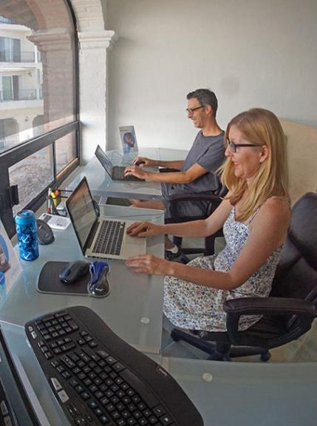
SECTION 2
Coworking in Business Clusters and Incubators
Coworking can be a ‘smart’ way to work for start up Engineering entrepreneurs. What does this mean for you? In this section, we exploring the advantages of coworking in Makers and Hackerspaces…

Slide 25
Co-working
Co+Working - “Co” means “with, together”. It takes its roots from the Latin “cum”. So, co-working really means working together, sharing the space, the ideas, the atmosphere.
Co Working spaces can be…
Membership based workspaces where diverse groups of freelancers, remote workers, and other independent professionals working together in a shared communal setting.
Today there is an increased availability of co-working spaces in many different guises. In this module, you will learn about different formats and apply that learning to your own circumstances.

Slide 26
Co-working Keywords
Collaboration
Community
Openness
Accessibility
Sustainability
What does this mean for you?
Achieve more than you would by yourself
Manageable cost, shared resources
Sharing energy, ideas and space
Work, your way
Available to anyone who needs it

Slide 27
Co-working
For many start up entrepreneurs that ‘go to work’ at their kitchen table, a spare room (the ‘box’ room) or the garden shed, clearing away one’s work to go back to family life is a constant challenge for many. The distraction of the washing machine and household chores can imped creative process!
Co working spaces bring together people working on a range of different projects/ contracts therefore there is little direct competition. Typically they offer affordable workspace, high speed broadband, access to facilities & in some cases to equipment

Slide 28
Co+Working Motivations
A report in Harvard Business Review found that people thrive in co-working spaces.
People using co working spaces are seeing their work as meaningful in the fact that they can bring their whole selves to work.
It can be really daunting to make the decision to leave a paid job, reliable income to set up your own creative business from home. Co working can help as it offers cheaper start up and help and encouragement through interaction with other like minded people.

Slide 29
Co+Working Motivations
Further research quantifies the benefits of co-working:-
When people work in a Co-working space:
86% felt less isolated
80% of their businesses expanded
71% felt that their productivity increased
75% expect their income to rise
66% expect their work volume to increase.
Source: Deskmag Global Coworking Surveys 2012 and 2014

Slide 30
Coworking Structure & Collaboration Culture
Coworkers report that having a community space to work in helped to create a structure on their working day and this discipline is motivational.
The more human centred the approach of the coworking space is the better it thrives.
Coworkers are free to choose who and how they interact with others in the space- often the best networking can happen over a cup of coffee at the communal café/kitchen – interaction is organic and not forced.
Coworkers can use coworking facilities whenever necessary- the meeting room/conference rooms/ studios/hubs / equipment /high speed broad band, usually offered at affordable rates.

Slide 31
Exercise
Think about working in a co working space:
Could it help you get your business off the ground? How?
Note down your 5 most essential needs from coworking?
What skills can you offer others in a coworking capacity?
Do you think that coworking is an option for you?

Slide 32
Business CLUSTERS
‘Clusters’ describe a group of related or mutually dependent businesses and resources that are grouped together in a defined area or in a virtual environment that is dependent on strong commitment to connectivity.
Clusters feed on diversity and change. They are uniquely diverse in structure, sector and services, and range from collective and co-operative, to labs and incubators; and can be static, mobile or online. More importantly, they are drivers with the potential to revive the economy.
New value is created when: technical innovation, creativity and business entrepreneurship are deployed together to make and distribute new innovative products.

Slide 33
Hackerspaces - Makerspaces
‘A ‘hackerspace or makerspace are community operated workspaces where people with common interests, often in software, machining, engineering, technology, education, science, art, electronics, fabrication or craft can socialise and collaborate.
These shared spaces give members a place to be creative and work on their projects in an environment that is inspiring and supportive of both new and old technologies.
MakerSpaces are quickly becoming a global phenomenon that is representing the democratisation of design, engineering, fabrication and education through social communities of creative people working together.

Slide 34
Examples: Hackerspaces - Makerspaces
The first Irish hackerspaces/makerspaces were established about 5 years ago and since then a number have set up in Ireland and Northern Ireland and include:-
Fab Lab Leitrim www.fablabs.io/fablabmanorhamilton
TOG Dublin Hackerspace (Dublin)- http://www.tog.ie
Lightbox Lab, North East Maker Space www.lightboxlab.ie
South East Maker Space (Waterford) – https://wiki.southeastmakerspace.org/doku.php
Nexus Hackerspace Cork www.hackerspacecork.com
091 Labs Galway www.091labs.com
Farset Labs Belfast www.farsetlabs.org.uk
IDEA CENTRE, Omaghwww.swc.ac.uk/innovate/idea/Makerspace

Slide 35
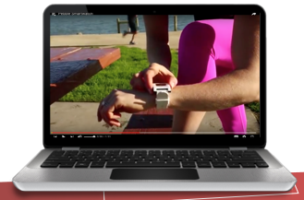
Spotlight on the Idea Centre, Omagh
The MakerSpace concept creates a social community of people that can share their skills and knowledge to design, create and manufacture products.
The Idea Centre www.swc.ac.uk/innovate/idea provides the physical resources, with high-end design and manufacturing equipment, and the social community will provide the knowledge and expertise to bring projects to life.
Notable products created through this very
concept are:
WATCH :Pebble Watch a smart watch technology
https://youtu.be/g6hUPbPH_xc?list=UU-WfB47Zgx2Q9LvS5us0Cwg

Slide 36
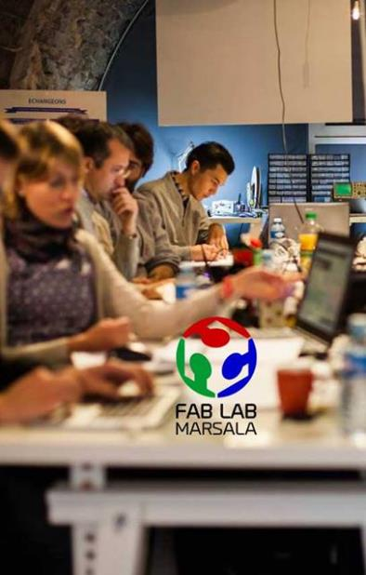
What is a FabLab?
FabLabs - digital fabrication laboratories - were set up to inspire people & entrepreneurs to turn their ideas into new products & prototypes by giving them access to a range of advanced digital manufacturing technology.
The idea was conceived by renowned inventor and scientist Professor Neil Gershenfeld at Massachusetts Institute of Technology (MIT). His idea was: to provide the environment, skills, advanced materials and technology to make things cheaply and quickly anywhere in the world, and to make this available on a local basis to entrepreneurs, students, creators, small businesses and in fact, anyone who wants to create something new or bespoke.

Slide 37
What is a FabLab?
Click on this video to learn about Fab Lab Belfast http://www.fablabni.com/

Slide 38
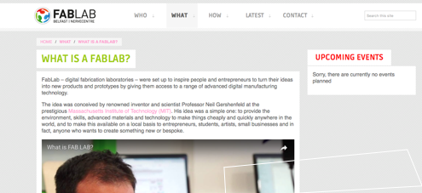
What is a FabLab Network?
A global network of 150 FabLabs+ exists, connecting people, communities and businesses across the world and enabling them to collaborate, problem solve and brainstorm ideas

Slide 39
CASE STUDY - Co-Labs Image Centre, Fermanagh http://www.swc.ac.uk/innovate/image/About-us
Image is an exciting creative technologies studio based at South West College Enniskillen campus. It is a design and development area focused on providing resources and services in the area of digital animation. The Hub offers resources to support the curriculum and also industry professionals in the following core areas :
3 D Animation
Digital Compositing
App Development
Motion Capture
Video game development
Interactive marketing
Promo creation

Slide 40
CASE STUDY - Co-labs Image Centre, Fermanagh http://www.swc.ac.uk/innovate/image/About-us
Image is an exciting creative technologies studio based at South West College Enniskillen campus. It is a design and development area focused on providing resources and services in the area of digital animation. The Hub offers resources to support the curriculum and also industry professionals in the following core areas :
3 D Animation
Digital Compositing
App Development
Motion Capture
Video game development
Interactive marketing
Promo creation

Slide 41
CASE STUDY - FabLab Manorhamilton
FABLAB Manorhamilton was started in late 2014 by a collective of Designers, Engineers and Makers. It operates a digital fabrication facility providing enterprises, creatives, schools and hobbyists access to a wide range of fabrication technologies that allow them to turn their ideas into new prototypes and products.
Follow what’s happening here:
https://www.facebook.com/fablabmh
http://www.fablabmh.org/

Slide 42
CASE STUDY - FabLab Manorhamilton
The Fab Lab Manorhamilton is a service for the whole of the North West of Ireland and this area is renowned for innovation and boasts some of Irelands leading design, manufacturing and artistic organisations and individuals.
Users have an unprecedented opportunity to access state of the art digital tools within a community setting and the addition of the Fab Lab to the area will provide a source of innovation, empowerment, education and new business development.
http://www.fablabmh.org/

Slide 43
Case Study: Common Work Areas in Poland
Poland
Title: Incubators, Fablabs, Makerspaces
Description: Institutions which provide co-working spaces in Poland such as Incubators, Fablabs, Makerspaces etc.
Video 1: https://andcards.com/blog/archive/top-coworking-spaces-in-poland
Video 2: https://gocarrots.org
Video 3: https://fablabtwarda.pl/strona-glowna
Video 4: https://zaklad.org
Video 5: Click here

Slide 44
Case Study: Collaborative Working Spaces
Turkey
Title: Co-Working Spaces, Fab Labs, Incubators
Description: In this section you will find a mix of working spaces 1 and 2 find co-working spaces, 3 Fablabs, 4 to 7 Incubators
Working Space Example 1: https://www.coworker.com/turkey/izmir
Working Space Example 2: https://www.coworkbooking.com/turkey/izmir
Working Space Example 3: https://www.ibbmeslekfabrikasi.com/tr/Fablab/56?AspxAutoDetectCookieSupport=1
Working Space Example 4: https://www.nuvege.org/ (EGE University)
Working Space Example 5: https://teknoparkizmir.com.tr/ (İYTE)
Working Space Example 5: https://minerva.yasar.edu.tr/ (Yaşar University)
Working Space Example 5: https://bambu.depark.com/ (Dokuz Eylul University)

Slide 45
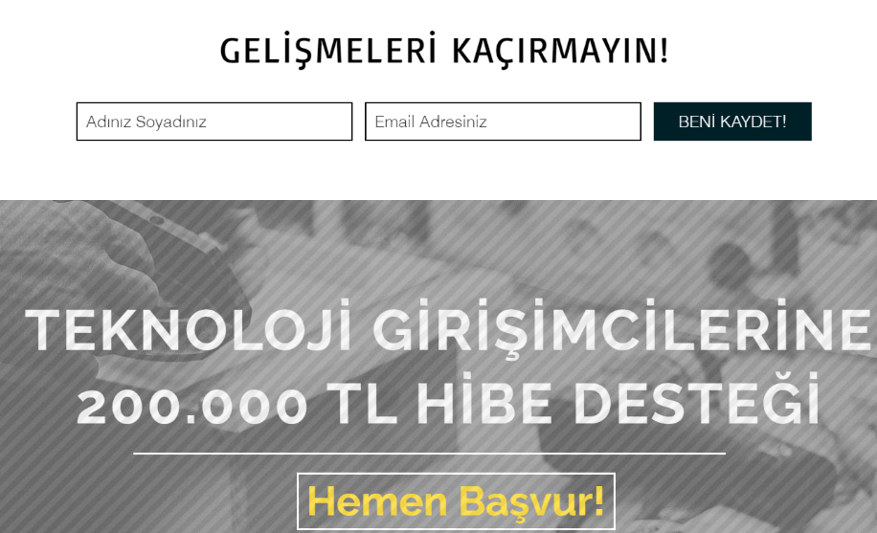
Case Study: EGE University EBILTEM-TTO May be Able to Help you Attain TUBITAK Entrepreneur Supports
TURKEY

Slide 46
Section 3
Collaboration Technology
Why consider collaboration tools? Working together is hard work—for a lot of reasons. You could even have teammates who work in different locations and different hours. Plus, everyone’s work is now spread across multiple apps. Technology can help streamline how you work and collaborate.

Slide 47
Use social media to develop your networks / find collaborators
Technology and the media enables people to connect, share dreams and ideas from anywhere and at anytime. Tribe-up and share your interests
Information is accessible instantly
Global markets are available instantly
Connect to people who can help and advise via social media
Costs of starting a business have changed
Plan your approach
Network
Collaborate
Employ new skills
Build an online experience
Share Resource

Slide 48
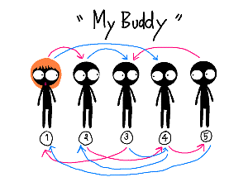
FACEBOOK GROUPS
Secrets to Building a Tribe/Creative Community with Facebook Groups. Facebook Groups are a powerful platform for creating a tribe and engaging with them online.
www.facebook.com/groups

Slide 49
FACEBOOK GROUPS
A Facebook group will provide:
Regular contact with your followers via the group (including creative collaborators) will help build a solid relationship
Notifications to members of a new post or comment on the post in the group allows for responsive conversations. This encourages deeper participation and collaboration
Instant Engineering (and STEM) community – your followers now have a voice and a direct connection to you. This drives a new level of engagement. Instead of being marketed to, they are now part of your tribe.

Slide 50
DIIGO GROUPS
Diigo groups are great for team-based research and collaboration. Diigo is a social bookmarking website that allows signed-up users to bookmark and tag Web pages.
Additionally, it allows users to highlight any part of a webpage and attach sticky notes to specific highlights or to a whole page. These annotations can be kept private, shared with a group within Diigo, or be forwarded to someone else via a special link. Learn how to use diigo: http://www.modern.pm/diigo-io3

Slide 51
SLACK
Slack is found everywhere in start-ups. The communication tool is how many start-ups keep each other in the know. But it may not work for your company, or there might be other communication tools your employees prefer. Either way, ask.
Find the tools for your company that empower people to work effectively and are tailored to their needs.

Slide 52
Useful link: Top Collaboration Software for your Start-up
Click to Compare:
More of All of the top Collaborative Software

Slide 53
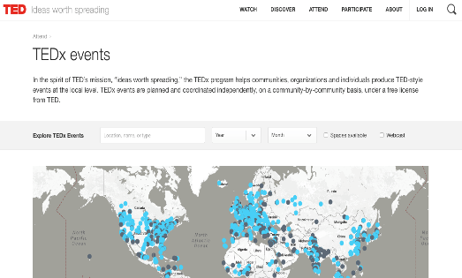
TEDX EVENTS
In the spirit of TED’s mission, “ideas worth spreading,” the TEDx program helps communities, organizations and individuals produce TED-style events at the local level. TEDx events are planned and coordinated independently, on a community-by-community basis, under a free license from TED. Have a look at what’s happening out in your region, national and get yourself out there…
Search for TEDx events near you:
https://www.ted.com/tedx/events

Slide 54
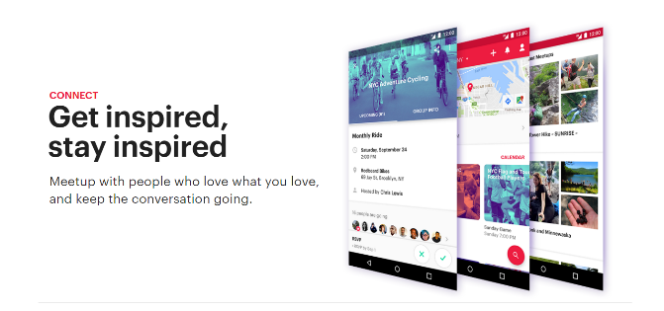
MEETUP - www.meetup.com
Meetup is organized around one simple idea: when we get together and do the things that matter to us, we’re at our best. And that’s what Meetup does.
It brings people together to do, explore, teach and learn the things that help them come alive.
At Meetups, people welcome each other. They talk, help, mentor, and support each other – all in pursuit of moving their lives forward.

Slide 55
What I Have Learned?
Collaboration can make a business more efficient by the sharing of resources among other businesses as needed
The collaboration of other companies or like minded individuals can engage innovative thinking and progressive business development
It is encourage for all levels of the business to engage in difficult and challenging company conversations through collaborative approaches in order to iron out potential business problems or weaknesses
There are numerous tools and supports out there that can assist a collaborative start up environments such as Makerspaces, FabLabs, Custers and Hackerspaces.

Slide 56
Thank you
Any Questions?
@EMERGEPROJECTEU
https://www.facebook.com/EMERGEPROJECTEU/?ref=br_rs
http://www.emergeengineers.eu/project-partners/
http://www.emergeengineers.eu/
#EMERGE #femaleengineers #Erasmus+
#femaleentrepreneurs

