Slide 1
Module 8
Financing & Getting Investor Ready

Slide 2
Module 8
Pricing, costs and making a profit Without truly knowing your costs, you cannot know if you are going to make a profit or not. Many start up entrepreneurs mistake turnover for profit. We will explain these in detail.
This module will cover all you need to know when it comes to financing and having an investor pitch ready. What your investors are looking for and what potential funding is available.
You will learn how to develop and deliver a 3-minute business pitch.
7 Ways to Fund your Start Up
We look at these sources of funding in detail - Bank Loan, Private investment, Y Combinator, Fund Yourself, Government supported Small Business Grants, Incubator or Accelerator, Crowd Funding
Nail your Investor Pitch
A step by step guide on how to create and pitch the perfect pitch

Slide 3
Section 1
Financial Planning, Pricing, costs and making a profit
Without truly knowing your costs, you cannot know if you are going to make a profit or not. Many start up entrepreneurs mistake turnover for profit.

Slide 4
Reminder of the importance
of your Business Plan
You wouldn't build a house without creating a plan. Why would you build a business without having a similar plan?
To help you think through the whole process - the value of a business plan is not only the plan itself, but the process of writing it.
To put down on paper how much money you need to get started and how much you need to make to break even and grow
To convince yourself that it is worth doing
To show others that you have thought it through
To use with a grant authority/banks to get support
To give you targets to aim towards and measure yourself against

Slide 5
Financial Section of your Business Plan
No business plan is complete without finances . If sales and marketing are the engine of the business, then finances are it’s lifeblood!
The financial section of your business plan is the basis of your business budget and a useful tool for managing cash flow on a monthly basis.
By completing this module, you will be confidently able to set out the financial profile of your business, the investment needed and be clear on routes to funding success.

Slide 6
Financial Section of your Business Plan
Tailor the financial data part of your plan to your needs but most plans include the following information:-
Start-up costs Revenue projections with comprehensive assumptions Expense projections with comprehensive assumptions Five-year cash-flow projections Five-year balance sheet projections Sources of Capital
The narrative of your business plan should back this up and also demonstrate..
Is your business viable ? Costing, pricing and breakeven
What business structure have you chosen?
What financial resources do you need to start up ?
Where are you targeting for support?
What is your cash flow profile ? Is there a burn rate period ?
Need to brush up on your business plan? We covered it in detail in Module 1, Section 2.

Slide 7
Pricing, costs and making a profit
HOW TO SET YOUR PRICE?
Let’s be clear…
Cost – the amount it takes for you to produce the product or service for sale
Price is the selling price per unit customers pay for your product or service. So, when customers ask, "How much does it cost," your answer is your price.
Turnover is the amount of money you take into the business (generated by sales)
Profit is what is left when you have covered all your costs

Slide 8
COSTS
The cost is a monetary valuation that needs to reflect and reward your ….
The purpose of costing
Is to control cost
To fix your price
To identify your most profitable sales
Effort
Materials
Resources
Time and utilities consumed,
Risks incurred and opportunity forgone (if you were working elsewhere how much would you have earned)

Slide 9
COSTS – 3 ELEMENTS
Working out costs for a physical product is straightforward. Your cost is the amount of expenditure it takes to make a product. It includes 3 elements:
The cost of your materials including packaging
Labour – the cost of your time in making and selling the item
Overheads – the costs of being in business – e.g. rent, transport, marketing costs
MATERIALS + LABOUR + OVERHEADS

Slide 10
Fixed: Fixed costs remain the same, no matter how much you produce e.g. rent, loans on equipment.
Variable: Variable costs relate to the amount of goods or services you produce. They are directly linked with changes in activity e.g. materials, stock, packaging, utilities. The more you sell, your variable costs increase. For example, you produce ceramic mugs for a cost of €2 a mug. If you produce 500 units, your variable cost will be €1,000. Types of costs
If your rent is €100 per month, then that does not change if you sell 10 mugs or 1,000 mugs.
FIXED
VARIABLE
TYPES OF COSTS

Slide 11
PRICING AND MAKING A PROFIT
Pricing your product or service is one of the most important business decisions you will make.
You must offer your products for a price your target market is willing to pay–and one that produces a profit for you–or you won't be in business for long!
Your pricing must takes into account your costs, but it also needs to consider the effects of competition and the customer's perception of value.
Bundle - Combining products and services can be a way of increasing the up front price (and therefore profit) by offering added value that costs you nothing in the short term. For example maintenance and support packages sold when goods are bought

Slide 12
1
TOTAL COST APPROACH
Calculate all costs for a product
Determine number of units - how many can you make and importantly how many can you sell (there is a difference!)
Divide total costs by number of units
Add profit figure - the magic number generating the price to customer
THERE ARE 2 MAIN WAYS OF COSTING/PRICING

Slide 13
1
TOTAL COST APPROACH
Example (mugs - not an engineering example but easy to understand!)
Total cost including all fixed and variable costs to run my mug business for 1 year is €10,000
I forecast I can sell 10,000 mugs (units)
I want to make a profit of 40 %
Price quoted to customer is €1.40 per unit
€10,000 divided by 10,000 mugs = €1 per mug Add profit 100% - €1 Price €2.00
THERE ARE 2 MAIN WAYS OF COSTING/PRICING

Slide 14
1
TOTAL COST APPROACH
Advantages
Simple to operate
Ensures you make a profit
Disadvantages
Not suitable for fluctuating businesses
Lacks flexibility for new business decision making
THERE ARE 2 MAIN WAYS OF COSTING/PRICING

Slide 15
1
TOTAL COST APPROACH
Calculate Breakeven
To be profitable in business, it is important to know what your break-even point is. Your break-even point is the point at which total sales equals total costs or expenses. At this point there is no profit or loss - in other words, you 'break even’.
Why your break-even point is important ?
Your business could be turning over a lot of money, but still be making a loss. Knowing the break-even point is vital in deciding prices, setting sales budgets and preparing a business plan.
The second costing method (Contribution Approach) is a better reflection of break even.
THERE ARE 2 MAIN WAYS OF COSTING/PRICING

Slide 16
2
CONTRIBUTION APPROACH
Determine Selling Price – influenced by the marketplace e.g. what the customer will pay + what competition are charging
Split Costs into Variable and Fixed
Calculate “Contribution” - selling price less variable costs.
THERE ARE 2 MAIN WAYS OF COSTING/PRICING

Slide 17
2
CONTRIBUTION APPROACH
Example
Our competitors sell their mug for €2.50 and customers seem happy to pay this price
Our variable costs to produce the mug is €0.75
Therefore contribution is €1.25 which is used to pay off our fixed costs (rent etc.) and
once the fixed costs have been paid in full, the contribution balance is profit.
THERE ARE 2 MAIN WAYS OF COSTING/PRICING

Slide 18
2
CONTRIBUTION APPROACH
Calculate Breakeven
Establish Total of Fixed Overheads
Establish Contribution per unit
Divide Fixed Overheads by Unit Contribution
Example
Total Fixed Overheads for the Mug business is €10,000
Contribution is €1.25 per mug
Break even point is 8,000 mugs.
The mug business company must sell 8,000 mugs to break even, all sales above 8,000 are profit.
THERE ARE 2 MAIN WAYS OF COSTING/PRICING

Slide 19
4 THINGS TO KNOW IN PRICING
There are some key considerations when pricing. Make sure to…
Be vigilant about the time it takes
Track your time over weeks/months to find out the average amount of time it actually takes to create/provide your main services that you offer. In time you will get quicker and better at what you do – you do need to know how much time you spend at a particular task to ensure that all of your work time is accounted for. Your hourly rate is very important to use for estimating purposes.
What is your clients/customers budget range and what are your competitors charging?
You need to what your competitors are charging.

Slide 20
4 THINGS TO KNOW IN PRICING
There are some key considerations when pricing. Make sure to…
Pay Yourself A Salary
Starting and running your own business is such a powerful feeling. However, it is very important to separate your personal and business finances. It is wise to pay yourself a salary. Just to be clear, your salary as the business owner may or may not be fixed. But include a fixed labour cost in your costings - even if you start with minimum cost rate. In practice, in the early days, a good method is to pay yourself a portion of the profits you make in a month (commission basis).
Keep clear records of all your incomings and outgoings on a daily basis relating to your business. You need these to be in control of your business and check that you’re covering all your bills

Slide 21
Section 2.
7 Ways to Fund your Start Up
There are many ways you can potentially fund your start up. In this section we introduce you to 7 of the most common.

Slide 22
Seeking the Right Funding for your Engineering Start-up
By creating a sound business plan, Engineering entrepreneurs can assess the amount of seed capital needed to start business, or how much venture capital is needed to expand their start-up business. From there, entrepreneurs are better able to find the right private investor for their needs.
Funding is required at all stages of development for small business entrepreneurs. For a new small business, obtaining initial funding, or seed capital, through traditional investment sources can be incredibly difficult, due to increasingly strict lending criteria.
As an alternative to borrowing money from banks and requesting government funding, small business entrepreneurs are beginning to take the initiative to find their own private investors through other financing platforms.
Adapted from Source: Irish Investment Network

Slide 23
Ways to Fund your Business
For any start up business, the challenge of putting together a financial investment package can be daunting. It can be even more daunting if this is your first time starting a business. There are many public and private funding opportunities; however knowing where to look is the key. Now we look at 8 different approaches.
Bank Loan
Private investment - Angel Investors
Venture Capital Investors
Y Combinator
Fund Yourself (Bootstrapping is Covered in Module 3)
Government supported Small Business Grants (Covered in Module 3)
Crowd Funding

Slide 24
1
Bank Loan
A business loan from a bank is another way of financing your business. In most cases, having a robust Business Plan is essential to convince the bank that you are worth backing. Often, a bank will ask for personal guarantees or other forms of security. Never offer security, especially if you are confident Business Plan stacks up. Finally, remember to shop around, there are many banks that may have different lending criteria for new businesses.
Dealing with Your Bank - Do's and Don'ts
Be prepared when meeting your bank
Keep your bank informed in good times and bad times
Choose a bank close to you
Shop around before choosing a bank
DO
Adapted from Local Enterprise Office
www.localenterprise.ie

Slide 25
1
Dealing with Your Bank - Do's and Don'ts
DO
Compare loan packages -Lenders describe the cost of a loan in different ways. Some will tell you the interest rate on the loan, and others may tell you the total amount of money you have to pay back. When lenders describe loan cost in different ways, it makes it difficult to compare your loan options.
Be prepared when meeting your bank
Keep your bank informed in good times and bad times
To make comparison easier, ask the lender to tell you the Annual Percentage Rate (APR) of the loan. APR is the total cost of a loan over one year, including fees. APR can be much higher for alternative lenders that provide fast funding and work with lower credit borrowers.

Slide 26
1
Dealing with Your Bank - Do's and Don'ts
DO
Choose between a line of credit and a traditional loan. Depending on your business needs, a business line of credit may be a better option than a loan. A loan is a fixed amount of money that you pay back with interest over a specific period of time; a line of credit is like a credit card. You get approved for a maximum amount of money that you can access as needed, and you repay it over a period of time. The advantage of a line of credit is that you only have to pay interest on the funds you use. A line of credit is better than a loan in two main cases. If you occasionally need short-term working capital to buy inventory or cover seasonal expenses. Loans typically work better when you need to finance a long-term investment, such as equipment or a premises.

Slide 27
1
Dealing with Your Bank - Do's and Don'ts
DO
Borrow at the right time: When you are planning about your business loan, make sure that you borrow at the right time. If you take the loan too early, then there are chances that you end up spending most of it for purposes other than what it was meant for. If you borrow it too late then it could put a hold on your business as you will also have to pay the interest at a time when your business can grow exponentially.
Borrow the right amount

Slide 28
1
Dealing with Your Bank - Do's and Don'ts
DON’T
Mix your Business and Personal account. It's never a good idea to mix your business money with your personal money. You can bank with the same institution if you want, but make sure you open a separate small business bank account. Don't transfer money between the two unless you have an excellent reason and you keep a paper trail.
Make the mistake of applying to only a single type of lender. Knowing all your options not only makes it easier to decide how to choose an appropriate business loan, but it also increases the chances of getting accepted for a loan.
Make the mistake of falling for an unreliable lender.
READ - 10 questions you should ask before applying for a bank loan

Slide 29
2
Private Investment - Angel Investors, Business Angels & Private Individuals
Angel Investment across Europe has taken off over the last few years. Angel investors invest in early stage or start-up companies in exchange for an equity ownership interest. Angel investing in start-ups has been accelerating. High-profile success stories like Uber, WhatsApp, and Facebook have spurred angel investors to make multiple bets with the hopes of getting outsized returns.
Business angels are private individuals or groups that invest their capital into start-up companies and entrepreneurial ideas in return for partial company management and/or a return on a set amount of the company’s profit (known as an “equity stake”). They often have other benefits for a company, such as experience in the particular sector and often a wide range of industry contacts that can help get your business in motion.

Slide 30
2
2 Private Investment - Angel Investors, Business Angels & Private Individuals
In addition to capital, Angel Investors also contribute their know-how or experience in company management and can offer valuable expertise and guidance. Angels usually seek active participation in the company in which they invest. Angel Investors are primarily motivated by return on investment and Angel Investor involvement can often help secure access to venture capital or classical bank loans.
Business Angels generally invest in the region where they live and in areas in which they have greatest expertise or knowledge.
Some specialise in providing finance in new technologies.
Source: Enterprise Ireland

Slide 31
2
The Ideal Angel Investor, Business Angels & Private Individuals will have
A strong commercial track record
Excellent business credentials
Capacity to invest
Ability to identify commercial opportunity
Time to invest in the creation of a new company
Vision to transform new technologies into solid businesses
Established links and relevant industry contacts
Source: Enterprise Ireland

Slide 32
2
6 Things Angel Investors, Business Angels & Private Individuals care about the most
The quality, passion, commitment, and integrity of the founders
The market opportunity being addressed and the potential for the company to become very big
A clearly thought out business plan, and any early evidence of obtaining traction toward the plan
Interesting technology or intellectual property
An appropriate valuation with reasonable terms
The viability of raising additional rounds of financing if progress is made
Source: Forbes

Slide 33
2
Private investment - Angel Investors
Angel Investor Networks
Most new businesses will have trouble getting significant amounts of capital, but business angel investment can help companies reach the next level of financing and expansion. Across Europe, Angel Investment Networks allows members to find and connect with other members regarding business investments and funding. Thousands of business angels use the network to search for ideas, and have entrepreneurs signing up on a daily basis.
e.g. Irish Investment Network has over 179, 388 registered angel investors. Their site is presented with
Clear listings posted angel investors that entail the details of their specific sector(s)
Potential investment amounts
Desired location of the potential business venture

Slide 34
2
All Your Angel Investor Questions Answered
What are the six most important things for angel investors?
What do angel investors like to initially see from an entrepreneur?
How long will it take to raise angel financing?
What financial questions should the entrepreneur anticipate from angel investors?
What questions should the entrepreneur anticipate about marketing and customer acquisition?
What questions should the entrepreneur expect concerning the management team and founders?

Slide 35
2
All Your Angel Investor Questions Answered
How risky is angel investing?
What questions should a CEO ask of potential angel investors?
What are the key factors in determining the appropriate valuation in a seed round of financing?
What are typical reasons angel investors will reject an investment?
What mistakes are made by entrepreneurs in a pitch meeting with angel investors?
All 20 Sets of Questions & Answers Here: Forbes

Slide 36
3
Venture Capital Investors
Seed and Venture Capital are becoming more frequent sources of investment providing capital for new businesses and entrepreneurs that would not be able to obtain loans. The global credit crunch has increased the demand for angel investors.
Venture Capital is:
Capital provided by full-time, professional firms (venture capitalists) who invest with management in ambitious, fast-growing companies with the potential to develop into significant businesses.
Is likely to add considerably to the credibility of the company and to supply management expertise, support and access to their contacts. As part of their mentoring and monitoring of their investment, they are likely to seek board membership.

Slide 37
3
Venture Capital Investors
In contrast to bank finance, venture capitalists are not looking for scheduled repayment, but for a minority of the share capital of your company in return for cash.
The venture capitalists will typically look to realise their investment in five years, either through floatation on a public market, a trade sale or for their stake to be bought out by the company.
Venture Capital funds usually invest in companies that are raising €500k+ in equity. The companies must be in a fast-growing, attractive sector, with a strong management team and demonstrable skills. The product/service must solve a clearly identified problem.

Slide 38
The Difference Between a Venture Capital and an Angel Investor
Angel Investor |  | Venture Capital
Private equity is simply shares (equity or securities) in a company that is not listed on the stock market
An individual investor Investment amounts: €10k - €100k, sometimes a bit more, groups could go up to €1m Hold private equity from having made investments directly into private companies Individuals often successful business people, who are investing their own personal funds into a potentially rewarding opportunity May be willing to invest in early-stage or start-up, as well as established companies Have experience and contacts to contribute May be willing to be "hands-off" or "hands-on" adding important skills | A company or business rather than an individual Investment amounts: €1M + Hold private equity from having made investments directly into private companies Capital is invested by firms or companies that use other people's money. They raise that money by offering investors a chance to take part in a fund that is then used to buy shares in a private company Seldom interested in early-stage, unless compelling reasons (e.g. high tech with already successful founders) Have contacts Require seat on board | A company or business rather than an individual Investment amounts: €1M + Hold private equity from having made investments directly into private companies Capital is invested by firms or companies that use other people's money. They raise that money by offering investors a chance to take part in a fund that is then used to buy shares in a private company Seldom interested in early-stage, unless compelling reasons (e.g. high tech with already successful founders) Have contacts Require seat on board

Slide 39
4
Y Combinator
Y Combinator provides seed funding for Start-ups. The goal is to get you through the first phase and get you to the point where you’ve built something impressive enough to raise money on a larger scale. Then they introduce you to later stage investors—or occasionally even acquirers.
Make small investments in return for small stakes in the companies funded
Help founders deal with investors and acquirers from well-known technology companies
Twice a year they invest a small amount of money in a large number of Start-ups. Once in January-March and one June-August
During Demo Day Start-ups pitch to a specially selected audience of investors and press
See a list of the benefits and resources available to YC founders here
Apply to Y Combinator, you just fill out an application form
Read More about Y Combinator

Slide 40
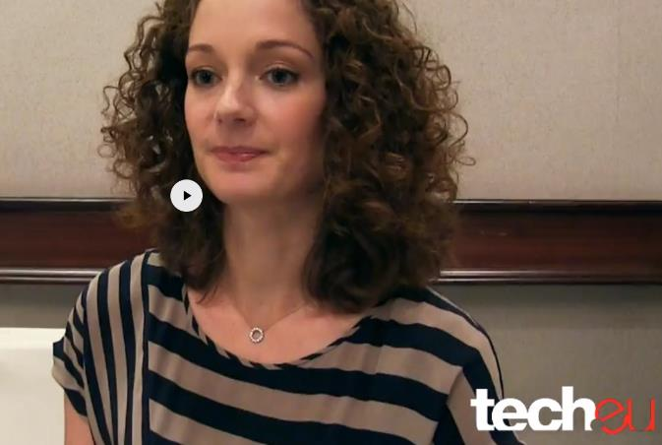
4
Y Combinator comes to Europe
Two and a half minutes. That’s how much time the influential tech incubator Y Combinator gives start-up founders to deliver a perfectly crafted pitch to an auditorium packed with investors and journalists.
Founders work with different partners ‘to help hone their speeches and custom tailor [the presentations] to every company. The key is to figure out the most important points and articulate it well.’
Click to watch interview with Partner Kirsty Nathoo

Slide 41
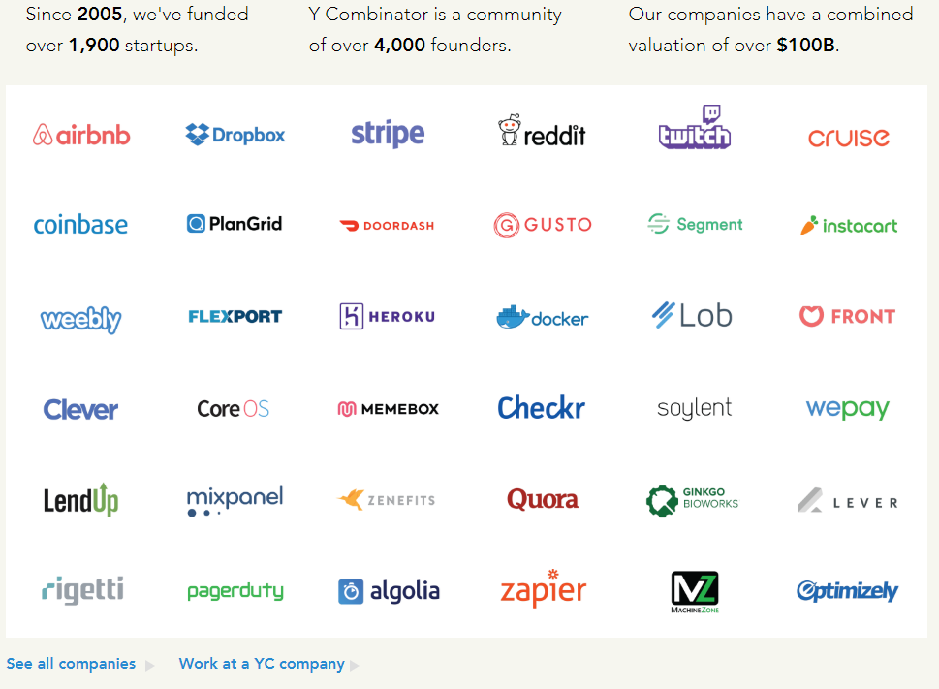
4

Slide 42
5
Ways to Fund Option 5
5. Fund Yourself (Bootstrapping is Covered in Module 4)

Slide 43
6
Government Supported Business Grants
Success in Writing a Grant Application - top tips
What are the real and positive differences the funding will make?
Remember – ‘People Give To People…’
Be creative, challenging and engaging about your idea, this is your opportunity to distinguish yourself from others.
Build your credibility and be professional!
One of the primary reasons why applications get funded is that the funders are convinced that the applicant organisation is well organised, has a good track record and is a capable promoter to carry out the proposed project. As we have outlined earlier in this course, be honest about your past experience showing what you have learnt from same.
Approach the application with a high degree of professionalism

Slide 44
6
Writing a Grant Application
– before you start
Put your best foot forward remember it is competitive
Make it interesting write in an interesting way that captures the energy & spirit of your project (journalist style)
Back it up with facts the power of evidence of need. It is not sufficient to say: “we know ..we think.” back it up with your proof of concept research
Stand out and be unique show that your project is additional – not competing with others
Seek assistance definitely talk to the funding agency before you apply
Describe your project truthfully and succinctly don’t assume that the funder will have any knowledge of your business, background or new project
Break down the requirements of the application into bite-sized pieces

Slide 45
6
Writing a Grant Application
– before you start
Presentation think carefully about presentation; most funders will read many applications and if an application is easy to read and well presented it makes their lives easier.
It takes a lot of time, energy and effort it takes a lot longer to put an application for funds together than you think !
Before you send your Application
Ask yourself, ‘Why wouldn’t they fund this?
Often a good way to strengthen your funding application is to try and ‘pick holes’ in it. Having identified the weaknesses you can then work on putting them right.

Slide 46
6
Writing a Grant Application
– before you start
Proofread, Proofread, Proof ready
The most important part of any application is READING THE GUIDELINES, following them to the letter, and ensuring that you do actually meet the criteria for the grant – some grant makers receive up to 30% of applications that do not meet the eligibility criteria

Slide 47
Are You Ready to Apply for a Grant Exercise: Answer These Questions
6
Questions | Questions
Who are you? Yes – proceed to next question No – do some more thinking What do you want to do? Yes – proceed to next question No – do some more thinking Why do you want to do it? Yes – proceed to next question No – do some more thinking What do you expect to achieve? Yes – proceed to next question No – do some more thinking | How much will it cost? Yes – proceed to next question No – do some more thinking How much do you want from whom? Yes – proceed to next question No – do some more thinking How much (and what) will you contribute yourself? Yes – proceed to next question No – do some more thinking How long will it take and when will you need to start? Yes – APPLY No – do some more thinking

Slide 48
Overcoming a ‘No’ when Seeking Funding
If the recipe isn’t right, and you don’t get the Grant, Crowd Fund or place on an Accelerator - be sure to use these rejections as a learning experience! Encountering a no can be disheartening. But don’t let it get the better of you. Consider these steps to increase your chances of being reconsidered, improve your potential for obtaining financing in the future and in general relieve the stress of securing funding
Reflect on your approach be honest with yourself. Did you rush the application? Did you really think you met the priorities or did you not do yourself justice in writing about your project?
Ask for feedback even if your rejection letter specifies a reason for your rejection, asking for verbal feedback will sometimes bring you a fuller and more open response.

Slide 49
Overcoming a ‘No’ when Seeking Funding
Act professionally even though disheartened, keep your behaviour and actions as professional as possible. If you thank the possible supporter politely for his/her time, and follow up in a few weeks when you’ve gathered more information or adjusted your business model, you may have a much better chance of getting that funding.
Find out what did get funded funders often publish lists of what they did fund
What do you notice about the projects that got funded? Were the businesses at a different stage to you? Were you asking for much more (or less) money than they received? Were you applying for activities that this funder hasn’t supported?

Slide 50
Overcoming a ‘No’ when Seeking Funding
Contemplate Your Options There’s no right or wrong way to pursue funding. If one channel seems to be generating more obstacles than opportunities for progress, it might be time to change up your strategy. Increasing your chances of getting a yes could be a simple matter of choosing the right channel (or group of channels) to use to cultivate funding.
Look At Your Business Model Use the rejection as a learning opportunity. Take a look at your business model for any major flaws or weaknesses. Fixing these gaps will make your overall business idea more attractive to other potential investors, and could be enough to change your initial rejecters’ minds

Slide 51
Overcoming a ‘No’ when Seeking Funding
Learn and Improve your Pitch . Your pitch needs to be strong in order to capture the attention of your potential investors. Over the course of a minute, or a couple of sentences, you should be able to explain your business concept and exactly why it’s a valuable investment opportunity for your intended prospect. If you can’t do that, your pitch needs refinement.

Slide 52
7
Crowd Funding
Crowdfunding is the financing of a new project by raising many small amounts of money from a large number of people. Thousands of businesses across Europe have raised funding through crowdfunding platforms. It is used not only to raise money online for a business idea or project but simultaneously build up a community and improve visibility.
It generates traction, social proof, and validation.
It’s an opportunity for crowdsourced brainstorming to refine your idea.
It gains you early adopters and loyal advocates.
It doubles as marketing and media exposure.

Slide 53
7
Crowd Funding – is it right for your business ?
Crowdfunding suits certain types of businesses – usually Start-ups or early stage companies that are looking for relatively small amounts of money. It has a higher success rate within certain sectors like the digital media and certain types of consumer goods businesses e.g. health.
Your first step is to research a good fit crowdfunding platform with track record of success that has delivered for similar businesses to yours.
Most popular crowdfunding websites

Slide 54
7
Crowd Funding – is it right for your business ?
Crowdfunding suits particular types of entrepreneurs, those with good marketing skills and who are active on social media. If marketing isn’t your skillset, or if you’re unfamiliar with social media, then crowdfunding might be a challenge. A crowdfunding campaign is not for a social media novice.
Excellent video pitches are essential to successful crowdfunding campaigns. Pitching your product or service to a mobile camera (most likely) requires preparation and perseverance. Do your research, by viewing other video pitches. Write a compelling script that communicates the selling points simply and clearly. Deliver it with passion. Reshoot it until it’s right.
Think Business - Crowdfunding Ireland Guide

Slide 55
7
Crowd Funding Models
Crowd funding models to consider are…
Pre-selling - when people donate towards the creation of a specific product,
Peer-to-Peer lending - borrowing from a number of lenders via an online platform, each lender lending a (small) amount in return for financial compensation
Equity lending - when people lend money to individuals or organisations in exchange for company shares
Different platforms facilitate different fundraising models. Finding the right funding model for your project is an important step for a successful campaign.

Slide 56
7
Crowd Funding – Pros and Cons
Advantages: Access to capital without equity stakes or rigid bureaucracy.
Disadvantages: A lot of projects never get off the ground which can be frustrating given the amount of time you can spend setting up the campaign. Back to the need for great marketing and social media prowess.
Most crowdfunding platforms have an “All or nothing” model meaning that if the funding goal of the campaign is not reached, all the contributions are returned back to the backers.

Slide 57
7
Crowd Funding – Platform Costs
Different platforms apply different charges depending on the model you chose – carefully check for …
Platform Hosting fee: Some platforms, although not all, charge an initial cost just for hosting your campaign. This cost varies from €0-300 and will be charged to all projects, be that successfully fundraised or not. Ask platforms what fee applies to them before starting the campaign.
Success fee: The majority of crowdfunding platforms will take a percentage of the total amount raised. The percentage varies from platform to platform and ranges between 3% and 12% of total raised.
Payment processing fees: Look out also for a service fee for every transaction made. Usually this fee is on average 3%. For instance, for every €100 donation/investment, only €97 reaches the campaign.

Slide 58
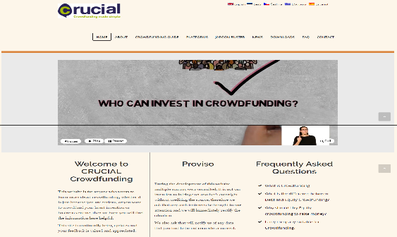
7
Crowd Funding – Exercise
Download and Review Crucial Crowdfunding resources
CRUCIAL Crowdfunding is an ERASMUS+ supported project, designed to inform all the different stakeholders who can potentially benefit from this innovative means of funding business ventures.
CRUCIAL Crowdfunding Project
Crucial Crowd Funding Resources

Slide 59
Why 99% of Businesses will Never be funded?
What Not To Do | What You Need to Do
Incomplete Not answering the fundamental questions that unveil the whole picture of your business start up. Not enough information leaves the investor with a multitude of questions and a bad impression. No or not enough research Product and market have not been researched or tested thoroughly Unrealistic and exaggerated figures and projections that don't take into account the evolving world or market place May look the part but isn’t Just because you have an PHD doesn’t mean you will succeed. Or just because it looks the part doesn’t mean it is. The devil is in the detail! | Show you can run a business They want to know what you have done, but more so how much you know the sector. They want to know you can run a business- go back to our entrepreneur personality tests in Module 2. Know your field inside out: from the supply chain and licensing laws, to the health and safety procedures entailed. Do your research thoroughly. It helps if you have worked and experienced the subject field of your stat up Adaptable & Anticipate Very few businesses stick to the original plan as they grow after funding. Show you are adaptable and can anticipate what the market will do and why. Must have tested the product and the market properly As we said, don't buy an off the shelf business plan and try to make it work. It never does.

Slide 60
Case Study: My New Startup
Poland
Title: Funding from Foreign Investors
Description: Videos describe the process of acquiring founding, from different resources, for example foreign investors.
Video 1: https://www.youtube.com/watch?v=LAmlmmIHEeo
Video 2: https://www.youtube.com/watch?v=GGu9eNnjtec
Video 3: https://www.youtube.com/watch?v=EDlysR81gz4
Video 4: https://www.youtube.com/watch?v=YjEI3b5_104
Video 5: https://www.youtube.com/watch?v=EDlysR81gz4

Slide 61
Case Study: EGE University EBILTEM-TTO May be Able to Help you Attain TUBITAK Entrepreneur Supports
TURKEY

Slide 62
Case Study: TUBİTAK Supports Implementing Bodies Other Than EBILTEM-TTO
TURKEY

Slide 63
Section 3
Nail Your Investor Pitch

Slide 64
Become Pitch Perfect !
A pitch, or business pitch, is the short presentation start-up founders make for investors, potential customers, competition jury, business partners, and many more!
This section will help you understand the pitch is not just words on a set of slides. You’ll understand the important ingredients you pitch must encompass to eventually create fantastic perfect pitch. Ingredients not limited to include;
relevant and realistic information, visuals, and an overall passionate energy to woo your audience!
It is very important you are able to explain what your start-up does in a clear and efficient way, so that the people you are talking will be interested in your idea and motivated to take action.

Slide 65
Become Pitch Perfect !
We introduce you to tools that will help you prepare your exciting 3-minute max pitch! Get ready to tell your compelling story about the need you have identified, how your product is that solution, and why your company will succeed. Key areas you will need to cover; evidence, telling your story, demonstrating community support and matching it up with your business priorities.
It should be as short as possible with the most important information in no more than 10-15 slides or by the time you have finished they will have forgotten your pitch
Create well designed slides. Your presentation is often the first time that potential investors (and even competitors) will hear about your start-up idea.
Never read off your slides as the audience has probably already scanned over it and they don’t want to hear something they’ve already read.
Source: Irish Investment Network

Slide 66
Become Pitch Perfect !
Don’t bore people with useless charts and stats unless they're absolutely necessary. Find a more creative way to present the relevant information.
Choose your strongest presenter, regardless of their position. Entrust your idea with the strongest and most charismatic member of the team.
Use high quality pictures to help to tell your story. People usually only retain 10% of the information that they’re told verbally, but add a few photographs and that number rises to 65%
Source: Irish Investment Network

Slide 67
Become Pitch Perfect !
Investors care about two things: potential returns and how quickly they’ll get them. Tell them how you’re going to make that happen – with credible data to back up your promises. Some investors may even expect to see a detailed exit strategy included. Structure your presentation carefully Don’t try to reinvent the wheel — the classic framework is still the best:
Present the market need, opportunity and differentiator – all backed by external market sources
Dive into product specifics, go-to-market roadmaps and sales strategies
Provide some background on the leadership team
Show financials, the multi-year outlook and exit strategies Using this logical structure provides investors with just the right amount of information at the right time.

Slide 68
How to Deliver the Perfect Business Pitch – 8 Shark Tank Inspired Tips
A great business pitch is among the first of many hurdles an entrepreneur must jump to get their company off the ground. Your business pitch can make a potentially life-changing impact on you and your business.
A great pitch can bring valuable partnerships that come with even more valuable financial incentives. Business pitches take place in a wide variety of settings, from elevators, to offices, to cocktail parties.
Entrepreneurs have a short amount of time to tell their stories, sell their products, answer questions, and overall make an impact that they hope will lead to a major investment opportunity.
Source:
Full Article

Slide 69
13 Tips on How to Deliver a Pitch Investors Simply Can't Turn Down
Take only 3 minutes
Turn your pitch into a story
Be laser focused
Explain exactly what your product or service is
Explain exactly what is unique about your product or service
Explain exactly who your target audience is
Explain exactly how you intend to acquire these customers
Explain your revenue model
Be wildly enthusiastic with focused confident clarity
Dress to kill
Practice your pitch
Anticipate questions, and answer each possible one ahead of time
Show them the exit strategy
Source:
Full Article

Slide 70
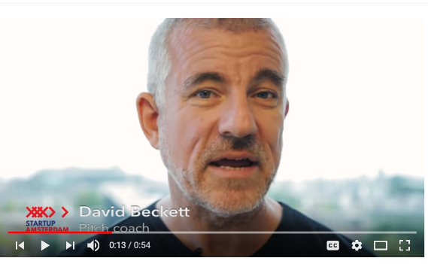
Craft your Perfect Pitch
Watch Pitch Coach David Beckett give you tips and tricks on how to make a great pitch. Do the exercises he prescribes to help you get your pitch perfect when you meet investors
Pitch tricks #1 How to Prepare
Pitch tricks #2 Communicating with your audience
Pitch tricks #3 Open your Pitch Like a Pro - David Beckett
Pitch tricks #4 How to Structure your pitch
Pitch tricks #5 How to End With A Bang
Pitch tricks #6 How to Manage Your Nerves
Pitch tricks #7 How to Stand out
Pitch tricks #8 The Importance of Time :
VISIT www.best3minutes.com for David's work and more on pitching
Source: Full Article

Slide 71
Craft your Perfect Pitch
A pitch deck is a brief presentation, often created using PowerPoint or other presentation tools, used to provide your audience with a quick overview of your business plan. It consists of succinct ideas and great visuals to support the pitch you’re delivering to your audience!
In The Complete Guide to a Pitch Presentation, you will discover information, tips and tricks, and examples to deliver the perfect pitch! You can go here to learn more about a 3-minute pitch.
Speaking of design, entrepreneur Daniel Eckler shares a great example of how you can design your pitch deck. He walks the reader through the philosophy behind the design of his startup’s pitch deck, with explanations based on his experience, slide by slide.
VISIT www.best3minutes.com for David's work and more on pitching
Source:
Full Article

Slide 72
Craft your Perfect Pitch - Exercises
Check out this ultimate cheat sheet for your startup’s pitch deck, providing you with ideas for your slides.
You will also get ideas and instructions to design a great pitch deck in this Pitch-deck introductory lesson!
Source:
Full Article

Slide 73
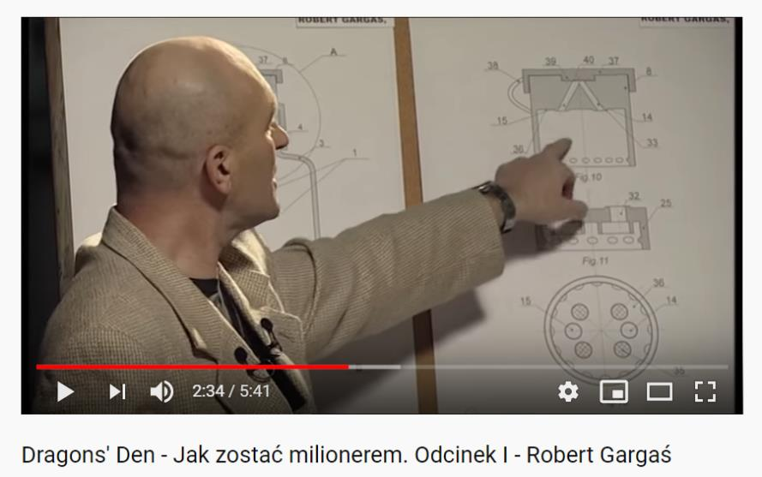
Case Study: Dragons Den Pitch Perfect
Polish version of Dragons Den reality show. The participants of the show, demonstrate their ideas for Business and five investors decide if support the financially or not
Poland

Slide 74
What I Have Learned?
My business plan and addressing the all sections is vital. I must have a table of contents, good summary and appendix and not assume that the investor will read all of my Business Plan. It is important that it is easy for them to read and find the information that they need.
There are many different types of funding available it is important to be aware of the different types and to make sure I select the one that best suits my business and business needs. If in doubt go to my mentor or local enterprise office.
It is not essential that I go for external funding support through an investor, angel or private individual. The right funding for my business may be available through grant funding. However I must be aware that investors and angels can bring valuable experience and input.
Having a good investor pitch is important not only for potential investors but anybody who wants to hear about my business. I must be able to explain my business clearly in approximately 3 minutes without notice.

Slide 75
Case Study: Polish Advisory Office
Title: Writing a Business Plan and Project Proposal
Description: MW&Partners are engaged in writing business plans and project proposal. MW&Partners is a Polish business advisory office.
Poland

Slide 76
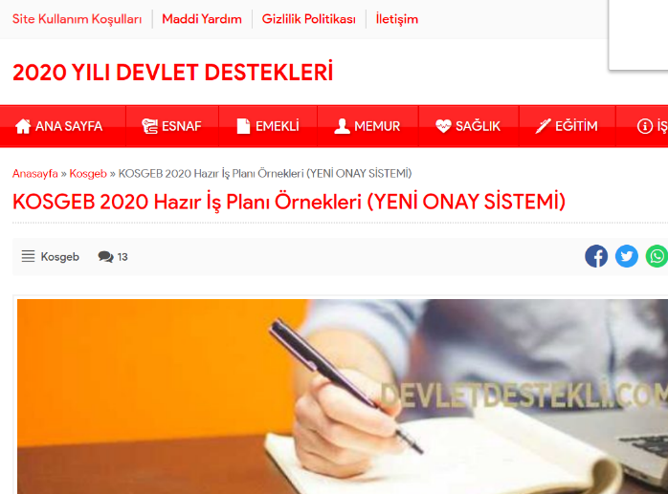
Business Plans: Samples
TURKEY

Slide 77
Thank You
Any Questions?
@EMERGEPROJECTEU
https://www.facebook.com/EMERGEPROJECTEU/?ref=br_rs
http://www.emergeengineers.eu/project-partners/
http://www.emergeengineers.eu/
#EMERGE #femaleengineers #Erasmus+
#femaleentrepreneurs

