Slide 1
MODULE 7
Get External Support

Slide 2
Module 7
You Need External Support
External supports can guide you in areas you/your team may be weak. In this section, we look at the benefits of mentoring, incubators/accelerators to you and your business.
This module will guide you on the different external supports that exist from services, mentors, advisors, panels, funding, digital tools. You will learn why and when you should engage in external supports.
You will know what is out there for women startup entrepreneurs in the engineering sector (and STEM.)
Finding the Right External Support for Your Startup Information and links to some key Entrepreneurship and Engineering external supports in Ireland, UK, Poland and Turkey
Digital Tools for your Start Up
12 Digital tools that can help automate and simplify some of your new business tasks and even improve operations.

Slide 3
SECTION 1:
You Need External Support
Succesfully starting a business requires a wide knowledge base across a multitude of areas – finance, product development, marketing, HR, PR and much more. External supports can guide you in areas you/your team may be weak.

Slide 4
The Difference Between Internal and External Business Support
A startup is a temporary organisation in search of a repeatable, scalable business. Startups are taking risks to grow fast and corporations are built to execute and minimize risks.
It is widely acknowledged that the Start Up sector of business brings its own unique challenges and many business people find this a particularly exciting yet challenging time, external support is there to help you navigate this journey.

Slide 5
What You Need as a Startup! Your Shopping List!
It is Most Likely You Will Need External Support with some or all of these elements…
Marketing, advertising, public relations strategy (and later, execute)
Branding. Name, logo, tagline, and look-and-feel
Design. Website, web / promotional copy, artwork, social media presence, business collateral (cards, stationery, signage, etc)
Legal. Corporate setup, permits, registrations
Accounting and bookkeeping system, find accountants and bookkeeper Banking relationship, merchant accounts, payments
Product. Evaluate and refine product / service design, user experience
Development. Setup methodology, iterations, road map, tools
Market. Competitive analysis, market size, monetization options Proforma financials: create projections
Business plan. Budget, executive summary, pitch materials, product video
Fundraising, finance

Slide 6
What You Need as a Startup! Your Shopping List!
It is Most Likely You Will Need External Support with some or all of these elements…
Operations manual, systems, setup
Growth. Develop sales team, business development, customer service, maintenance / support / repair, manufacturing / development, contract management, collections, vendors
Leasehold: physical setup, interior design, buildout, improvements
Facilities management. Supplies, furniture, utilities, equipment
Launch / roll-out and expansion plans
Teambuilding. Initial executive, board and and officers, develop corporate culture
HR. Recruiting strategy, hr, payroll, benefits setup
Office lease, facilities
Localization. Setup operations in appropriate locale; moving, visa and relocation issues
IT: computers, telecommunications, office automation, security, storage, records

Slide 7
How can External Supports assist you?
External Business Support Organisations can support you on your start up journey in a number of ways. It can be in form of money, network access or perks like credits to use development & marketing tools. Here are just a few:
Connect you to Service Providers; local business support organisations and networks can connect you with the right state/country service provider for your stage of business growth and or business sector
Training and Educational Seminars; they can help you with further entrepreneurship training, much of which is often subsidised. Training can cover all the key topics of interest and are a good way to keep your knowledge base up to date e.g. HR, Mediation, Export, Taxation and Leadership
Funding and Business Start Grants; many business support organisation and enterprise offices/centres offer financial supports and low cost office spaces/hot desks which might just be enough to help you get your business off the ground

Slide 8
How can External Supports assist you?
Business Sustainability Programmes – these are often run in partnership with a number of supportive enterprise bodies and organisations. They usually offer Start Ups and SMEs opportunity to have a meeting on issues of concern or interest regarding their business development. E.g South Dublin Chamber
Chamber of Commerce Network; these local/regional business network initiatives usually host multiple meetings throughout the year, some weekly, or biweekly. Designed to create a supportive business environments they often include engineering factions. E.g County Tipperary Chamber of Commerce Engineering Section

Slide 9
How can External Supports assist you?
Business support services refer to those business activities that act as auxiliaries to trade and facilitate smooth flow of goods from producer to consumer and the functioning of business as such.
These include banking, insurance, transportation, warehousing and communication.
Banking helps in providing finance and payment facilities, insurance to provide a cover to all sorts of business risks
Transportation to facilitate physical movement of goods from one place to another, warehousing to provide storage facilities at various places to meet seasonal variations in demand
Communication for facilitating exchange of information and ideas between producers, middlemen and consumers.

Slide 10
External Start Up Supports:
SPOTLIGHT ON MENTORING
Mentoring is designed to match up the knowledge, skills, insights and entrepreneurial capability of experienced business practitioners with small business owner/ managers who need practical and strategic advice and guidance. The mentor contributes independent, informed observation and advice to aid decision making

Slide 11
External Start Up Supports:
SPOTLIGHT ON MENTORING
The right business mentor can have a profound and fundamental impact on your enterprise, particularly for those at the early stages of an enterprise and aiming to have high rates of growth.
You should find mentor(s) as early as possible, preferably who have prior experience of engineering entrepreneurship. Once you have found the right mentor, there are 5 ways to make the most of business mentoring.
https://medium.com/@pardeepg/building-startup-role-of-mentors-and-external-support-9293f22941f2

Slide 12
Mentorship can Help you get through the Chaos!
Quicks Reminder: The Role & Involvement of a Mentor
The Role of Mentor
Listen and understand your business
Advise and provide direction
Help the promoter identify problems and suggest areas for improvement
Discuss solutions and innovative ways of improving business activity
Help with the decision making process
Share experience and knowledge
Provide structure and context for discussion
Offer assistance in compiling a business plan
The Areas of Involvement
Business Strategy
Financial Planning
Market Research
Marketing & Promotion
Production Planning
Distribution
Corporate Organisation
Website Planning & Design

Slide 13
Still in a Maze of Decisions?
Mentorship means something different to nearly everyone you ask. At its core, however, it is a unique type of bond based on growth, shared knowledge, compassion, and -often- raw and real honesty.
When somebody takes an initiative of startup, then they have already prepared for HR activities, financial aid, marketing strategy and all such essential factors. But one of the major factor that nobody includes in their execution process is “consulting”. Consulting with the right startup can be the most fruitful thing for making a startup successful.

Slide 14
Mentorship at the right time could make your business…
“
I think mentorship is everything. It is the fundamental foundation of everything. My mentor told me -bluntly- that my desire to control everything was holding the project down, and that if I continued down that path it was 100% certain that I would fail. I made radical changes to my mindset, approach, and behaviour. I started to let people in, sharing aspects of GoHero that were better handled by those with the right skills. The effect was evident almost immediately. Pieces started falling into place, and the new energy brought in the right people at the right time.
DR. ERIKA EBBEL ANGLE CEO at Ixcela, Inc
”
Full article The Best Advice for Women in Startups and STEM

Slide 15
Mentorship can Help you get through the Chaos!
Interview with Dr Erika Ebbel Angle
She advises women to go out and find people who are more talented than you are to help in areas that you don’t have a strong skill set. In her experience, and I agree, as long you are motivated and willing to work hard, skills can be taught.
All throughout her life, Dr. Angle has surrounded herself with people who have been willing to mentor her. Their advice, guidance, and openly candid feedback was vital as she worked to build her companies.

Slide 16
Key Benefits of External Support & Mentoring
Help you connect your start up business to suppliers, distributors and specialist services such as legal and accounting
Can cover all sections of business including: sales opportunities, networking and business advice and assistance
TIP: Join a business community TODAY!
Connect with other Start Up businesses and the specialist support agencies that are there to support your business
Feedback on product, marketing, growth strategies, anything related to entrepreneurial journey

Slide 17
Key Benefits of External Support & Mentoring
Experience & Connections: Mentor(s) bring with them their experience, their insights, their connections. Its not just about the mentors but about a network of like-minded founders which adds even further value. This brings with itself access to a wide plethora of people like angel investors, VCs, influential people in industry.
Unique perspective; Many were startups who succeeded and struggled gives them a unique perspective and their advice is fundamentally different.
The emotional support that one gets from Mentors massively outweighs all other perks

Slide 18
Why Engage in External Support and a Mentor?
Startups Paint the Picture Without Mentorship
‘There were times when the going was tough and I didn’t really know what to do. At those moments, there was this yearning to be able to talk to someone who would understand’.
‘There were decisions and situations that were inexplicably hard to fathom. I could only wish that someone could guide me about the choices I had’.
‘There were instances where I had gone long periods without speaking to anyone about the struggles, the successes, the pains and the gains. These often left me quite emotionally empty and added to the efforts of entrepreneurship’.

Slide 19
External Start Up Supports:
Making the most of business mentoring
Understand why you need or want this mentor. Usually, the mentor is someone whose knowledge and/or experience exceeds your own to such an extent that their input can have a substantive positive impact on your business´ performance and your ability to run it.
Know where the issues lie. Although the mentor should be able to indicate some of the areas that you might want to focus on, you are in the best position to understand your business and the goals that you want to achieve. The mentor is there to help guide you toward these goals

Slide 20
External Start Up Supports:
Making the most of business mentoring
Have the right attitude. You need to enter this relationship with the right mindset and attitude. See your mentor as someone who is trying to help you carry your business forward, and has valuable advice to give you.
Know how your mentor can add value. A mentor cannot be “ all things to all people” and to make the most of their input, you need to understand where their expertise lie and find ways that these are applicable to growing your business.

Slide 21
External Start Up Supports:
Making the most of business mentoring
Find the time. It’s easy to get caught up in the day to day challenges of running your own business and putting bigger challenges on the back burner. The mentor is there to help you to develop and achieve your longer term goals. You should put everything out there and explore creatively with your mentor.

Slide 22
Let’s take a look at some mentoring feedback…
Entrepreneur STATEMENT: “We need to get some things organized first.”
FEEDBACK: Although it may be accurate that the business requires more organization, one of the most popular forms of procrastination is organizing or cleaning.
It is a popular form of distraction from the task at hand because the procrastinator still has the benefit of feeling productive while they avoid the larger task at hand.
Procrastination and distraction from your objectives still keeps you from achieving the business goals.

Slide 23
Let’s take a look at some mentoring feedback…
Entrepreneur STATEMENT: “It’s a really busy time for us right now; we should wait until things are quieter.”
FEEDBACK: It is likely that the ongoing busyness you are experiencing is more about your team being over-capacity due to either a) inefficient systems; b) growth; c) inconsistent revenue cycles or d) limited training and tools for team members.
The resolution to this kind of busy time is not to wait it out because the risk of waiting is actually a decline in business and a marred reputation due to lessening service quality.

Slide 24
Let’s take a look at some mentoring feedback…
Entrepreneur STATEMENT: “We want to get through this transition before we get started.”
FEEDBACK: A healthy business is always in some sort of transition. The questions business leaders should be gaining support in answering are a) is this the right transition? b) are we optimizing this transition? c) what comes next and how can we proactively start to prepare?
In the midst of all these questions being answered, wouldn’t it be great to be supported in making this transition happen smoothly?!

Slide 25
External Start Up Supports:
Spotlight on Incubators and Accelerators
An Incubator typically offers shared office spaces, networking and mentoring opportunities. Co-working is often a part of the incubator experience, though some offer private office spaces. Incubators cater to new companies specifically, nurturing the growth of a new business as the name suggests
Meanwhile Accelerator Programmes are geared towards existing businesses that have the potential to grow. Different from incubators, accelerators offer mentorship and typically also provide seed capital in exchange for a share of the business.
Let’s look at the advantages of a typical accelerator …..

Slide 26
Join an Accelerator to Advance & Innovate your Start-up
Comprehensive Support: Operating a start-up can be lonely and challenging. That’s where an accelerator can help. You get support from mentors and those sponsoring you. Besides emotional support, they provide direction, experience and knowledge. Plus, you have the support of other founders in the accelerator program with you.
A Full Roster of Activities: The few months of an accelerator program are jam-packed with activities that benefit your start-up: meetings with mentors, feedback sessions, “demo day” presentations, and networking. There is a lot of information and even more to apply directly to your start-up.

Slide 27
Join an Accelerator to Advance & Innovate your Start-up
Investor Access: Accelerators don’t tend to give much in funding, what they do is connect you directly to interested investors who are drawn to accelerators in the hopes of discovering the next big thing. On “demo days,” many investors are invited to watch the presentations, then you get to meet and mingle with them. They can offer additional funding offers, especially when they see that the accelerator program has helped you further develop your start-up and shows the potential for return.

Slide 28
Join an Accelerator to Advance & Innovate your Start-up
Accelerated Knowledge: An accelerator program packs in so much information from the years of experience and skills that each mentor or accelerator manager has amassed. This concentrated information allows you to speed up what you are doing with your start-up. Instead of reinventing the wheel, you are leveraging their years of accumulated wisdom to launch your start-up in a more calculated, strategic way. Clearly, this can improve your chances of success.

Slide 29
Join an Accelerator to Advance & Innovate your Start-up
Gateway to Future Customers: Accelerators include target audiences at demo days so they can hear what you are doing. This can create an early buzz and provide advanced publicity can also help you notify them of your launch. The prospects you interact with can form the start of an important database of leads, as well as give you a head start on brand development and recognition.
Skills Development: Accelerators focus on teaching you the skills that are essential for running a business, including sales and marketing, communications, finance and even some technical skills. You can work with other founders who are in the same program cohort, providing a great testing ground for disseminating your skills later on to your own team

Slide 30
Join an Accelerator to Advance & Innovate your Start-up
Risk Management: The risk of failure is on the mind of every start-up founder. It can feel as though the cards are stacked against you. This includes the market you are entering, the product you are offering and the concept that you are selling. An accelerator can identify the risks within your concept and help you work on minimizing them. It can provide you with direction in proactively taking on risk and managing it effectively.

Slide 31
Join an Accelerator to Advance & Innovate your Start-up
8. A Bigger Picture, Long-term View: As a founder, especially a first-timer, it can seem impossible to look beyond the first six months to a year. It is vital to work toward a much longer view and outcome. Mentors in accelerator programs can help you see the complexity that will develop in time and steer you in the right direction to deal with it. They can ask the questions that get you thinking of the bigger picture and what it should look like, then can suggest the tools and tactics to get you there.

Slide 32
Join an Accelerator to Advance & Innovate your Start-up
Springboard: An accelerator can work for start-ups in all phases of their growth. Even those that are much closer to becoming an actual business should consider one. You may have encountered a problem or reached a growth plateau. An accelerator can be that propeller to the next level that you couldn’t figure out how to get to on your own. This might include using the accelerator and the expertise within it to launch a more diversified offering or expand into a new market.
An Accelerator for Everyone: The growth in accelerator programmes means that there is one that most likely addresses your growth stage, location, industry or niche, desired level of oversight and involvement, planned outcome or any other factors that are critical to what you want to accomplish. The result is an encouraging environment that will help you thrive.

Slide 33
Join an Accelerator to Advance & Innovate your Start-up
Motivation and Morale: The collective and collaborative environment found in accelerators is sure to keep you going and moving forward. Interaction with other founders is a powerful motivating force. When you hear about their own self-doubts and challenges, it resonates with you. Plus, it reminds all of you that it is possible to overcome those doubts and work together to clear your respective hurdles.
Continued support long after the program ends: Just because the accelerator program ends in a few months doesn’t mean the support does. Long-time relationships develop at accelerators. Plus, the alumni network is always there to tap into, inquire about talent, seek investors, or get feedback as you continue with your start-up or take on any other projects in the future.

Slide 34
SECTION 2:
Finding the Right External Support for your Startup
Spotlight on Entrepreneurship and Engineering external supports in Ireland, UK, Poland and Turkey

Slide 35
First You Need To Figure Out What Support You Need?
You may have a lot of the support you need already internally, especially if you have matched your business needs to the skills when interviewing or hiring your team.
The external support you need depends heavily on the skills and experience of you (the entrepreneur) and/or your team. The collective strengths and weaknesses of the team and the evolution of the startup will determine what that "I wish we had access to someone with expertise in X" is. In the early days it's likely to be someone with technical or market research or product development experience. It might then migrate to someone with sales experience. Then possibly to people management and then operations and then training etc...

Slide 36
Existing Supports for Female Entrepreneurs
Ireland
Enterprise Ireland
They may be able to provide you with the advice, specialist expertise and connections you need to drive your company’s growth. They do this by providing access to:
internal development advisers
external mentors, from the private sector in your country and overseas.
https://www.enterprise-ireland.com/en/Management/Access-Strategic-Advice-and-Expertise/

Slide 37
Existing Supports for Female Entrepreneurs
Ireland
Enterprise Ireland – Internal Development Advisers
They provide you can access expertise in areas as diverse as export sales, technology development, market research, raising private investment and human resources.
Primary function is: carry out an assessment of your business development needs and to ensure that you are aware of all supports and services for which you might qualify, and from which your business might benefit.
https://www.enterprise-ireland.com/en/Management/Access-Strategic-Advice-and-Expertise/

Slide 38
Existing Supports for Female Entrepreneurs
Ireland
Enterprise Ireland – Internal Development Advisers
Your Enterprise Ireland Adviser can co-ordinate access for you to teams of Enterprise Ireland staff members who have specialist expertise in a range of key strategic business development functions. Such as:
Market Advisers
Technology Development Advisers
Human Resource Development Advisers
Investment Advisers
Technology Licensing Specialists
Information/Market Research Specialists
https://www.enterprise-ireland.com/en/Management/Access-Strategic-Advice-and-Expertise/Specialist-Advisers.html

Slide 39
Existing Supports for Female Entrepreneurs
Ireland
Enterprise Ireland – External Mentors
They also have external mentors, advisers and specialists drawn from the private sector in Ireland and overseas. This extensive networks of experts in Ireland and overseas enable them to connect you to sources of strategic advice and sectoral knowledge that can support you in addressing business challenges, and developing and executing growth strategies.
They offer programmes and funding supports to allow client companies access much needed advice and expertise,

Slide 40
Existing Supports for Female Entrepreneurs
Ireland
Enterprise Ireland – Innovation Vouchers
The Innovation Voucher Initiative was developed to build links between small businesses and Ireland's higher education institutes.
Innovation Vouchers worth €5,000 are available to assist a company to explore a business opportunity or technical problem with a college or higher education institute.

Slide 41
Existing Supports for Female Entrepreneurs
Ireland
Enterprise Ireland - panel of Mentors can help you with a range of business activities such as:
Commercialisation of new products and services
More targeted sales and marketing
Expansion into new markets
Strategic business planning
Attracting outside investment and funding options
Improved R & D, design, innovation, production and logistics
Better HR management
Management succession

Slide 42
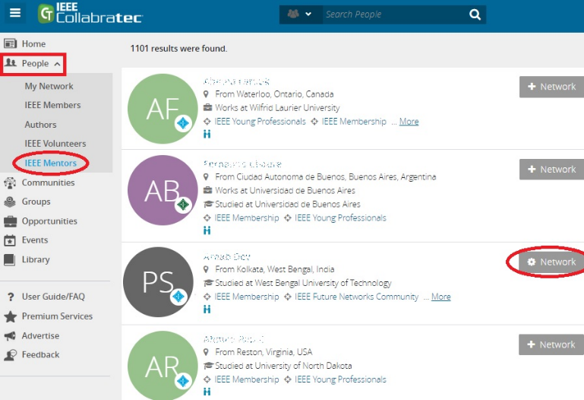
External Business Supports – IEEE GLOBAL Mentoring Programme
IEEE represents professionals of engineering, computing, and technology information around the globe. IEEE and its members inspire a global community to innovate for a better tomorrow through its more than 419,000 members in over 160 countries, and its highly cited publications, conferences, technology standards, and professional and educational activities.
IEEE Mentoring Program is a member benefit for professional and Graduate Student members of IEEE – FIND OUT MORE

Slide 43
External Business Supports – Professional Networks of your Peers
Besides offering connections to potential customers or investors, a strong peer network can become a boundless source of support, accountability, and fresh ideas to test out and build on- new projects, collaboration. A key skill is finding a balance between creative independence and qualities allowing mutually beneficial networking.
There are a range of creative /business support & Professional Development Networks that creative entrepreneurs can tap into through social media platforms, forums etc.. Research and make a list that is relevant to you.

Slide 44
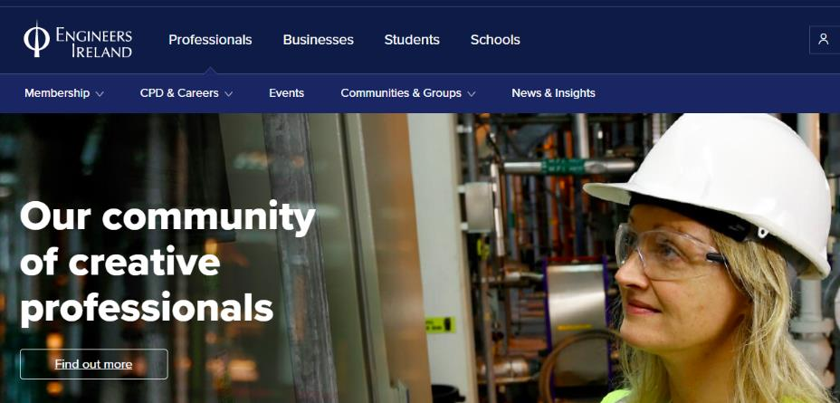
Professional Networks of your Peers: Engineers Ireland
Engineers Ireland – brings together engineers and engineering professionals in one of Ireland's biggest professional bodies.
Engineers Ireland offers an award-winning, expert strategic mentoring programme, designed for delivery of tangible results in your organisation.
This community of 25,000+ engineers are committed to creating solutions for society. From developing life-saving medical devices to building Ireland's infrastructure, their members solve problems through innovation and creativity.
https://www.engineersireland.ie/

Slide 45
Professional Networks of your Peers: Network Ireland
Network Ireland is the largest of its kind in Ireland, supporting the professional and personal development of women.
Membership is made up of a diverse group of women, from budding entrepreneurs, SME owners, professionals and leaders in indigenous and multinational organisations to non profits, charities, arts and the public sector.
Benefits of joining Network Ireland are vast and include access to their “Mentoring for Success” Programme.
http://www.networkireland.ie

Slide 46
Types of External Support:
Business Incubators and Accelerators
A business incubator is an organisation that helps new and startup companies to develop by providing services such as management training or office space.
Advantages: Access to considerable sums of money & relevant mentoring expertise. Disadvantages: Intensive mentoring can be a burden in some cases also many incubators will demand a considerable equity stake.
Business Accelerators are mostly focused on business growth/export. They offer expertise from the front lines of industry worldwide, with the relevant sales and marketing experience to advise and guide companies on accelerating their export growth.
Enterprise Ireland Internationalisation Grant provides funding of up to 50% to companies working with a Business Accelerator.

Slide 47
7
Example Accelerator, Ireland
ArcLabs Accelerator
The NDRC’s first ArcLabs accelerator in Waterford supported nine tech start-ups that each received up to €50,000 in supports.. The investment in each company included €30,000 in direct investment and a further €20,000 in business supports from backers
“World-leading companies are already emerging from the south-east and, with industries such as retail, property and recruitment primed for digital disruption, the potential for more growth is clear.”
“Mentorship is fundamental for these early-stage companies and a key pillar of the support system that allows start-ups to become valuable contributors to the regional and national economies,”
Enterprise Ireland CEO Julie Sinnamon.

Slide 48
7
Example Accelerator, Ireland
Example Start-ups through Arclabs Accelerator
1 Herdsy a disruptive agritech tracking company
2 Kraken Data with an ever-growing number of integrations and a powerful brain, Kraken Data enables e-commerce digital agencies to be effortlessly data-driven and keep clients happier for longer by delivering maximum results.
3 BluCoup a marketing platform that enables retailers to engage with consumers in real time as they shop. Its technology then tracks the consumer’s behaviour from offer engagement through to redemption. This allows the platform to deliver bespoke offers to the individual in the future.
4 TurnedSee a log-in only platform that enables hotels and venues to showcase their offering in a 360-degree format.

Slide 49
External Business Supports – Local Enterprise Offices IRELAND
Get in contact with your local enterprise development agency to help you develop your idea, test its feasibility and secure funding to bring it to a reality. In addition to providing grants, they are a powerful source of business advise, networks and business development programmes.
In Ireland, Local Enterprise Offices LEOs provide you with advice, information and support in starting up or growing your business, with 31 dedicated teams across the Local Authority network. Discover more about the available Business Supports or find your Local Enterprise Office.
http://www.businessregulation.ie/Supports-for-business/

Slide 50
Some other key supports from Local Enterprise Offices and Enterprise Ireland
Funding Competitive Startup Funds provides investment of €50,000 for female led businesses
Training Exxcel STEM Programme is tailor made, has one to one intensive mentoring, learning, networking
Mentoring Going for Growth is designed to support women who are serious about growing their business

Slide 51
Some other key supports from Local Enterprise Offices and Enterprise Ireland
Female High Fliers Program is an accelerator programme for female led startups specifically addressing challenges
NDRC Female Founders provides female business owners with the tools to figure out if your tech-based startup idea has the potential to be something big
More support initiatives for ambitious women to grow scalable businesses in Ireland here.

Slide 52
Accessing External Support – some useful links
Access Strategic Advice and Expertise
Learn skills to start and develop your business
Develop export selling capability
Leadership and Management Development

Slide 53
Existing Supports for Female Entrepreneurs
Northern Ireland UK
Loan Funds
Enterprise Northern Ireland Loan Fund http://www.eniloans.com/
Start Up Loans through ENI have an interest rate of 6% fixed (6.2%) APR. Individuals applying for a loan are required to satisfy a set of eligibility criteria before being selected – such as submitting a business plan to prove that the business has the means to pay the loan back. Businesses must be less than 24 months, be based in Northern Ireland and applicants must be over 18 years old.
Northern Ireland Small Business Loan fund http://www.nisblf.com

Slide 54
Existing Supports for Female Entrepreneurs
Northern Ireland UK
Women In Business: Yes You Can - £20K Pitching Competition
This Pitching Competition is part of a new 3-year Female Enterprise Programme, Yes You Can, which is a collaboration between the 11 Local Councils in Northern Ireland, Invest NI and Women in Business. Pitching guidelines https://www.womeninbusinessni.com/getattachment/4bd75ec5-472e-4b0b-80d8-693a9291b2fe/Pitching-Compettiton-Guidelines-2019.pdf.aspx?lang=en-GB
Invest NI Innovation Voucher
An Innovation Voucher provides funding to small and medium sized businesses to work with an expert Knowledge Provider from a University, College or other Public Sector Research Body bringing new knowledge to help businesses innovate, develop and grow.
https://www.investni.com/support-for-business/innovation-vouchers.html

Slide 55
Existing Supports for Female Entrepreneurs
Northern Ireland UK
Training
Exploring Enterprise Programme is a free programme which provides an insight into starting a business or allows you to take the first steps to gaining employment. https://www.enterpriseni.com/exploring-enterprise-eep
Grit & Grace
A 3-day leadership programme for ambitious and dynamic female leaders. Over the course of the programme you will have the opportunity to discover your own unique leadership style, network with your peers and build your confidence to succeed. This is a highly interactive programme – specifically designed to deliver immediate and sustainable impact. https://www.womeninbusinessni.com/Programmes/Grit-Grace.aspx

Slide 56
Existing Supports for Female Entrepreneurs
Northern Ireland UK
Training
Women in Business (WIB) Your Voice
A bespoke 2-day training course, helping participants develop excellent presentation and communication skills. Designed especially for Women in Business members, The course aims to develop exceptional presentation and communication skills and improve the performance of leaders, executives, business owners & managers through a combination of learning and practical application. The purpose is simple: to build knowledge, skills & confidence in order in order to influence & create impact through exceptional communication and presentation. https://www.womeninbusinessni.com/Programmes/Your-Voice.aspx

Slide 57
Existing Supports for Female Entrepreneurs
Northern Ireland UK
Mentoring
Women in Business (WIB) (Power of 4 programme)
Offers local women a chance to be part of a six month programme that provides training, mentoring, role model support and builds a peer network.
Women in Business (The Mentoring Programme)
The mentoring programme offers places on the programme four times per annum, matching 30 Mentors with 30 Mentees for a 12-month programme of mentoring support. As a result, we are continually recruiting experienced and accomplished women, who are willing to gift their knowledge and expertise to other women at an earlier stage in their careers.

Slide 58
Existing Supports for Female Entrepreneurs
Northern Ireland UK
Mentoring
Women in Business (The Mentoring Programme)
Induction sessions include:
How your values, goals and motivation contribute to your success as a mentee or mentor
Exploring how to maximise your time on the Mentoring Programme
Q & A session with WIB and Advance Coaching. Opportunity to network with mentees and mentors
https://www.womeninbusinessni.com/Programmes/The-Mentoring-Programme.aspx

Slide 59
Case Study: Women who Benefited from Coaching & Mentoring
Poland
Title: Women on Business Debate
Description: : Interviews with women who used the services of coaching and mentoring organizations in order to improve their business carrier. They agree that such a service is beneficial and help women understand different approaches to business. Moreover, it helps women to be more open for new possibilities.
Video 1 https://www.youtube.com/watch?v=2tWG46q9twU&t=490s
Video 1 https://www.youtube.com/watch?v=DYYyNrXBf3M

Slide 60
Case Study: Interview with Female Entrepreneurs who Invested in Additional Training
Poland
Title: Successful Polish Women in Business
Description: : Interview with women who run their own business. Most of them started to invest in trainings, as their education did not have nothing in common with their business. The video provides an information how find appropriate educational resources
Video 1 https://www.youtube.com/watch?v=M2XEvmAvgdg

Slide 61
Case Study: Polish Coach and Mentoring
Poland
Title: Polish coach and mentoring support organizations
Description: : Three organization which provide support future entrepreneurs, employers and employees. The links provide an information how coaching and mentoring work in Poland. The existence of such an organization indicates that couching and mentoring are popular services in Poland,
Video 1
Video 2
Video 3

Slide 62
Case Study: Entrepreneur Supports
TURKEY

Slide 63
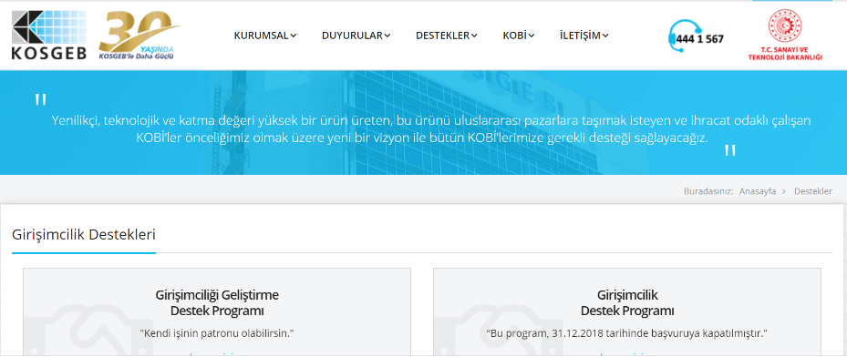
Case Study: Entrepreneur Supports
TURKEY

Slide 64
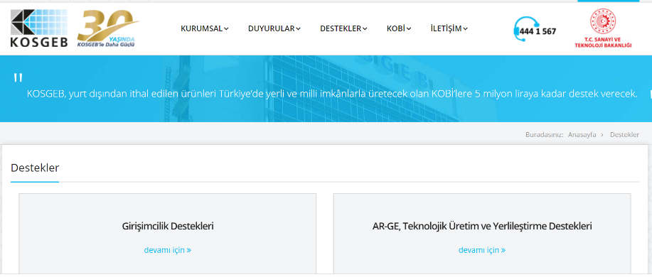
Case Study: Entrepreneur Supports
TURKEY

Slide 65
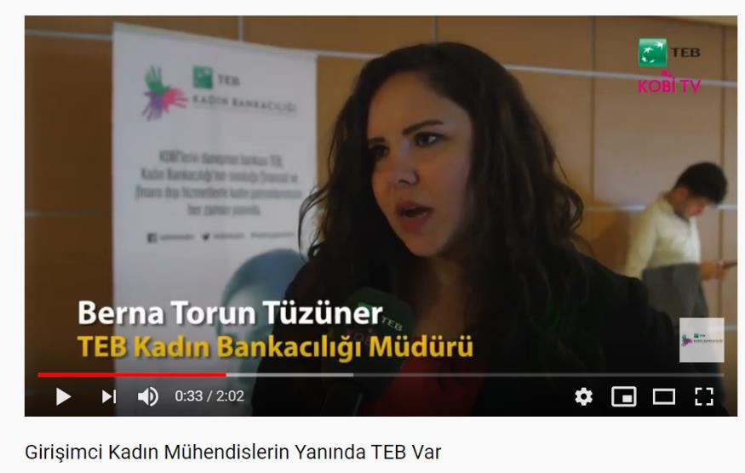
Case Study: A bank giving support for women engineers in İzmir
TURKEY

Slide 66
SECTION 3: DIGITAL TOOLS FOR YOUR STARTUP
Time and resources are often scarce in the early start up stages as you try to get your business off the ground. Digital tools can help automate and simplify some tasks and even improve operations.

Slide 67
Best Start Up Tools
Modern startups run on digital tools. From communicating with customers, collaborating internally or protecting their assets, entrepreneurs should know that there’s a digital platform or service for everything.
If you have a great business idea and you have the passion to achieve your goals, then these startup tools can do their bit to help you in accomplishing your goals. So, try them out when your startup is ready to move forward!

Slide 68
Best Start Up Tools
Facebook Fbstart which is designed to help early stage mobile companies. Fbstart provide bouquet of perks from Facebook and it’s partners like Parse, Adobe, SurveyMonkey, Proto, Appurify and Hootsuite. They also provide mentorship and access to worldwide mobile events but we have not utilized yet.
Check the program details at fbstart.com

Slide 69
Best Start Up Tools
Google Startup Launch have support program for startups, details are available at Startup Launch.
Google provide $100K worth credits which can be used for their cloud services. Apart from credits they provide training and support to build and launch application.

Slide 70
Best Start Up Tools
WhiteSource
This is one of the best startup tools that will take care of the security and compliance issues. It suggests the open-source components that would suit your needs as you search online. Moreover, it would also send you alerts in case it finds any software bugs, security risks, and policy problems. In fact, it is a highly versatile tool that works with any programming language.
https://hackernoon.com/10-best-startup-tools-for-2020-j21pa32z6

Slide 71
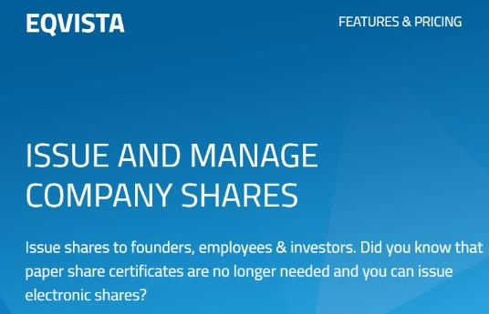
Best Start Up Tools
Eqvista
You will need to keep track of all the shares in your company. This is especially if you are about to take in investments and grow your company. For this, is a great cap table management application that allows companies to track, manage and make intelligent decisions related to the equity and ownership of the company. You can issue shares electronically, stay complaint with the equity laws, and manage all the shares in your company with Eqvista.

Slide 72
Best Start Up Tools
ContractZen
The first impression is everything. So, when an investor comes to evaluate your startup before they invest in it, you need to be prepared for the due diligence process. This means that you should have all your documentation in place. These documents usually include tax documents, financial statements go-to-market strategy decks, intellectual-property documents, and development plans.
The best way to store all these documents is by setting up a cloud-based virtual data room (VDR). ContractZen is one of the best startup tools for this. Setting this up is very easy where it can be done with just a few clicks.

Slide 73
Best Start Up Tools
ContractZen
With this, you will be able to eliminate the trouble of opening folders or bringing out papers. You just need to search for the document and you will get the one you are looking for immediately. ContractZen also incorporates additional features like the calendar app, email feature, and e-signature services.

Slide 74
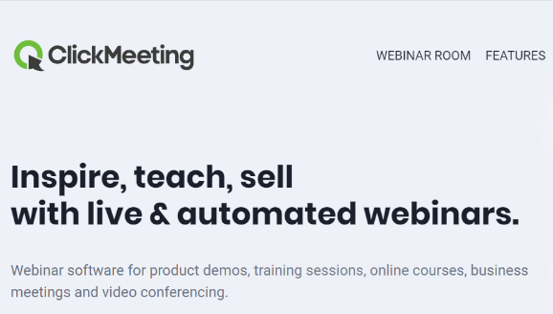
Best Start Up Tools
ClickMeeting
It is a webinar platform that can help you in building important partnerships without the need of leaving your office. You will need to begin by creating branded invitations for your sales presentation or online demo. And then get all the leads from your email list into this application to send the invites directly.
As soon as one of the lead accepts the invite, you can have a virtual face-to-face meeting with them to offer them a live demo of your product. Additional features include the use of whiteboard technology, screen sharing to display anything from your system.

Slide 75
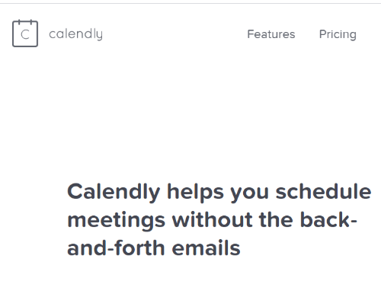
Best Start Up Tools
Calendly
How tiring is it to schedule a meeting with a client? Doesn’t it take you a ton of emails before you both have decided on the time for the meeting? With Calendly, the hassle of spending hours on deciding a meeting time is taken away. It takes care of all the process.
And once you have scheduled a meeting, all you need to do is share the link with the person allowing them to select the time that they are comfortable with for the meeting. In fact, it is a great time saving application that you can use.

Slide 76
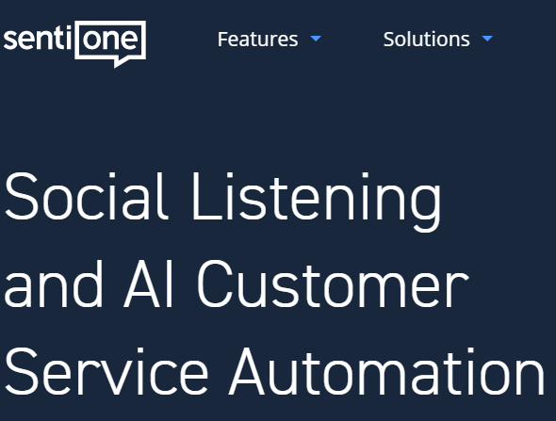
Best Start Up Tools
SentiOne
You need to successfully handle your brand and connect with your target audience. There are many different platforms and digital landscapes, it will take a lot of your time for monitoring all these things. SentiOne is a social listening platform. It allows you to tap in directly to what the world is saying about you and your industry on any of the social media platforms or important websites.
It will scan all the forums, blogs and news websites online. It would also help you in tracking your brand reach and the sentiment by buzz and word-of-mouth marketing.

Slide 77
Best Start Up Tools
WalkMe
Do your visitors find your website intuitive and easy to use? WalkMe makes everything easy for all the first time users of the website. It helps users navigate through the website without any trouble by offering them with intuitive visual elements for the navigation. This would in turn reduce the bounce rate and increase the conversion rates.

Slide 78
Best Start Up Tools
Freshteam
Freshteam helps you with the complete hiring process and condense it into a single dashboard. With this, a single manager can gain control and see all the candidates in one place. This tool would also help you source and filter the top talents to find the best candidate that is close to you easily.

Slide 79
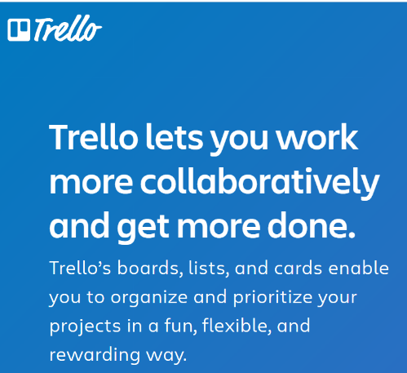
Best Start Up Tools
Trello
Each day, there might be many things that distract people from their goal. To overcome this, it is important to organize all the tasks and work towards a goal. With Trello you can easily create tasks and share it with your team to keep their goals in mind. You can create notes for each and every tiny little thing like the code components, marketing plans, or anything that your team needs to build for your business to roll freely. It helps in managing projects easily, assign tasks to the right people and get updates about it, allows you to create a CRM that is easy to use and that manages your contact information of all your leads.

Slide 80
Best Start Up Tools
Falcon
How do you grow a brand and how do you spread the name of your product? With marketing, right? Falcon is a great social media marketing application that helps your team grow the brand name easily and fast in the market. You can easily create posts, schedule them, edit them, and publish them on any social media platform easily. You can easily store all your content and manage it as well. Additional features include a single sign in to all the social media platforms, get notifications directly here and handle them, track the analytics and understand the audience better with this application.

Slide 81
What I Have Learned?
I know the difference between support services, mentors/advisors, funding supports and what they role is and how they can assist my startup. I can now choose the right support for me.
I realise that I can’t do everything and the quicker I engage the priority supports I need in the beginning it will get my business off to a healthier start instead of plunging my resources into areas of my business that will not progress its development
That I should engage with my Local Enterprise Organisation straight away and start on my Business Plan as a priority. It is important to get assessed to understand what my particular needs are. Business community support is important especially when learning from those who have learned the valuable mistakes and risks.

Slide 82
@EMERGEPROJECTEU
https://www.facebook.com/EMERGEPROJECTEU/?ref=br_rs
http://www.emergeengineers.eu/project-partners/
http://www.emergeengineers.eu/
#EMERGE #femaleengineers #Erasmus+
#femaleentrepreneurs

