Slide 1
MODULE 6
Marketing for Success

Slide 2
Module 6
What is marketing?
Learn what marketing is and the relationship it has to sales. Great marketing starts with your brand so we will look at branding in detail including your brand story
Without marketing many businesses wouldn't exist because marketing is ultimately what increases your customer base and drives sales.
In this module, you will learn some basic but essential marketing tactics and skills that will help get your business off the ground!
Marketing for Success
Developing your brand. In this section, we get top marketing tips for success from 12 Successful Female Entrepreneurs (from a range of sectors)
Reaching your Audience
The buying journey and touch points. How to get to your customers? Where your customers are? What Your Customers Want?

Slide 3
SECTION 1: What is Marketing?
Learn what marketing is and the relationship it has to sales. Great marketing starts with your brand so we will look at branding in detail

Slide 4
Relationship between Marketing and Sales
Many people wonder abut the difference between and sales and marketing.
Let’s be clear …while marketing and sales are related in business, they are not the same thing…

Slide 5
Relationship between Marketing and Sales
MARKETING
Long term
Aim is to build relationships
While sales is really the 'push' to buy the product once the customer is in place, marketing is the 'pull' that gets the customer to you in the first place.
SALES
Short term
Aim is to ‘close a sale’ (that is get someone to buy your product)
Sales strategy is based on the individual buyer and what needs to be done for them to give you their cash or click on the buy button

Slide 6
Marketing is ….
Marketing is everything you do to place your product or service in the hands of potential customers. It is a process to create interest amongst potential customers in your products and/or services.
Good marketing makes it easier to sell your product/service.
Your business plan needs to take this on board.
Think of marketing as this goldfish !
It helps you to stand out in a crowded marketplace.

Slide 7
Marketing revolves around your target customer
As a rule, today’s consumers want and need more information than ever before. A good product or service is no longer enough. As well as knowing what your product or service does.
They also want to know what’s in it for them – how they will benefit.
They want reviews.
They want to ask questions.
They want testimonials.
They want to be reassured.

Slide 8
Advise from a marketing expert* of 20 years….
Marketing is any contact between you and someone who may buy from you. It is everything you do to place your product or service in the hands of potential customers.
It is important to view marketing as a process, not an event.
It is not a function; it is a way of doing business. It is a mindset.
Marketing never stops. Like the laundry, it is never done!
It is about standing out and trying harder, every day (not just when you feel you should or you need to).
Marketing is about relationships.
You are your most important marketing tool.
*Orla Casey, Momentum, Ireland

Slide 9
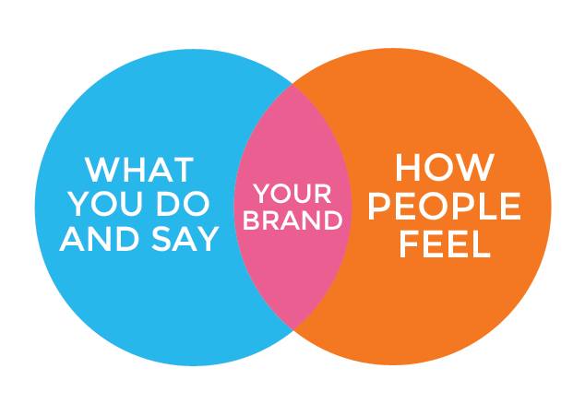
Great marketing starts with your brand….
Your brand is more than your name and logo (although these are very important).
Your brand is your promise to your customers – a promise of quality, of consistency, of usability, of durability – all the things that help make your product or service special in the minds of your customers.
The key strength of branding is it should make an emotional connection with the consumer and stay long in their memory.
Ensure this section of your business plan is visual and highly tailored and very sharp marketing and sales approaches are articulated clearly

Slide 10
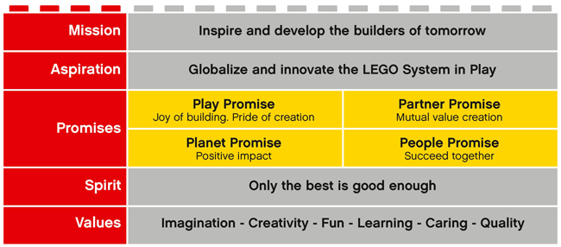
Brand Promise Example: LEGO
“The LEGO brand is more than simply our familiar logo. It is the expectations that people have of the company towards its products and services, and the accountability that the LEGO Group feels towards the world around it. The brand acts as a guarantee of quality and originality.”
Lego explain each of their values on their website and it makes for interesting reading:
https://www.lego.com/en-us/aboutus/lego-group/the_lego_brand

Slide 11
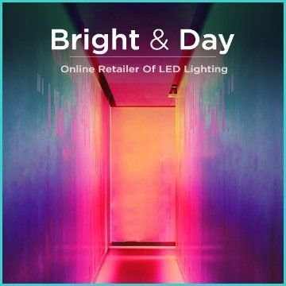
Developing Your Brand
1. Make Sure You Know Your Audience
Starting with a clear idea of exactly what message you want to send, and whom you want your brand to resonate with will help you first choose a style (preeminent, playful, pragmatic, modern, intriguing, powerful) which will be the north star through the road to choosing a brand name.
For example, if you are selling consumer-based products, and your target consumers are millennials, or generations Y or Z, you will have a bit more flexibility to think outside the box, with intriguing names like Urban Decay or playful names like Squatty Potty. However, if you are a corporate company aiming for baby boomers, you'd be smart to choose something more classic, like Stone Eagle Advisors or Zenith Capital.

Slide 12
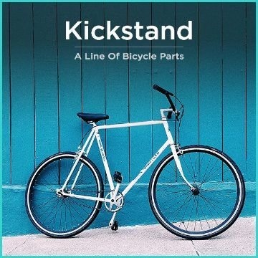
Developing Your Brand
2. Focus on Your Brand, Not Business
Before brainstorming name ideas, write down some aspects that are unique to your brand. Many startups make the mistake of explaining their features or business in the name. This leads to boring and dull names. For example, if you write:
“We are opening a high-end seafood restaurant in Everett, Washington.”
Your name ideas will likely have these undertones:
High-end = classic name
Everett = local restaurant and location themes
This may - but likely will not - fit your vision.

Slide 13
Developing Your Brand
2. Focus on Your Brand, Not Business
If you write
“We are opening a unique, hip, seafood restaurant. The decor will be minimalist. The food will be top-notch, but the ambiance will be more casual.”
Your name ideas will likely have undertones that more accurately represent your Brand:
Unique, hip = fresh, unique, and modern name
Minimalist decor = straightforward name

Slide 14
Developing Your Brand
3. Visualise Key Ideas
The next step is to come up with the different ideas and images to convey in your name which are inherently linked to your brand.
Instead of focusing on the descriptive element -- i.e., what you sell -- focus on expressing one or two other core concepts that are essential to your brand, culture and values.
For example, if you are a food-delivery startup, your ideas could convey images of healthy living, ethically sourced products or great customer service and quick delivery time.

Slide 15
Developing Your Brand
4. Know the Danger Zones
Once you have your style, themes and purpose clear in your heads, it’s time to really start experimenting.
But before trying out different names, you should know which areas to avoid. With so many trademarks out there, the freedom to use almost any particular English word is becoming slim. The common danger zones are:
Single English words
Power words -like force, united, omni, icon
Symbolic words - like bridge, spring, sage, rocket

Slide 16
Developing Your Brand
4. Know the Danger Zones
But just because you can’t use one stand-alone word doesn’t mean you can’t combine these words into something original.
Types of names that have been attached to powerful brands have included:
Transmutations - Zappos, Zumba
This and that - Haute and Bold, Crate & Barrel
Compounds - SnapChat, WordPress
Visual Story - Ice Mountain, Red Bull
Blends - Groupon, Instagram

Slide 17
Developing Your Brand
4. Know the Danger Zones
While compounds and transmutations are great, you should say the words out loud to make sure they stay within the following three guidelines:
Is the name easy to say? It should roll off the tongue, rather than twist it.
Is the name easy to hear? Consumers should be able to hear your brand name, then quickly tap it into Google to find you.
Is the name easy to spell? Simple misspellings such as Flickr, Xero and Lyft are much easier to trademark, but if they are hard to spell, problems could result.

Slide 18
What is a Brand Story & why you need one in your Business Plan?
Your brand story is unique and special to only you and your business. It is a blend of how your Engineering business start up came to be, what you’re passionate about (e.g. solving problems through engineering solutions), your business culture (e.g. the ethics behind your business – environmental etc), how your product make people’s lives better and why your product is worth noticing.
Good brands often have human traits that your targets might identify with. They have a strong emotional context. You want your customer targets to think ‘he/she is like me’ or ‘that’s how I think’. Your brand story should convey and share your brand promise. Now we will look at steps to creating your own brand story…

Slide 19
Creating your Brand Story… The elements to create or capture your brand story…
Start with your Personal Story: Your history, how you got started, the choices you made, were other characters involved?
Your Passion Story: What you love and why you love what you do.
The Personality Story: How people might experience your brand, the customer experience or your approach to the work.
The Customer Story: What do you customers say about you?

Slide 20
EXERCISE:
Using Pinterest (or a similar) create an online storyboard for your brand which tells the story of your business through images. Include:
Photos of yourself - your passions and skills
Photos of your product
Snippets of behind the scenes work
What motivates / inspires you ?
Images which represent your target market
If possible, images that convey the problem your business solves

Slide 21
SECTION 2:
Marketing for Success
12 Successful Female Entrepreneurs (from a range of sectors) share their Best Marketing Tips

Slide 22
Marketing for Success
Entrepreneurs Share Their Best Marketing Tips
Go where your potential customers and clients are!
Make Inbound Marketing a Priority
Know your Customer. Create the right customer Persona
Implementing Call Tracking Platforms….and more….

Slide 23
Marketing for Success
Entrepreneurs Share Their Best Marketing Tips
One of the toughest challenges an entrepreneur faces is marketing. You can have a great idea and you can have a great product; but if you can’t effectively market your idea, you’ll never be as successful as you were meant to be.
With so many other competing entrepreneurs and ideas, marketing can be a tough nut to crack. In this section you’ll find out successful marketing tips business owners and entrepreneurs implemented and how their strategies led them to success.

Slide 24
#1- Go where your potential customers and clients are!
Suzanne Brown, Oksuzi marketing
Focus your marketing efforts on where your customers or potential customers spend their time. Go where they are and where they spend their time. This will require you to do some research to understand their current behaviour and to understand where they spend their time. For example, participate in groups on Facebook or LinkedIn. See how potential customers are responding to competitors’ efforts and where they’re engaging with competitors. If your clients don’t spend time on one type of social media, don’t spend time there and don’t use your budget in that marketing medium

Slide 25
#2- Make Inbound Marketing a Priority
Crystal McFerran, Velo IT Group!
Inbound marketing is focused on attracting leads through relevant and helpful content and adding value at each stage of the buyer’s journey. With inbound marketing, prospective customers find your brand through channels like blogs, search engines, and social media. Inbound marketing is hands-down the most effective strategy – specifically, content marketing (on-site and off), search engine optimization and social media. There is no magic to marketing – it’s all about attracting clients with helpful, relevant content that addresses their pain points and/or needs and provides value.

Slide 26
#3 - Know your Customer. Create the right customer Persona
Preksha Madan, AdNabu!
This may seem like an easy job, but I recommend my fellow marketers to sincerely focus on this step. A lot of times, I’ve seen people on my team just assume the buyer persona that seems fine to them, which is the worst way to do it, because no matter how amazing is your marketing strategy, if you are not targeting the right audience, it’s useless. So, create buyer persona based on real data of your customers and market research (If you’re new). Once you’re able to put a face and personality to your buyer, it’s easier to meet their needs.

Slide 27
#4 – Frequent Live Events
Nicola Lloyd, Frank Recruitment Group!
Live events are definitely one of the best ways to generate leads and start to build relationships, but it’s important to follow those up afterwards. We do post-event email marketing campaigns and divide the leads out per region so the managers can work on them with the sales teams. We have regular calls after the event with the sales team to make sure they know where they are with the leads. Once you build up the relationships you can go back to the events and people come over and say, Oh hi, I met you guys last year.. This is the massive advantage of events over email marketing; it’s more personal and you’re not just a faceless recruitment agency.

Slide 28
#5 – Consistency is key
Amber Phillips, Amber Phillips Design!
Don’t try to do everything and don’t try to be everything! Pick a few key tactics and do them consistently. You don’t have to be on every social media platform and you don’t have to do every single marketing method you come across. Find what works best for you and concentrate on becoming the best in that particular method.

Slide 29
#6 – Implementing Call Tracking Platforms
Marissa Katrin Maldonado, Relative Marketing Group!
One of the best tools you can use to track specific marketing campaigns and return on investment (ROI) is by implementing a call tracking platform. A call tracking platform allows you to assign unique phone numbers and tracking sources providing you with valuable information on what marketing campaigns are producing leads and which are not. These metrics provide information on where to spend marketing dollars and where to cut costs. I have worked with many clients over the years who were throwing their marketing dollars in the wind, with no real tracking in place. Imagine how much money it saves once this is implemented allowing companies to be able to make informed marketing decisions!

Slide 30
#7 – Shock/surprise and talk
Jinal Shah, If I Were Marketing!
Do anything that shocks a reaction out of the audience be it unexpected tears or surprise or jaw-dropping. Once that’s achieved then open conversation while they are still digesting what they saw/ heard/ experienced. Those few precious seconds when your tactic or storyline left the audience speechless are your marketing gold. Use them to engage and start a conversation about your brand and product.

Slide 31
#8 – Building Relationships
Michele Daae, Daae Consulting!
I’m not a flashy, slick salesperson, nor should I want to be. I’m an introvert. My marketing approach mirrors my personality so it comes across as natural and genuine. I like to think of business relationships in the context of romantic relationships. If you are on a first date and the person you meet asks you to marry them, you’d probably run…fast! Same thing in business. Don’t try to close the deal on the first meeting. It’s awkward. Have a first date. (Check out my website.) Then ask them out for coffee. (Want to download my free report?) If things click then you’ll want to ask them for dinner. (Purchase my entry-level product.) And, then yes, if all goes well…marriage. (It’s time you bought my high-ticket offer.) And, don’t forget – schedule date nights after you’ve closed the deal.

Slide 32
#9 – Focus on the Benefits, Not the Features
Caity Hubert
Make sure you’re communicating what you and your company can do for your current and potential customers by explaining benefits, not features. Showing and telling your client how your products or services will improve their life stirs much more desire for your offer than simply explaining the features. If recommending a shampoo for a client, for example, explain how their hair will look and feel after use rather than listing out the ingredients. Some people may purchase solely based on features, but most are driven by an emotional reaction and feelings of desire for the benefits of what you’re marketing.

Slide 33
#10 – Contribute regularly to existing well-trafficked blogs
Paige Arnof-Fenn, Mavens & Moguls!
Thought leadership is an effective and cost-efficient way to build your brand, increase your visibility more broadly, raise your profile and attract more clients. Activities like speaking at a conference, writing articles, building your following on social media all contribute increasing your awareness with potential customers and building your credibility with a larger community. Instead of trying to start your own blog or newsletter, try contributing regularly to existing well-trafficked blogs in your industry or newsletters of like-minded organizations reaching the same target audience as you. Make sure you put your URL or contact info on it so they can find you and follow up. When your articles or talks become available online, make sure to send them out via social media to all your friends, followers and contacts.

Slide 34
#11 – Know your goals
Kristen Harold, KMH Marketing!
I know that answer lacks fancy buzz-words and may sound simple. However, it’s the basis for any successful marketing strategy. Don’t look at marketing as a “quick fix” rather than a long-term solution. Marketing has many moving parts and you need to understand and communicate your business goals in order to know where to allocate your marketing resources. Do you want to get more leads? Do you want to sell a certain number of products? Do you simply want to raise awareness in specific markets? Odds are, it’s a mix of all of the above. Laying this out first helps you or whomever is handling your marketing understand the needs of the business and from there you can build a thoughtful marketing strategy to help you reach those goals. Without it you’re going to waste a lot of time and money!

Slide 35
#12 – Always have an engaging elevator pitch ready
Kelley Lauginiger, American Freight Furniture & Mattress!
Since you never know when or where your potential customers or investors may cross your path in life, you need to have an engaging elevator pitch ready to share at any time. The average adult attention span is under eight seconds, so you should have something compelling to offer about your brand that shows value, and does so quickly.!

Slide 36
SECTION 3
Reaching/Attracting your Audience and getting Sales started!
The buying journey and touch points. How to get to your customers? Where your customers are? What Your Customers Want?

Slide 37
Your Customer defines your Marketing and Sales Strategy
In Module 2, we went into considerable detail on customer profiling as part of your Validating your Business Idea. We also touched on some relevant is content in Module 5 where we introduced you to 9 business models. The one you chose will determine how you approach you sales and marketing.
In an increasingly competitive world, start-ups need to get their products to the market faster than ever. A strong marketing strategy will help you hit the ground running.
In the section which follows we will look at ways to reach and engage in your customer

Slide 38
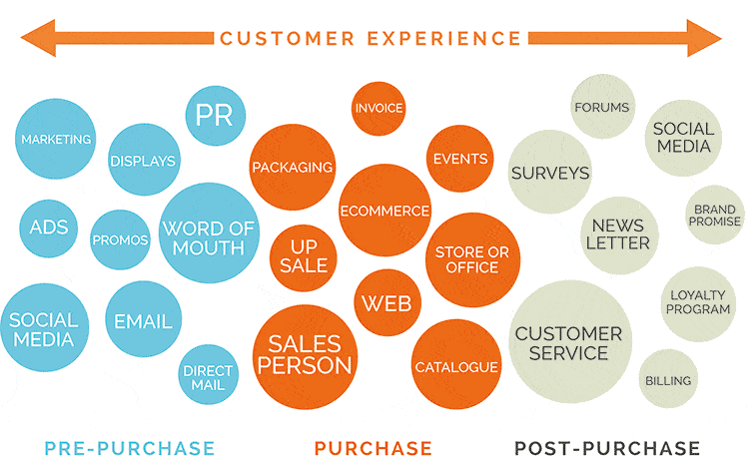
Customer Touch Points
Customer touchpoints are your brand's points of customer contact, from start to finish.
For example, customers may find your business online or in an ad, see ratings and reviews, visit your website, shop at your retail store, or contact your customer service.

Slide 39
The buying journey and touch points
Marketing touchpoints are customer interactions with your brand over the course of their buyer journey. Mapping those touchpoints across the buyer journey will help your brand provide the right experience for your customers across channels.
The Customer Journey: One Touchpoint at a Time
Consider the many ways your customers interact with your brand, you also can start building out the customer journey, find the right content or experience to deliver on the right channel at the right time to the right person.
Building the customer journey means knowing and understanding your customers: their pain points, their challenges, their motivations, and more. It’s a process we call “humanizing marketing,” in which deep understanding of your customers allows a brand to use marketing to make a positive impact on their lives.

Slide 40
The buying journey and touch points
Some of the keyways touchpoints are likely to influence the customer experience.
Use Data to Make Your Website Your Most Versatile Touchpoint Your website contains numerous potential touchpoints: product pages, blog posts, location specific pages. An understanding of your customers is crucial to perfecting your website as the hub of the digital customer experience. One of the best ways to align your touchpoints is by mapping the customer journey. Start with personas: who are your key customer segments? To understand who they are and how they are likely interact with your brand at key touchpoints, you need to get insights from customer data. Personalization is one of the biggest trends in marketing right now (and the one that marketing executives feel most unprepared for), but it requires walking a very particular line around customer data.

Slide 41
The buying journey and touch points
Map the Customer Journey to Find Crucial Touchpoints
Organic search insights are a key component in understanding how your customers are likely to engage with your brand. What questions are they asking that you can help them answer? What can you share about your brand’s area of expertise? What kind of device are they using? Use technology to access and organize your insights so you can get the most impact from them. Next, consider the stages of the customer journey: what is your customer trying to accomplish when they search for specific groups of phrases?
https://www.conductor.com/blog/2019/01/what-is-a-touchpoint-marketing-touchpoints-on-a-buyers-journey-in-2019/

Slide 42
The buying journey and touch points
Finding the Right Moment: Other Digital Channels
Other key channels that you need to consider include social media, paid search, display ads, and more. All too often, we divide our marketing into paid and earned strategies that can deploy very differently. But the same humanized marketing strategies and considerations you apply to your “earned” interactions like blog posts driving organic traffic should apply to every touchpoint.
If you are buying space on a search engine results page, does the content you’re providing match the search intent of your customer? It needs to; you should not buy space just to have it, but because you are able to provide real value to your customer at that touchpoint. https://www.conductor.com/blog/2019/01/what-is-a-touchpoint-marketing-touchpoints-on-a-buyers-journey-in-2019/

Slide 43
The buying journey and touch points
Beyond Digital Touchpoints: Integrating Brick-and-Mortar Experiences
Increasingly, customers are demanding seamless omnichannel experiences, in which they are able to interact with brands across channels both digital and in person. It’s crucial to bring together data from non-digital sources like in-store purchase history that are often isolated to get a whole picture of your customers’ interactions with your brand across all channels.
https://www.conductor.com/blog/2019/01/what-is-a-touchpoint-marketing-touchpoints-on-a-buyers-journey-in-2019/

Slide 44
How to Find Your Customers?
Develop a Plan for Customer Acquisition the secret to this is to know who would make an idea customer
Look for and follow business prospects on social media Don’t try to sell to them on social media feeds try to develop relationships with potential customers. Retweet or comment on their posts. Mention them on your social media!
Work your local newspapers and radio stations can be powerful and have a huge reach and lead to potential new customers especially if your customers read or listen to the title you are on. Send people who have done well or who have been on such mediums who could be potentially a customer send them a ‘congratulations’
https://www.businessknowhow.com/startup/findcustomers.htm

Slide 45
How to Find Your Customers?
Be sure your website and social media pages make it easy for visitors to know how to reach you better still give them a reason to give you their contact information
Sponsor events that bring your potential market together. This can be an inexpensive way and a direct way to get in front of your customers
Work your personal network ask people if they know people who would use your services, ask them to promote you and talk or refer you.
Study your successful competitors where do they advertise? Where do they network? What tactics do they use? What works for them may just work for you.
More tips here: https://www.businessknowhow.com/startup/findcustomers.htm

Slide 46
How to get to your customers?
Encourage them to join your email list Email marketing isn’t the newest marketing channel around, but it continues to be one of the most effective. Sign up for an email marketing provider, gather contacts online by adding a sign-up form to your website, and start sending professional messages using a mobile-responsive email template.
Start a Blog Start your blog as a written record of the questions your customers ask you all the time? Wouldn’t that actually be a time-saver if you had a resource at the ready to point to?
Host a photo contest If you encourage your current customers to share photos of themselves enjoying an experience, their friends will be soon to follow. This is a great way to reach new people without a lot of effort. Create a timely contest that’s easy for people to participate holiday photo contest and offered an enticing reward to encourage participation.
https://blogs.constantcontact.com/marketing-to-reach-new-customers/

Slide 47
How to get to your customers?
Encourage reviews Post a call to action on your Facebook page and in your next email blast to ask loyal fans to share a review.
Ask for referrals Don’t let the fear of rejection stand in the way of reaching new customers! Even if only a couple people say yes, you’ll get in front of some valuable new customers.
Write a survey or poll Do you know how most of your customers found out about you? Do you know what products, services, or topics they’re most interested in?
https://blogs.constantcontact.com/marketing-to-reach-new-customers/

Slide 48
What Do Your Customers Want?
Figure out what problem you’re trying to solve. Netflix broke its own business model a few years ago. The company earned a position as a market leader in the home entertainment space with its original model of charging a subscription to customers and sending them DVDs through the mail. But Netflix was thinking beyond their customers’ ability to articulate what they really wanted. They wanted a faster, more convenient way to receive and consume their entertainment. Their upgrade was about solving their customers’ problems.
Had Netflix asked its customers seven years ago what they really wanted from the company, they might have said they wanted the subscription rates to be lower. What percentage of those customers would have answered, “Let us stream your content over the Internet, to our TVs and other devices, by embedding an app directly into our cable and satellite services and other set-top boxes?” Not many.
https://www.productplan.com/what-customers-really-want/

Slide 49
What Do Your Customers Want?
“Faster Horse” Theory of Product Management made famous by Henry Ford. When horses were the primary means of transportation, and Ford asked his would-be customers what they wanted in terms of better transportation, most simply answered, “a faster horse.”
What Ford’s customers really wanted, without having the vision or language to explain it, was a more effective and convenient means of transportation. Ideally, one that didn’t need to rest so often or leave poop in the owner’s driveway.
It’s the concept of problem first—the idea that you don’t start with the product. Rather, you lead with the problem that you’re solving. If you can figure out what your customers’ real problems are — not simply the problems they themselves are able to articulate, but the real ones — then you can identify the opportunities to create products that delight those customers.

Slide 50
What Do Your Customers Want?
Learn what your customers’ customers want. If you’re selling a business-to-business product, this is another vital strategy for successful innovation. Learn not only what your customers want but what their customers want. As a product manager, you need to really understand the buyer persona that you’ll be working before you can prioritize features.
If you develop a data analysis platform for consulting firms, then the clients of those consulting firms represent a gold mine of intelligence for you about what types of features will resonate with your consulting firm personas.

Slide 51
What Do Your Customers Want?
Stop listening to your customers. You don’t want to ignore your customer or user personas outright. Their feedback can be an invaluable source of information on where your existing products are working and where they are coming up short.
But you need to keep in mind that your customers know only what they’ve seen and used, and as such, they are often a misleading source of information about what you should be building next.

Slide 52
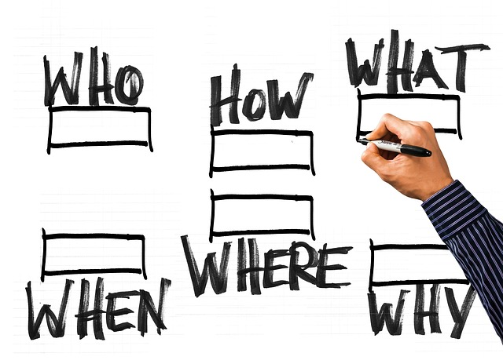
What Do Your Customers Want?
Learn as much as you can about your personas’ jobs or lives. You’ll notice that again this is a suggestion not to focus on your product itself, but rather on the people who will be using it.
If you sell lawnmowers for residential use, for example, asking your existing customers what they want from your next model will almost certainly yield predictable results: faster blades, bigger grass catcher, more cutting-height options, lower engine noise, etc.

Slide 53
Getting started with Sales
Awareness
Consideration
Purchase
A simple way to look at the customer buying cycle is to break into three stages in even the most complex sales situation:
Awareness – when a customer first becomes aware of your product or service . Or where a customer first becomes aware of a need that they want to fulfil
Consideration – when a customer starts evaluating solutions to their need
Purchase – when a customer makes the decision and completes the purchase

Slide 54
Your Sales Plan
Awareness
Consideration
Purchase
Your sales actions with the customer buying cycle
Describe what you see the customer problem to be
Introduce your solution
Provide detailed information of your solution
Provide back up proof – customer testimonials, reviews
PERHAPS
Offer an incentive
Purchase

Slide 55
Upselling
Highly important ancillary sales – e.g. one year customer support package
Upselling adds perceived value to a sale that the customer is already willing to make, as well as offer upgrades to purchases.
Customers will value your opinion
Easier to sell up to a customer - they have already indicated a willingness to purchase
READ MORE - www.wikihow.com/Upsell
EXERCISE – After reading the above how do you think you can add upselling opportunities to your business ?

Slide 56
Upselling
The sales and marketing section of your business plan needs elaborate further on who and where your customers are and how you will reach them. While you may have developed a wonderful product or service, it's all for nothing if you don't have customers and clients
Start with your brand and take the reader through all the learning you covered in this course.

Slide 57
Case Study: Success stories, motivational guides!
TURKEY

Slide 58
Case Study: Success stories, motivational guides!
TURKEY

Slide 59
What I Have Learned?
I understand what marketing is and its relationship to sales
I have learned successful marketing tips and tricks and the different strategies and ways I can reach, know and understand my customers.
I know a multitude of ways I can implement marketing strategies that are cost effective, I don’t have to be an expert to carry out.
I understand that I need to implement a mix of different marketing mixes and strategies but the most important thing to do is concentrate on those that fit my business, my customer and me best. To do a few things right because to try and do all perfectly on a shoestring is next to impossible.

Slide 60
@EMERGEPROJECTEU
https://www.facebook.com/EMERGEPROJECTEU/?ref=br_rs
http://www.emergeengineers.eu/project-partners/
http://www.emergeengineers.eu/
#EMERGE #femaleengineers #Erasmus+
#femaleentrepreneurs

