Slide 1
MODULE 4
Undertaking a Proof of Concept Process

Slide 2
Module 4
Proof of Concept
Learn and work through a Proof of Concept Process and Ideas Assessment, Name & Protect your idea
In our earlier modules, you assessed your entrepreneurial potential, you learned why now is a good time to start-up and learned how to validate your business idea. In this module, we take you through the proof of concept process and how, with minimal resources, you can accelerate your Engineering start up idea.
Bootstrapping
Bootstrapping what is it and is it right for you? The importance of minimum viable product (MVP), Business Models for Your Startup
Testing your idea on shoestring
Interviews, Case Studies, Startup Advice from Top Entrepreneurs

Slide 3
SECTION 1:
Proof of Concept

Slide 4
What is Proof of Concept?
Proof of Concept (PoC) is a small exercise to test the design idea or assumption.
The main purpose of developing a POC is to demonstrate the functionality and to verify a certain concept or theory that can be achieved in development.
By undertaking a proof of concept (POC) process you are gathering sufficient evidence of the technical viability of your product or service. Some commercial feasibility assumptions or conclusions may need to be adjusted as new knowledge of the product emerges.

Slide 5
Undertaking a Proof Concept Process
The POC stage generates knowledge about the product’s design, performance, production requirements, and preliminary production costs. The end result is a working model known as a prototype.
Ideas are turned into operational form (not necessarily the final form). The core functionality of the idea is tested, basic prototypes may be developed and IP registration can be established. It is essential that the results of a POC are reproducible, and, if relevant, the quality expectations of the relevant regulatory community are satisfied.

Slide 6
Typical Activities that could be
involved in a POC
Running a new process for the first time and testing that it performs the desired transformation of inputs to outputs
Delivering a service for the first time, testing that the expected benefits to recipients are realised and that the delivery method is effective
Examine the operational requirements of the product/process
Identify potential safety and environmental hazards
Conduct a preliminary production assessment
Conduct a preliminary manufacturing assessment
Estimate engineering prototype costs
Initial production of a new product prototype and testing that it can actually be used as planned

Slide 7
Some Proof of Concept Parameters when Checking for Proof of Concept
Net profit
Gross profit
Revenue/ revenue growth rate
Number of customers/clients /users
Customer/clients /users growth rate
Systems and processes
Total amount invested in business
Return on investment
The result from the analysis of these parameters says a lot about the potential of a business idea that has been set in motion. These parameters can also be used to see how well a small business/start-up is doing.
Source: Whats Proof of Concept and Why I should Know It

Slide 8
How do I Know My Business Shows Proof of Concept?
When a business idea shows proof of concept, it means one or all of the following:-
Systems and processes within the business are reproducible on a commercial scale
The business is been able to capture its own sizeable audience
The business has been able to successfully sell a product/service and make money (profit) from its audience.
A business that has not attained a proof of concept is not necessarily failing. It has most likely not been able to clearly identify how to make money from an audience on a commercial scale and needs more investigation.

Slide 9
Prototype Summarised
Proof of concept (PoC)
Demonstrates feasibility and confirms potential
Exposes a realistic implementation of a small portion of the whole system
Less cost and time for feature validation compared to full-scale project
Gives way to innovative ideas right in the initial stage
Discloses errors, bugs, and risks involved at an early stage
Gives a ‘yes’ or ‘no’ instantly to the viability of your project

Slide 10
Intellectual Property Rights (IPR)
Intellectual property rights are the rights given to persons over the creations of their minds. They usually give the creator an exclusive right over the use of his/her creation for a certain period of time.

Slide 11
As part of Proof of Concept Name & Protect your idea
Intellectual Property Rights (IPR)
It's natural to fear that your idea might be stolen. But you can't turn your vision into reality without the help of others. Sooner or later, you're going to want to ask an industry expert to evaluate your product or service. You're going to need to collaborate with a manufacturer or distributor.
But patents cost thousands of €€ and take years to be issued. You can't afford to wait that long to start bringing your product to market.
Source: Stephen Key Co-Founder of inventRight

Slide 12
As part of Proof of Concept Name & Protect your idea
Intellectual Property Rights (IPR)
There are creative ways to actively protect your idea without applying for a patent. Here are three affordable strategies that will protect your business idea from being stolen:
Non-disclosure agreement (NDA): Have anyone you work with sign a non-disclosure agreement that commits them to confidentiality. An NDA can be a mutual agreement between two parties not to share information with third parties, or it can go one-way (since you're sharing information about your idea with them). If the agreement doesn't have an expiration date, that's powerful.
Non-compete agreement: If you hire someone to help you, have him or her sign a non-compete agreement. A non-compete agreement prevents an individual or entity from starting a business that would compete or threaten yours within an established radius.

Slide 13
As part of Proof of Concept Name & Protect your idea
Intellectual Property Rights (IPR)
Work-for-hire agreement: If you hire someone to help fine-tune your product, make sure to establish that you own any and all improvements made to the idea. Anything they come up with, you own. You will still need to list the person who came up with improvements as a co-inventor in your patent, but they will have no rights to your invention.
There are 4 ways to protect intellectual property. To protect your idea effectively when you launch your product, you need to utilize one or more of the other three types of intellectual property before you commence your marketing activities. -

Slide 14
As part of Proof of Concept Name & Protect your idea
Intellectual Property Rights (IPR)
There are 4 ways to protect intellectual property. To protect your idea effectively when you launch your product, you need to utilize one or more of the other three types of intellectual property before you commence your marketing activities.
Trade Secrets
Protects a new invention e.g. A new formula of Coke
Trademarks
Protects brands e.g. Apple
Copyrights
Protects works of authorship e.g. drawings, movies, books
Patents
Protects functional or ornamental features

Slide 15
As part of Proof of Concept Name & Protect your idea
Intellectual Property Rights (IPR)
 |  | PROTECTS | INFRINGEMENT | REGISTRATION PROCESS | TERM | COMPARATIVE COSTS
PATENT | Utility Patent | Functional Aspects | Make, Use, Offer, Sale, Import | Yes | 20 years upon filing | Expensive
 | Design Patent | Ornamental Features | Make, Use, Offer, Sale, Import | Yes | 15 years upon filing | Moderate
TRADEMARKS |  | Brands | Used in commerce | Optional | Potentially indefinite, limited by use | Inexpensive
COPYRIGHTS |  | Works of Authorship | Copying, etc. | Optional | Life Plus 70 Years | Inexpensive
TRADE SECRETS |  | Information | Misappropriation | No | Potentially indefinite, limited by secrecy | Depends
This table illustrates each of the four different types of intellectual properties and what they might be used to protect in a broader sense…

Slide 16
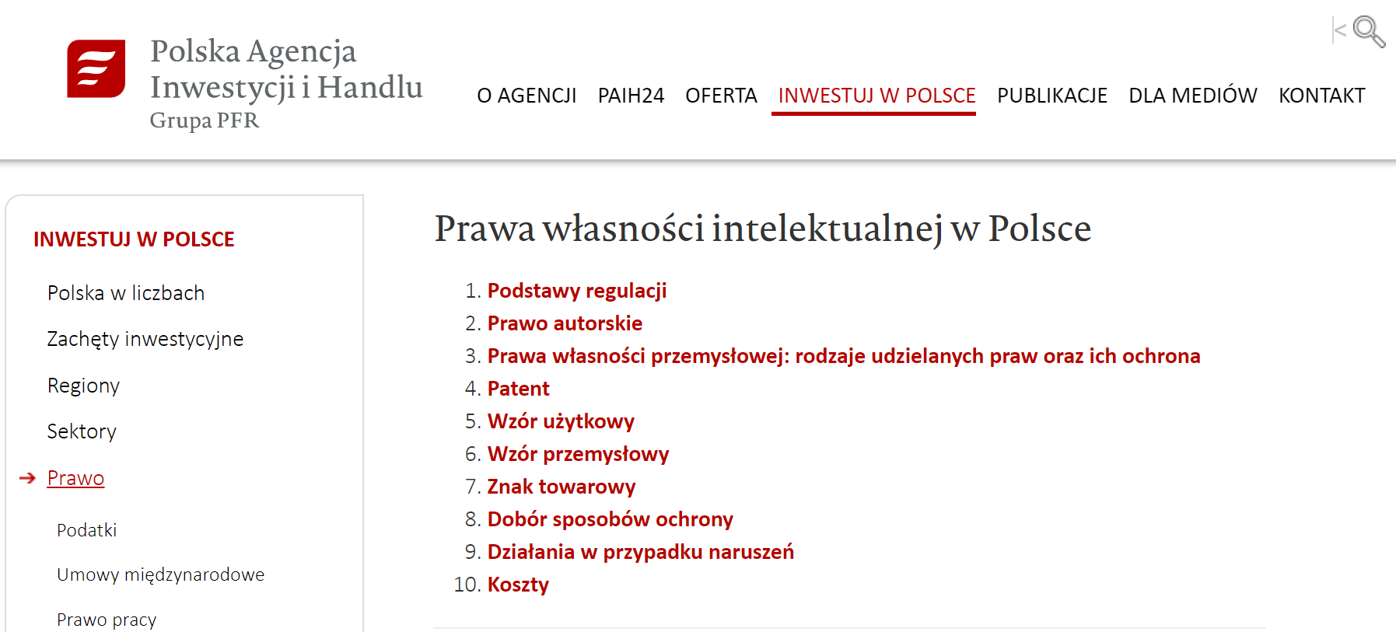
IPR: Generic Guidelines for Poland
On this official website of Polish government there are tabs where one can find various information about the process, protection and application of IPR laws.
POLAND

Slide 17
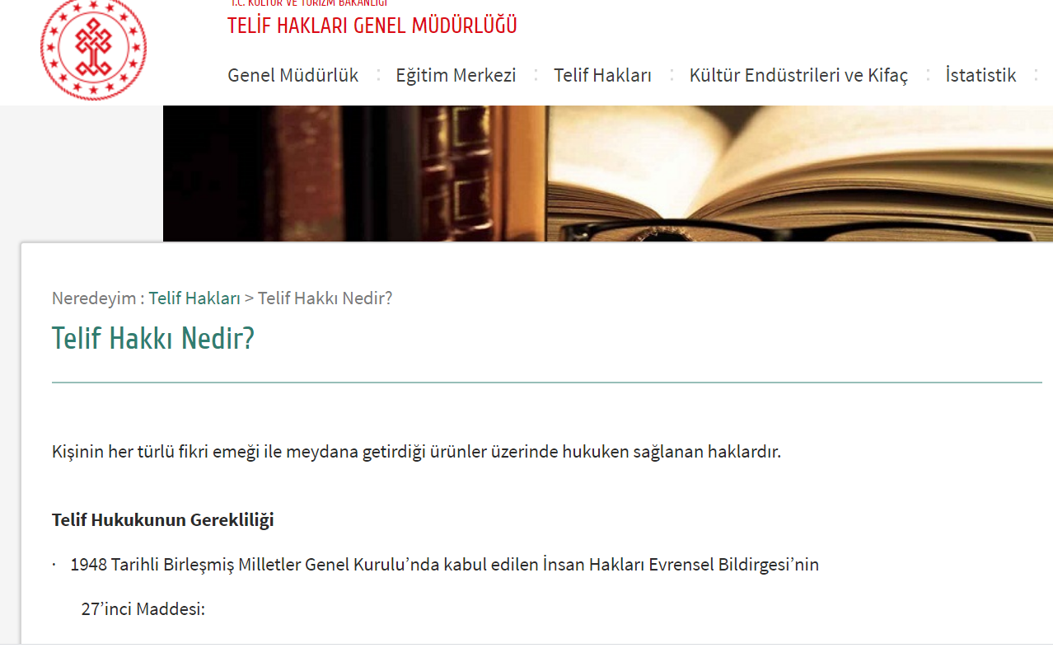
IPR: Generic Guidelines for Turkey
TURKEY

Slide 18
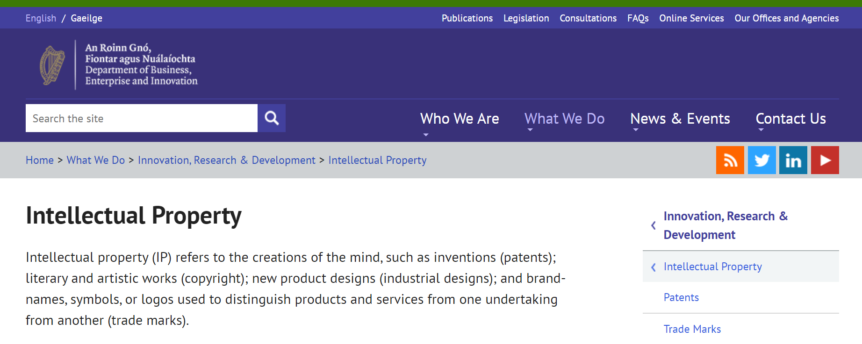
IPR: Generic Guidelines for Ireland
Ireland

Slide 19
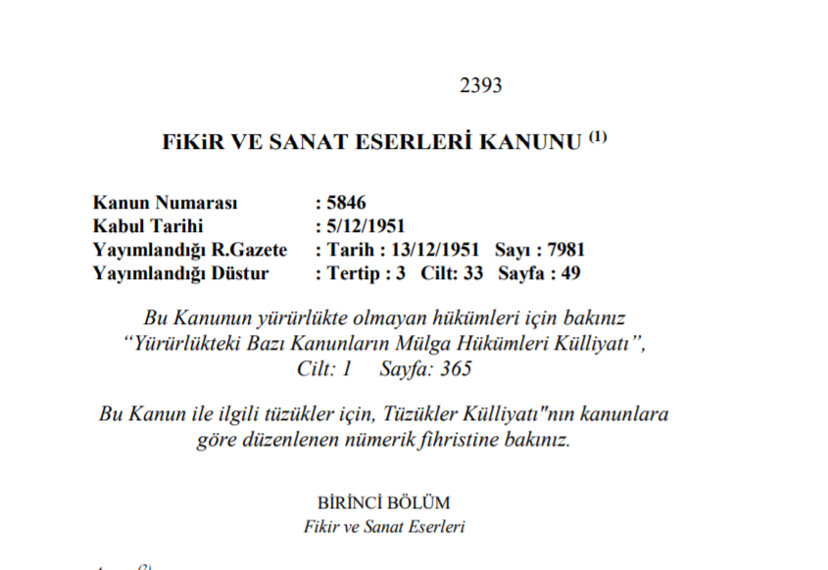
The Relevant Law for Turkey
TURKEY

Slide 20
European Research Council
ERC Proof of Concept Grant can be used to
Establish viability, technical issues and overall direction
Clarify intellectual property rights position and strategy
Provide feedback for budgeting and other forms of commercial discussion
Provide connections to later stage funding
Cover initial expenses for establishing a company
Proof of Concept Grants are up to €150 000 for a period of 18 months. More than one Proof of Concept Grant may be awarded per ERC funded frontier research project but only one Proof of Concept project may be running at any one time for the same ERC frontier research project.
Source: ERC Proof of Concept

Slide 21
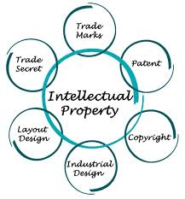
European Research Council
ERC Grant is Evaluated on 3 Evaluation Criteria
The ERC is led by an independent governing body, the Scientific Council.
Excellence (Innovation potential): Proposals will have to demonstrate that the proposed Proof of Concept activity could greatly help move the output of research towards the initial steps of pre-commercialisation.
Impact: The proposed Proof of Concept is expected to generate economic and/or societal benefits.
Quality and efficiency of the implementation (Quality of the Proof of Concept plan): The proposed Proof of Concept is based on a sound approach for establishing technical and commercial feasibility of the project.

Slide 22
Case Study: Interview with Renata Nowacka-Hopaluk, Chairman of the Board, Bio-Circle Surface Technology
POLAND
Title: Presents idea and concept of Bio-Circle Surface Technology Products
Description: : Interview with Renata Nowacka-Hopaluk, Chairman of the Board in Bio-Circle Surface Technology company. She presents the idea and concept of Bio-Circle Surface Technology products and the innovative approach to start and develop business and offer which at the beginning can be outstanding from the one existing at the market.
Video: https://www.youtube.com/watch?v=03ywodO51ec

Slide 23
Case Study: How to protect your company and products
POLAND
Title: Advice from Polish Lawyers how to Protect Your Company
Description: Short videos, in which lawyers describe the laws and ways how to protect company and its products in Poland. Videos shows the processes of application and functioning of such as laws.
Video 1: https://www.youtube.com/watch?v=hmiPo3QrBSE
Video 2: https://www.youtube.com/watch?v=HdvTQQeJ6MQ

Slide 24
Choosing Your Business Name
How to come up with a Winning Name for Your Business!

Slide 25
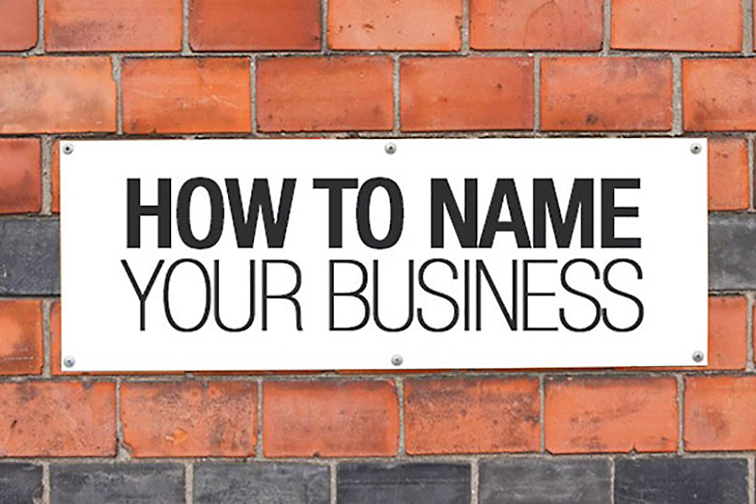
Choosing a Business Name
A highly important task is to choose a Business Name for your start up.
Many start- ups now choose a short, branded name - a name that’s unique and memorable.
You may find that key domain names are taken and other businesses have trademarked your chosen name. So, do your homework.

Slide 26
Choosing a Business Name
Avoid hard to spell names
Don’t pick a name that could be limiting as your business grows
Conduct an internet search
Get the .com domain name
Use a name that conveys meaning
Conduct a trademark search
Assess if the name is catchy
Get feedback on the name
Make sure the name sounds good when said aloud
Use resources available for brainstorming names
Make sure every person is happy with the name
Read: https://www.forbes.com/sites/allbusiness/2016/10/23/12-tips-for-naming-your-startup-business/

Slide 27
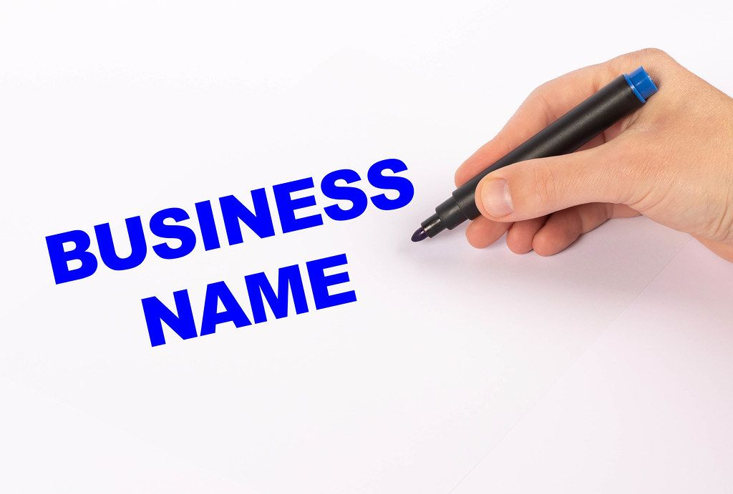
Choosing a Business Name
The best company names are emotion-driven and memorable. If you’re struggling to name your company, think about the emotions that you want your target customer to feel. When choosing your business name, think about the words that you’re using in everyday life.
Certain sounds inspire positive emotions and result in experiences that are likely to be liked, remembered, and shared. You should focus on the words that you associate with specific sensory experiences: lightness, darkness, strength, weakness, sharpness, and dullness, as examples.

Slide 28
Choosing a Business Name
If you can’t find a word that perfectly captures the essence of your brand, invent your own.
Words are ever-changing and follow evolutionary cycles.
There are new words, slang or formal, entering the market, all the time.
A readily apparent example of this trend is Google - a word that arose from complete obscurity to eventually earn its place in the Oxford Dictionary.

Slide 29
Choosing a Business Name
Resources for Brainstorming Names
There are several sites than can help you brainstorm names including;
VisualThesaurus.com (gives you a visual around a keyword)
Shopify Business Name Generator (generates business name ideas and checks domain availability simultaneously)
Namemes.com (provides a startup company name generator)
Namimum.com (allows you to generate names based on theme)
Read: https://www.forbes.com/sites/allbusiness/2016/10/23/12-tips-for-naming-your-startup-business/
This Photo by Unknown Author is licensed under CC BY-NC-ND

Slide 30
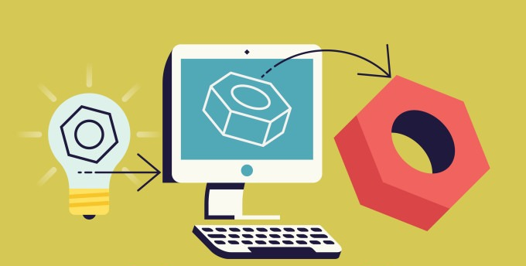
SECTION 2:
Bootstrapping, Minimum Viable Product and Prototyping Explained

Slide 31
Bootstrapping
Bootstrapping is the act of starting a business with no money - or, at least, very little money. It certainly means starting a business without the help of venture capital firms or even significant angel investment.
Bootstrapping a business can be tough but is highly rewarding; it develops great discipline and creativity that can bring out the best in a company. With bootstrapping, almost everything is done internally to keep costs low.
Source: Bootstrapping Tips on How to Self Fund a Business

Slide 32
Bootstrapping Benefits
You get to retain complete control and ownership of your business.
It teaches you to focus on cash flow
Develops great discipline and creativity that brings out the best in the company
It is a consistent way to gain traction which provides leverage when seeking investment from investors
Because you are involved in various aspects of your business, it gives you the organizational experience which will be vital in developing the company
It helps you realize the talent and capacity you have so you attract the right people + find the right partners
Source: Whats Proof of Concept and Why I should Know It

Slide 33
Bootstrapping The Drawbacks
The revenue, or lack of! If you manage to launch your company with your own funds, getting access to the necessary capital for growth may be a challenge
Organic development stagnates without money at your disposal. The lack of cash resources might prevent you from developing your project on schedule with the impact you won’t be able to meet your growth goals on time.
Lack of credibility. The backing of external investors that vouch for you as you establish your business shows they have faith in your idea, its potential and your future plans. A lack of external investors can hurt the credibility of your enterprise early in the game.

Slide 34
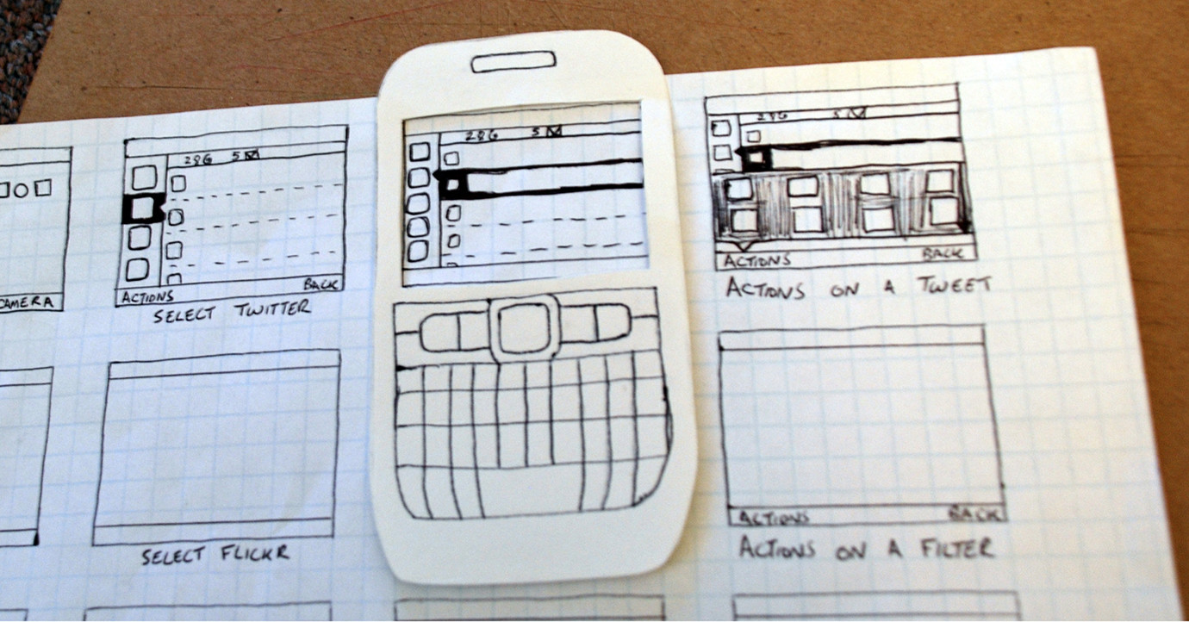
What is a Prototype?
A prototype is an early sample, model, or release of a product built to test a concept or process or to act as a thing to be replicated or learned from.

Slide 35
A Prototype Summarised
A Prototype
Early feedback on the product
Identification of mistakes in the design and development phases
Increased acceptance by users owing to the visual effect
Less expensive and lucrative and faster
Simplifies complex ideas into an understandable format
Application/System flow validation by business users

Slide 36
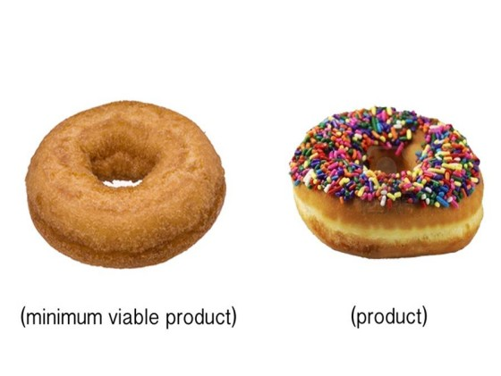
What is a MVP?
A minimum viable product (MVP) is a product with just enough features to satisfy early customers and to provide feedback for future product development

Slide 37
MVP Summarised
A minimum viable product (MVP)
Increased Production Readiness
Offers right subset of features to keep users satisfied
Creates value for users with continuous feedback and improvement
A minimal form of your complete product
Gives valuable insights to grow gradually keeping customers in mind
Garners high retention in a small investment
Helps in preventing wastage of time, money and efforts
Set the path for increased feasibility and value

Slide 38
Watch video: MVP explained
A MVP can help you test your hypotheses about the market, and your customers, before you spend too much time creating and shipping the product.

Slide 39
Minimum Viable Product (MVP)
17 Examples of Successful MVP’s

Slide 40
17 Common Examples of Successful MVPs
Startups need to get their products to the market faster than ever in an increasingly competitive world. The a.k.a. MVP is the way to achieve this, but you must be able to provide the right key features that differentiate and give value to customers to attract clients and investors before the market moves on.
Facebook connected students together via their college or class
Groupon Vouchers launched with a WordPress site and emailed PDFs to subscribers
Airbnb partners had difficulties with paying their rent and came up with a solution
Amazon started off selling books online
Source: Howwedostartups.com

Slide 41
17 Common Examples of Successful MVPs
Dropbox pretended they had their product ready by creating an explainer video
Zynga Developed Farmville by going live on Facebook.
Pebble The coin-sized smartwatch
Zappos went into shoe retailing with no stock
Etzy found an audience that needed their own MVP to resonate with.
Buffer created a landing page with different pricing and features, subscribed to the waiting list
Twitter was an SMS platform for internal use
Foursquare started with limited functionalities
Spotify started as a closed beta to test the market. Signed artists once knew people wanted
Source: Howwedostartups.com

Slide 42
17 Common Examples of Successful MVPs
Uber started off connecting drivers to iPhone owners
iPhone the first version lacked many basic functionalities
AngelList tested their service idea by doing simple email intros to investors
Product Hunt started with a tool called Lindydink allowing members to share
READ - Full Story on each of the 17 MVP’s Here
Source: Howwedostartups.com

Slide 43
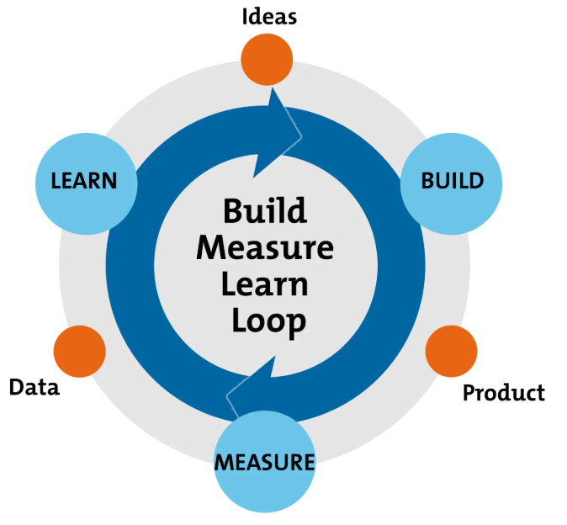
EXERCISE:
Build Your Own MVP
Read this article to find out the Do’s and Don’t of an MVP
Create your own MVP considering it must deliver minimum yet a valuable product that:
Serve at least one specific audience
Address at least one key problem
Have a well-designed user experience
Be easy to build and launch quickly
Source: Get Smarter Building Startups

Slide 44
EXERCISE continued
Follow and complete each of the 4 tasks below in the article so you can build an MVP
Before you must understand and identify your success criteria
To build the right MVP map outline your user’s journey
Have the story-map ready before you build an MVP
Use the product roadmap to prioritze the features before you build an MVP
Source: Get Smarter Building Startups

Slide 45
SECTION 3:
Testing your Idea

Slide 46
Test Your Idea with Simple Steps on a Shoestring Budget
Before you complete this section you need to be familiar with your Target Market and understand exactly who they are. Make sure to refer to
Module 2: Validate Your Business Start Up Idea – see section on Initial Market Research & Strategy
Module 6: Marketing for Success – see section on How to Find Your Customers
Source Entrepreneur Europe

Slide 47
Test Your Idea with Simple Steps on a Shoestring Budget
If your idea has support, then consider developing an MVP, or minimum viable product, to determine if it is a product others would really use. Build a working prototype, or look to a resource that has the ability to leverage newer technologies, such as 3D printing.
If you have a technology idea, such as a smartphone app, look to crowdsourcing or a Startup Weekend event to find the assistance you need.
Talk to people in your market and see if you can complementary package/add-on to their product
Source Entrepreneur Europe

Slide 48
Test Your Idea with Simple Steps on a Shoestring Budget
Make Some. Sell Some. Sales pace and reviews can be valuable market proof.
Freelance Market Researchers. Independent market researchers can be hired to conduct all or part of your market test. To cut costs down as low as possible, craft your own questions and have a professional frame the questions for unbiased results.
Source Innovate, Inc.

Slide 49
Test Your Idea with Simple Steps on a Shoestring Budget
Market Research Mobile Apps. App-based market research is popular as a cost-effective and quick data-gathering solution for companies of all sizes. Apps like Mobile Market Research and Field Agent are easy to use and have a broad database of your ideal demographic.
DIY Market Research. A quick and inexpensive way to find a group with similar backgrounds to your target demographic. Document your market research efforts for future marketing needs. Video, audio and photographs of your methodology can help reinforce the validity of your results.
Source Innovate, Inc.

Slide 50
What I Have Learned?
I understand the Proof of Concept (PofC) Process and its importance to further validate my business idea
I can explain the key business terms bootstrapping, prototyping and minimal viable product
I also know the steps to get started in building my own MVP
I have gained some key insights into how I can test my business idea on a shoestring

Slide 51
Thank You
Any Questions?
@EMERGEPROJECTEU
https://www.facebook.com/EMERGEPROJECTEU/?ref=br_rs
http://www.emergeengineers.eu/project-partners/
http://www.emergeengineers.eu/
#EMERGE #femaleengineers #Erasmus+
#femaleentrepreneurs

