Slide 1
MODULE 3
Unlock your Entrepreneurial Brilliance

Slide 2
Module 3
Becoming a Successful Entrepreneur
Why skills and traits are so important and how to develop them so you can become a successful entrepreneur.
This module will guide you on your entrepreneurial journey based on your specific skills and traits
You will learn how to become more socially connected to information, peers, advisor and experts in the field
Realise the different types of entrepreneurs and how they succeeded based on their different traits, skills and approaches
Staying Connected to Vital Information
How to How to stay connected with industry to guide future decisions, continue your entrepreneurial development and… Unlock Your Brilliance!
Real Life Case Studies of 8 Different Types of Entrepreneurs and How They Succeeded…The Accidental Entrepreneur, The Introvert, Uncertain but Tried Anyway
Real Life Case Studies of Top 7 Innovative Female Start Ups

Slide 3
SECTION 1:
Becoming a Successful Entrepreneur
Why skills and traits are so important and how to develop them so you can become a successful entrepreneur

Slide 4
Must Have Traits & Skills of a Successful Entrepreneur
What does it take to be a successful entrepreneur? It certainly helps to have strong technology skills or expertise in a key area, but these are not defining characteristics of entrepreneurship.
Instead, the key qualities are traits such as creativity, the ability to keep going in the face of hardship, and the social skills needed to build great teams.
If you want to start a business, it's essential to learn the specific skills that underpin these qualities. In the section, which follows we will look at some of the must have traits and skills of successful entrepreneurs.
https://medium.com/swlh/10-must-have-traits-of-a-successful-entrepreneur-d46519452b0e

Slide 5
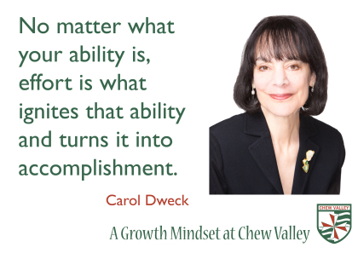
Must Have Traits & Skills of a Successful Entrepreneur
Traits
Passion
Strong Work Ethic
Strong People Skills
Determination
Creativity
Competitiveness
Self Starter
Open Minded
Confidence
Disciplined
https://medium.com/swlh/10-must-have-traits-of-a-successful-entrepreneur-d46519452b0e
Skills
Research
Focus
Learning
Communication
Cash Management
Problem Solving
Risk Taking
Time Management
People Management
https://www.entrepreneur.com/article/249137

Slide 6
Difference between Skills & Traits
Skills are tasks you can do well, whereas traits are typically defined as features of your character.
You learn and acquire skills in life/work, whereas traits are theorized as integral to you either through genetics or experiences in life.
Skill acquisition is achievable and manageable through training and you can strengthen/unlock new traits and passions at different stages of your life.
https://bizfluent.com/info-8247704-differences-between-skills-traits.html

Slide 7
Ways to Improve Your Entrepreneurial Skills and Characteristics
As an entrepreneur, you may be born with certain traits such as vision, intuition and drive. You might even have an overflow of invention ideas. There is a popular saying: Hard work beats talent when talent does not work hard enough. This is especially true in the world of entrepreneurship. It does not matter how much passion or creativity or drive you have as an entrepreneur, without the right skills and perspective, you will struggle to grow your business.
There are several different types of entrepreneurs, but most successful entrepreneurs have defining skills and attributes that have helped them achieve phenomenal success like the ability to deal with failure, focus on the right customers, increase productivity, hire effective people and manage money.

Slide 8
Ways to Improve Your Entrepreneurial Skills and Characteristics
Join An Entrepreneur Community: Interact with entrepreneurs who have already been through all the hardships and gain new knowledge that you can apply
Find A Business Mentor: Business mentors usually give you very specific advice about your business and can help you improve your entrepreneurial skills.
Read More: It expands your knowledge and gives you new insights into business management. Read small business blogs to learn and improve your skills.
Listen To Business Podcasts: Podcasts give you detailed insight into how entrepreneurs are using the internet to grow their businesses at a fraction of the cost of traditional marketing methods.
Learn From Your Mistakes One thing you should always do is reflect on your past decisions and ask yourself: How could I have done that better?
https://businessfirstfamily.com/improve-entrepreneurial-skills/

Slide 9
Assess Your Entrepreneurial Potential!
Do you have what it takes to be an entrepreneur?
What kind of entrepreneur are you? What are your entrepreneurial strengths and weaknesses? What kind of leader are you? How resilient are you?
Take some tests and find out….

Slide 10
Let’s assess/review your Engineering skills first!
As an engineer you already employ a mixture of skills on daily basis. Leadership and communication are interpersonal skills that successful engineers employ on a regular basis.
These soft skills complement your “hard” technical skills, such as programming or a working knowledge of chemistry which relate to your field of work.
Engineers are natural problem solvers and creators in everything from biology to computer programming. Engineering as you know, is fundamentally about problem solving and multi-tasking, and that means finding new ways to apply existing knowledge—a truly creative process. You may have been attracted to engineering because of its creative element?!
Source https://www.thebalancecareers.com/list-of-engineering-skills-2063751

Slide 11
Let’s assess/review your Engineering skills first!
Engineering is very technical and relies on concise and accurate communication between colleagues. But you will also have to communicate with people outside of the field, such as clients and sometimes the general public, who do not have a technical background. Some key communication skills include:
Emotional Intelligence
Presentation Skills
Active Listening
Motivation
Negotiation
Ability to Clarify and Paraphrase
Stress Tolerance
Source https://www.thebalancecareers.com/list-of-engineering-skills-2063751

Slide 12
Let’s assess/review your Engineering skills first!
Frequently, in your work as an engineer you will need to manage a project or manage a team. This will include integrating with auxiliary departments while trying to meet deadlines on a budget.
Because of the administrative demands required of most engineers, many of them go on to become CEOs and thought leaders and ENTREPRENEURS!
Source https://www.thebalancecareers.com/list-of-engineering-skills-2063751

Slide 13
Let’s assess/review your Engineering skills first!
Engineers almost never work alone; you will work with a wide range of employees, both fellow engineers and people outside your department, to bring your projects to fruition. Teamwork is the essence of department integration and collaboration.
You need to be able to work collaboratively with different types of people at every level, applying skills as varied as verbal communication and appropriate body language to goal-setting and prioritizing problems. You need the character and integrity that will induce other people to trust you and rely on you as you all work together.
Source https://www.thebalancecareers.com/list-of-engineering-skills-2063751
This Photo by Unknown Author is licensed under CC BY-NC-ND

Slide 14
Let’s assess/review your Engineering skills first!
Projects in engineering are extraordinarily complex.
Sometimes they involve dozens, if not hundreds, of people.
A small mistake at any point during planning, development, or construction can result in failure.
A failed project not only loses money but could have much more serious implications, as design/implementation flaws could injure or even kill people.
As such attention to detail is a very important key engineering skill!
Source https://www.thebalancecareers.com/list-of-engineering-skills-2063751

Slide 15
Your Engineering Skills applied in an Entrepreneurial Setting
Just as happens in engineering, entrepreneurs start with a big goal they have to break down into smaller, more achievable parts.
If you are a computer scientist building a web platform, you have to imagine the final site, but in order to begin, you need to first break down the Java script line by line, in order to eventually reach the final goal.
Likewise, entrepreneurs need the ability to connect seemingly unrelated topics to create one coherent solution.
Source STEM Skills

Slide 16
Assess your STEM Entrepreneurial Potential
Entrepreneur Self Assessments: What You Need to Know.
If you're starting or leading a company, it's beneficial to know yourself inside and out. Assessing yourself with professional self assessment tools can:
Help you understand how you work best, so you can make appropriate changes.
Help your stakeholders to understand what motivates and drives you.
Help you recognize when you need help.
Help you choose who to hire to compliment your strengths and weaknesses.

Slide 17
Why are personality tests so important to an aspiring entrepreneur?
Self assessments help individuals get in touch with what their core competencies are and how those may overlap with what’s needed to take on running a business.
While your personality is highly relevant in your success, it’s not the only defining factor which we explore in greater detail in this training module.

Slide 18
EXERCISE: Entrepreneurial potential self-assessment
Starting a business can be a rewarding and enriching experience. However, it might not be the right professional choice for you.
Before making the leap, take some time to find out whether the opportunities and challenges of entrepreneurship fit with your personality. This test will evaluate your entrepreneurial traits, as concerns motivations, aptitudes and attitudes.
EXERCISE
Entrepreneurial Potential Self Assessment

Slide 19
EXERCISE: The Entrepreneur Equation
The Entrepreneur Equation is a New York Times bestselling book that provides exercises and assessments to help you assess your personality vis-à-vis entrepreneurship, as well as your mindset, timing and the particular opportunity.
EXERCISE
Author Carol Roth put together an interactive online quiz to see how your personality compares with the popular profile of today's successful entrepreneurs

Slide 20
EXERCISE: What Kind of Entrepreneur are You?
Are you Achievement Striving? Industriousness? Taking Control? Driven by Passion or Creativity?
The summaries provided in this entrepreneur questionnaire will give the candidate an understanding of the strength of the characteristics they already possess, as well as a bearing on the areas that may require improvement, in order to aid in the development of a successful entrepreneurial career.
EXERCISE
Entrepreneur Personality Test

Slide 21
EXERCISE: What Kind of Leader are You?
This test will help you measure your five key aspects of leadership:
Organisation
Responsibility
Transformational leadership
Assertiveness
Resourcefulness
Using this feedback, individuals are able to identify their strengths and aim towards improving areas that may currently require further development.
EXERCISE
Leadership Test

Slide 22
EXERCISE: How Resilient are You?
This test will assess your resilience and ability to deal with stress and adversity by focusing on 5 key headings:
Adaptability
Self Control
Self Sufficiency
Optimism
Persistence
Resilience is more important than ever, to be able to keep up with changes or to accept difficulties when presented with a challenging situation. EXERCISE
Resilience Test

Slide 23
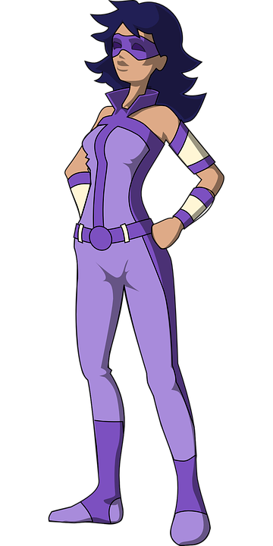
SECTION 2:
Staying Connected to Vital Information
How to stay connected with industry to guide future decisions, continue your entrepreneurial development and… Unlock Your Brilliance!

Slide 24
Stay on Top of Industry Trends
Update your news feed If you don’t have time to click through and read an article that sounds interesting, use a “save for later” app like Pocket so you can revisit it when you have more time.
Leverage your connections Your network connections (if they’re good) should have their eyes and ears to the ground, too. Start an email thread where you can share interesting findings or articles. A Slack channel for sharing this sort of information is also helpful.
Use SEO Try using a relatively inexpensive SEO tool like Moz to enter keywords in your industry to identify emerging patterns in people’s searching behaviour. One strategy is to go after terms that are niche.
https://squareup.com/us/en/townsquare/8-easy-ways-to-stay-on-top-of-industry-trends

Slide 25
Stay on Top of Industry Trends
Subscribe to trade journals This may sound antiquated, but trade journals are still one of the best ways to stay in the know about specific issues in your industry. Do some research to figure out which ones you should subscribe to and get on their lists.
Subscribe to magazines Often, you’ll find something that’s either relevant to your line of work or that might spark an idea or insight.
Remember to Network Conferences, local networking events, trainings, and Facebook groups are dedicated to getting you in front of colleagues and experts.
Engage with your Customers Getting feedback in the form of surveys or simply replying to customers’ posts on your social channels are good ways to see from your audience’s perspective. Don’t ever underestimate the power of customer insight.

Slide 26
Stay on Top of Industry Trends
Keep an eye on your competitors Think you spotted a trend but aren’t sure if it’s anything that will catch on? By observing what your competitors are doing, you can capitalize on emerging news, trends, and opportunities. Sure, staying ahead of the competition is key, but knowing what they’re up to is one part of coming out on top.
Linked In Company profiles are a good way to find more information on companies in which you have an interest. You'll be able to see if you have any connections at the company, new hires, promotions, jobs posted, related companies, and company statistics, updates, articles, what they are up to, what is new and emerging.

Slide 27
Unlocking Your Brilliance
Women Thriving in Engineering Sector Entrepreneurship
Interview: Karen Purcell, Engineer, Entrepreneur & Author
Karen Purcell is an engineer and entrepreneur who imparts her experiences and strategies for women to survive and thrive in the sector.
Purcell majored in electrical engineering. After six years working for an electrical engineering firm, she started her own company called PK Electrical specialising in major infrastructure project lighting, power, and electrical design.
Today, the company has grown from one to twenty-two people, with over 3 million in revenue as well as numerous industry awards.
Image Source: @STEMspire More information about Karen
Karen is also author of: Unlocking Your Brilliance: Smart Strategies for Women to Thrive in Science, Technology, Engineering, and Math

Slide 28
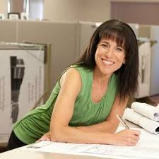
Unlocking Your Brilliance with Karen Purcell
How to Overcome Gender Barriers & Imposter Syndrome
What are the best ways for a woman to overcome gender barriers?
Karen: Have the confidence to follow through and be present. Stick to your guns. Don’t let other people’s attitudes or actions get you down.
How do you overcome “imposter syndrome’’?
Karen: Ruth Charney, president of the Association for Women in Mathematics says, ‘everyone has had a crisis of confidence. As a grad student, you wonder if you will be any good. And once you get a job, you’re convinced you’re not that good and don’t belong there. As you get older, imposter syndrome subsides, but never goes away. To deal with it, you need to find confidence builders and to maintain confidence’.
Source: Strategies to Help Women Strive in STEM Careers

Slide 29
Unlocking Your Brilliance with Karen Purcell
How to Overcome Gender Barriers & Imposter Syndrome
Is finding Confidence Builders particular to women in STEM or for anyone?
Karen: It can be for anyone, but is even more so in STEM because you are surrounded by so many men that it can be a drain on your confidence especially if they try to belittle you or talk down to you. For example, in my specialty, we do lighting and power design for construction projects and going out in the field. There were plenty of times when someone thought I was an assistant and not and engineer. Then I opened my mouth and they realized I was and engineer. This was when I was working for Tom and they looked to him for approval, as opposed to realizing that what I was saying was true. That’s a shot at your confidence - when someone doesn’t really believe what you’re saying. That’s more dominant in STEM.
Source: Strategies to Help Women Strive in STEM Careers

Slide 30
Unlocking Your Brilliance with Karen Purcell
How to Overcome Gender Barriers & Imposter Syndrome
You say a major reason why women should go into STEM is because of product design e.g. early voice recognition systems responded only to male voices, so that women’s voices were literally not heard. And more dangerously, air bags in cars were designed for male body sizes.
Karen: Yes, the systems were originally calibrated to recognize male voices because only males were designing such products. But everyone deals with air bags on a daily basis. So having a women’s input with respect to product design makes a huge difference.
Source: Strategies to Help Women Strive in STEM Careers

Slide 31
Unlocking Your Brilliance with Karen Purcell
How to Overcome Gender Barriers & Imposter Syndrome
Do you think it matters whether a woman has a male/female mentor?
Karen: It doesn’t matter. One advantage of having a woman is that she can share what the experience has been in a male-dominated field, but I really don’t think it matters.
Do you have other advice for women entrepreneurs in STEM? Karen: Being a part of any support group that is business-oriented and networking are essential to success. Showing confidence is really important. When I was in school I didn’t learn anything about running a business. I just followed my dreams and passions and learned and stumbled along the way. Having external support groups along the way has definitely helped.
Source: Strategies to Help Women Strive in STEM Careers

Slide 32
Unlocking Your Brilliance with Karen Purcell
How to Overcome Gender Barriers & Imposter Syndrome
Do you think it matters whether a woman has a male/female mentor?
Karen: It doesn’t matter. One advantage of having a woman is that she can share what the experience has been in a male-dominated field, but I really don’t think it matters.
Do you have other advice for women entrepreneurs in STEM? Karen: Being a part of any support group that is business-oriented and networking are essential to success. Showing confidence is really important. When I was in school I didn’t learn anything about running a business. I just followed my dreams and passions and learned and stumbled along the way. Having external support groups along the way has definitely helped.
Source: Strategies to Help Women Strive in STEM Careers

Slide 33
Section 3
Case Studies of Real- Life Female Entrepreneurs in Engineering (and STEM)

Slide 34
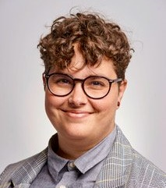
Talita Holzer, waytoB
Talita Holzer is the CEO and Co-Founder of waytoB. She is a Manufacturing Engineer and an advocate for Diversity and Inclusion.
waytoB is an award-winning Irish startup that helps people with intellectual disabilities become more independent. The platform consists of two sides – one for the user and one for their partner. Personalised content, a heart rate monitor, and a panic button are just a handful of the features designed to ensure that the individual is safe at all times.
https://www.women-in-tech-dublin.com/blog/top-7-innovative-female-led-irish-startups

Slide 35
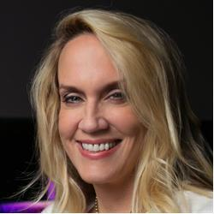
Brenda Romero, Romero Games
Based in Galway, Romero Games is the BAFTA award-winning studio behind strategy game Empire of Sin. Brenda Romero is the CEO of Romero Games. She entered the game industry in 1981 and has since worked on over 50 games including titles in the Wizardry, Ghost Recon, and Dungeons & Dragons franchises.
https://www.women-in-tech-dublin.com/blog/top-7-innovative-female-led-irish-startups
https://www.lynda.com/Brenda-Romero/4851408-1.html

Slide 36
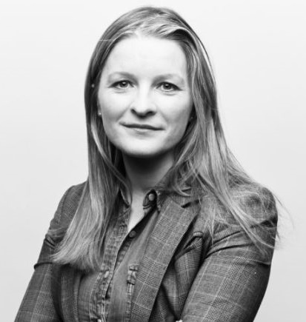
Aine Kerr, Kinzen
Áine Kerr is the COO and Co-Founder of Kinzen. Kinzen is a technology company that specialises in building personalised news products for people and publishers.
Allowing you to take control of the news, the business supports a societal shift from an 'Attention Economy' to an 'Intention Economy’, Prior to this she worked for Facebook as its Global Head of Journalism Partnerships, for Storyful and the Irish Independent, The Irish Times, and Irish Examiner.
https://www.women-in-tech-dublin.com/blog/top-7-innovative-female-led-irish-startups
https://www.siliconrepublic.com/start-ups/aine-kerr-kinzen-inspirefest

Slide 37
Deepa Mann-Kler, Neon
Neon is led by female tech thought leader and award-winning designer Deepa Mann-Kler.
Prior to moving into immersive technology, Mann-Kler was a multi-disciplinary artist who primarily worked in neon, painting, drawing and photography.
Neon is a wellbeing company that uses immersive technologies to improve health outcomes. The business has a clear vision to create software applications in virtual, augmented, and mixed realities.
https://www.women-in-tech-dublin.com/blog/top-7-innovative-female-led-irish-startups

Slide 38
Rachel O’Donnell, The UX Studio
A user-focused approach to the creation of a website, app, or piece of software is key to running a successful tech business. The UX Studio focuses its work upon four key sectors, HMI Design, UX Design, Websites & E-Commerce and Bespoke Software UX & UI.
Concerned with solving real user problems. The UX Studio is headed by Limerick-educated Rachel O'Donnell, who comes from a family of five successful women in tech. O'Donnell started her career in Design back in 2008 and now boasts an extensive CV of UX jobs.
https://www.women-in-tech-dublin.com/blog/top-7-innovative-female-led-irish-startups

Slide 39
Ciara Garvan, WorkJuggle
WorkJuggle was born from the frustrations of raising a family at the same time as holding down a high-profile tech jobby its CEO Ciara Garvan.
A user-focused approach to the creation of a website, app, or piece of software is key to running a successful tech business.
WorkJuggle connects highly-skilled professionals with flexible work, be it contract work, part-time roles, or remote working. It allows organisations to access high quality talent and scale quickly when they need to.
https://www.women-in-tech-dublin.com/blog/top-7-innovative-female-led-irish-startups

Slide 40
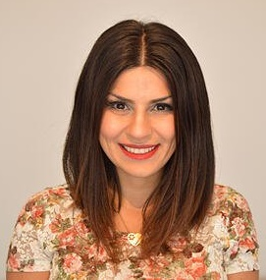
Ciara Garvan, Girls in Tech (GIT)
Coral Movasseli is the Managing Director of Girls in Tech Dublin. The company has grown to be the largest organisation of its kind in the country and, in early 2019, it hosted the first Women in Tech hackathon in Ireland.
GIT aims to accelerate the growth of innovative women entering into the high-tech industry and building start-ups. The business achieves this through the creation of proprietary, innovative programming, and strategic global partnerships.
https://www.women-in-tech-dublin.com/blog/top-7-innovative-female-led-irish-startups

Slide 41
Dr Anjali Jaiprakash - Medical & Healthcare Robotics, ARC Centre of Excellence for Robotic Vision, QUT
CLICK TO SEE FULL VIDEO
Anjali is developing robotic systems to support surgeons with knee arthroscopy and also a universal retinal diagnostic system.

Slide 42
“
We want to give surgeons affordable precise tools and robotic systems that they can use in surgeries to enhance their abilities
”
DR ANJALI JAIPRAKASH - Medical & Healthcare Robotics, ARC Centre of Excellence for Robotic Vision, QUT

Slide 43
Dr Catherine Ball, Multiple Start Up Owner, Author & Entrepreneur Supporter
CLICK TO SEE FULL VIDEO
Dr Catherine Ball – Environmental Engineer, Entrepreneur CEO & Co-founder, SheFlies, & World of Drones Congress.
Catherine works on projects where #Drones, #Robotics and #Tech meet environmental protection and more

Slide 44
“
I have 5 of my own start ups currently operating. One Planet Woman is a business that I started to provide mentoring and sustainability guidance as well as start up advice
”
DR CATHERINE BALL – Environmental Engineer, Entrepreneur CEO & Co-founder, SheFlies, & World of Drones Congress

Slide 45
CLICK TO SEE FULL VIDEO
Emily de la Pena – Civil Engineer & Entrepreneur, Founder Coding Kids
‘I like number crunching but at the same time I care about people and I think if I just be myself, if I’m genuine in my values and behavior that can also allow me to thrive being a business owner’

Slide 46
“
There are a lot of stories that when you are in business you’ve got to hustle and have a big extroverted personality but that’s not me, I’m introverted
”
EMILY DE LA PENA
Civil Engineer & Entrepreneur, Founder Coding Kids

Slide 47
The Co-Founders
Dr Kate Lomas – Biopsicist & Co-founder, Inventor & Chief Technology Officer, Hemideina
Dr Elizabeth Williams – Chemist & Co-founder & Chief Executive Officer, Hemideina
Kate discovered a new insect hearing organ that has inspired her to revolutionise the cochlear implant, she partnered with Liz to Co-found a MedTech start-up.
CLICK TO SEE FULL VIDEO

Slide 48
CLICK TO SEE FULL VIDEO
The Inventor & Multiple Trier
Sarah Last – Biologist, Inventor, Entrepreneur, Co-founder and Chief Technology Officer, MimicTec Sarah is an AgTech inventor
Sarah invented a device that encourages chick survival at early stages of life. Mimictec is an ethical agricultural company working in the poultry industry

Slide 49
“
I’d tried a couple of business ideas… I got a masters of Entrepreneurship. One day somebody mentioned that when animals are less stressed they are more productive, it was my aha moment
”
SARAH LAST
Biologist, Inventor, Entrepreneur, Co-founder and
Chief Technology Officer, MimicTec Sarah is an AgTech inventor

Slide 50
What I Have Learned?
I know there is no ‘ideal’ entrepreneur personality to be successful. There are many different traits and skills. I should have a mix of good traits and skills such as being thrill-seeking, sociable, analytical, intuitive and creative…
Now I have taken the entrepreneurial tests I am aware of what kind of entrepreneur I am and I of the different ways I can improve my entrepreneurial skills, traits and characteristics.
I know how to stay on top of vital industry information to guide my future decisions, continue to further develop and evolve my business
I am confident I can unlock my brilliance as a result of this Module

Slide 51
EXTRA LEARNING
In this section we provide you with some extra information on the topics covered so you can delve deeper

Slide 52
CLICK TO SEE FULL VIDEO
The Innovative Capital Raisers
Discussion Female STEM Panel:
Rema Subramania, Founder and Partner, Ankur Capital.
Anu Acharya, CEO Mapmygenome.
Shereen Salah Ahmed Manager, Incubation Centre.

Slide 53
The Youngest Self Made Female STEM Billionaire
Elizabeth Holmes has a Bio-Tech empire called Theranos.
She is being compared to visionaries like Bill Gates and Steve Jobs. Holmes mission is to allow blood testing in every drugstore at a fraction of Medicare costs by a replacing the needle and using a tiny drop of blood from a finger.

Slide 54
@EMERGEPROJECTEU
https://www.facebook.com/EMERGEPROJECTEU/?ref=br_rs
http://www.emergeengineers.eu/project-partners/
http://www.emergeengineers.eu/
#EMERGE #femaleengineers #Erasmus+
#femaleentrepreneurs

