Slide 1
MODULE 1
Engineering Entrepreneurship: Where are the Women?

Slide 2
Engineering Entrepreneurship: Where are the Women?
Ambition Knows No Gender
Being your own boss can be a great career move. We explain why and meet some female engineering entrepreneurs breaking the mould.
It is known that perceptions of opportunity and capability are strongly link to entrepreneurial activity - that is, if you think you will succeed and will be supported, you are more likely to try.
EMERGE provides the training, support and guidance you need to succeed. This module is the start of your entrepreneurship journey.
Getting started
What is a business plan is and why it is so important? We debunk the myths of business planning
Reducing the Risk of Start Up Failure
Fear of failure is an immobilising barrier to entrepreneurship and is even more prevalent for Women in Engineering
This module will ignite your female Engineering Entrepreneurship spark!

Slide 3
SECTION 1:
Ambition Knows No Gender
Could entrepreneurship be a viable career path for you? In this section we meet some inspiring women who have “started up” and we find out why NOW is a good time to become an engineering entrepreneur. We get started on our business journey by learning about the 5 Stages of Business Development.

Slide 4
“
Never ever give up your dreams just because you’re a girl and that you don’t have any support from anyone
”
DEENA VENUGOPAL
Founder and CEO of Anabytes

Slide 5
Why entrepreneurs are important?
Entrepreneurs are the lifeblood of any expanding economy, generating jobs, introducing new products and services, and creating jobs for ourselves and others

Slide 6
Spotlight on Engineering Entrepreneurship
Some of your engineering skills are the foundation of a great business. Curiosity, creativity and innovation leDad to a deeper exploration of entrepreneurship.
Becoming an entrepreneur involves business, marketing and finance skills; however, many do not realize the value that STEM skills can also contribute to running a company.
Relevant STEM skills to entrepreneurship include: numeracy and mathematical skills, data and critical analysis skills; systematic and critical assessment of complex problems, problem solving and the application of the theoretical knowledge, the ability to communicate; ingenuity, logical reasoning and practical intelligence.
Source: https://skillspanorama.cedefop.europa.eu/sites/default/files/EUSP_AH_STEM_0.pdf

Slide 7
Did you know the key traits of entrepreneurship are embedded in Engineering?
Engineers, what ever the field are all essentially trying to do one thing: face a problem that’s both challenging to understand and solve. Engineers work in a variety of fields to analyze, develop and evaluate large-scale, complex systems. This can mean improving and maintaining current systems or creating brand new projects. Engineers will design and draft blueprints, visit systems in the field and manage projects.
This process is very similar to entrepreneurship, but here the solving of problems is done via business planning which helps you to dissect your idea. The modules that follow 2-9 look at each key step of your business plan in detail.

Slide 8
Spotlight on Female Entrepreneurship… here come the girls!
Women are becoming business owners at higher rates - but rates of female entrepreneurship have historically lagged those of men. Female-led businesses only make up 30% of companies around the world. But we are catching up - globally, from 2015 to 2016, women entrepreneurship rates increased by double that of their male counterparts*.
Women are starting engineering businesses across the spectrum of micro to high growth - from supporting life to creating wealth.
* https://www.huffingtonpost.com/entry/women-entrepreneurs-are-driving-economic-growth_us_59f7c3dce4b04494283378f3

Slide 9
What you need to succeed? Top entrepreneurship tips from your peers!
“Be better than average”
Leah La Salla, CEO & Co-Founder of Astral AR.
“As a woman in this industry, you will face a lot of doubters….You have to be better than average, and you have to know much more than the average start-up, because investors will demand it of you. One thing that helps is having truly great partners. If you can be strategic with your network and with who you do business with, you can lean on them for support you when need it.”
Astral AR is a drone piloting system that uses IoT technology to help law enforcement stop bullets and detect guns and bombs through walls.

Slide 10
What you need to succeed? Top entrepreneurship tips from your peers!
“Set your stakes high, take things one step at a time.”
Samantha Snabes, Co-founder, re: 3D
“Women in tech and STEM fields – you are every bit as qualified as anyone else, so set your sights high and take things one step at a time. The world needs big dreamers and people who will execute on a vision. I think a great mentality that our team has which has allowed us to get to where we are is shooting for lofty goals, no matter how insurmountable the challenge may seem. You eat an elephant a bite at a time, and that’s a state of mind that helps us tackle big projects that others may have written off as impossible’’.
re: 3D is the creators of Gigabot, an industrial human-scale 3D printer that prints from plastic recyclables.

Slide 11
What you need to succeed? Top entrepreneurship tips from your peers!
“Believe from your core that you have a
great product then never give up”
Sharmi Albrechsten, CEO, SmartGurlz Inc.
“Once you catch that entrepreneurial spirit it won’t ever leave you, you’ll just have to do it. Passion will take you so far, you’ll need tenacity and inner strength, but if you believe from your core that you have a great product then never give up! In the coming years, I expect to see a huge rise in women in tech and in provisions and incentives for women in tech. We’re really lacking in tech products and services that are tailored to women. That’s all going to change.”
SmartGurlz is developing self-balancing robots and action dolls that encourage girls to learn to code
Source: https://www.business2community.com/social-buzz/shark-tank-update-smartgurlz-02072289

Slide 12
What you need to succeed? Top entrepreneurship tips from your peers!
“Ask other start-ups for advice… and be patient.”
Teri Dankovich, founder of Folia Water
“Imagine what success looks like as a business owner in a few years in the future, and then figure out what you need to do to get there. Ask other scientist-run start-ups for advice on how to get started and how to grow your business. Find more experienced business and technical people in your verticals for advisors. Create a community of other start-up founders to share your wins and loses with. Be patient.”
Folia Water is a water filtration system made up of a single sheet of paper, which can provide 50 litres of safe water for 50 cents a sheet

Slide 13
What you need to succeed? Top entrepreneurship tips from your peers!
“Don’t over think it. Take calculated risks.”
Grainne Kelly, Founder and CEO of Bubblebum
“Don’t over think it. Take calculated risks. You don’t have to ask for permission to succeed. It is not a rocket science, don’t be blinded by technical jargon and don’t be afraid just ask plenty of stupid questions! ”
Grainne Kelly is the CEO and inventor of Bubblebum UK Ltd, manufacturer of the world’s first inflatable car booster seat.

Slide 14
Why NOW is a great time to be an entrepreneur?
Entrepreneurship is the transformational megatrend of the 21st century due to its capacity to reshape economies and industries throughout the world.
Now is a great time to be an entrepreneur and start a business for many reasons:
Increase in Supportive Environments for Female Entrepreneurship
Abundance of Financial Support for Female Entrepreneurs
Rise of Women Entrepreneurs (older/younger/ migrant/everyone)
New ways to do business (Social Entrepreneurship, Frugal Innovation)

Slide 15
Female specific supports entrepreneurship supports have a key role to play. In this video, we learn about the Enterprise Ireland Competitive Female Entrepreneurship Fund, that is helping female entrepreneurs succeed in areas that were once male dominated.
Example of Financial Support for Female Entrepreneurs
CLICK TO SEE FULL VIDEO

Slide 16
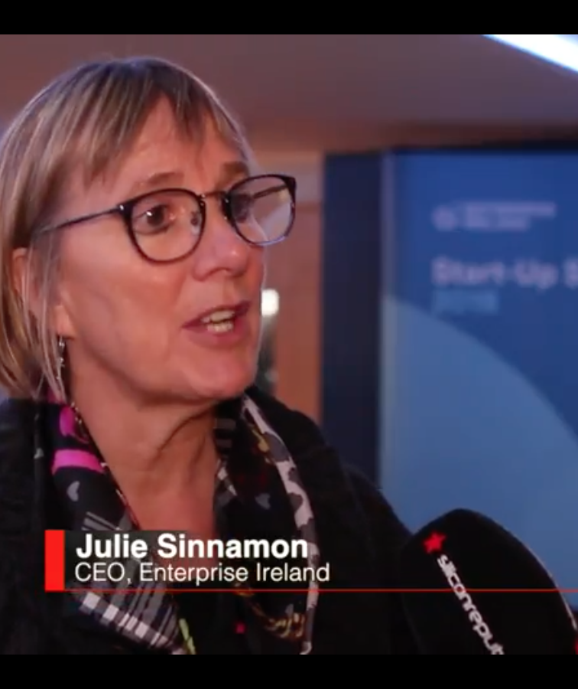
CLICK TO SEE FULL VIDEO
Now is a Good Time to Start in Engineering Entrepreneurship – what the funders want?!
Enterprise Ireland CEO wants women founders to get 50% of funding
Ireland is leading the field for funding women-led tech firms. Internationally, the funding level for women-led companies is typically 6% or lower. Enterprise Ireland is bucking this trend, with 35% of all high-potential start-ups (HPSUs) backed in 2017 being women-led. For the CEO of Enterprise Ireland, Julie Sinnamon, 35% is still not good enough.

Slide 17
This is not an Irish problem; it is a global problem. Only 8% of tech entrepreneurs globally are female, so it is a big problem
JULIE SINNAMON
CEO of Enterprise Ireland

Slide 18
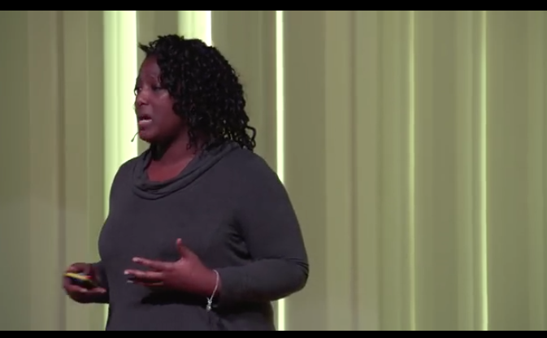
An initiative by Stemettes . Outbox Incubator provides seed funding, intensive mentorship, and support to talented girls aged 22 and under who have innovative business and technology ideas.
CLICK TO SEE FULL VIDEO
Example of Supportive Environments for Female Entrepreneurship
Source Meet the Next Generation of STEM Entrepreneurs https://outboxjourney.com/incubator/

Slide 19
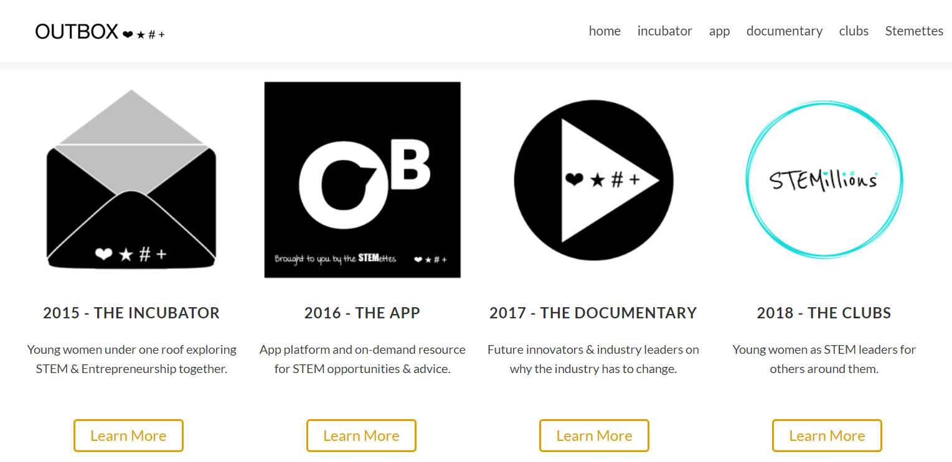
An initiative by Stemettes . Outbox Incubator provides seed funding, intensive mentorship, and support to talented girls aged 22 and under who have innovative business and technology ideas.
CLICK TO FIND OUT MORE
Example of Supportive Environments for Female Entrepreneurship
Source Meet the Next Generation of STEM Entrepreneurs https://outboxjourney.com/incubator/

Slide 20
Impact of engaging with Female Entrepreneurship supports like Outbox Incubator
I was reminiscing about Outbox the other day and was thinking about how I wished I was as confident and ambitious as I am now back then, only to realise that it was Outbox itself that helped me become more confident.
Ellora, Scotland

Slide 21
SECTION 2:
Getting Started
What is a business plan is and why it is so important? We debunk the myths of business planning and learn why experimentation is just as important as planning.

Slide 22
Yes, becoming an entrepreneur inevitably involves business, marketing and finance skills; however, many do not realize the value that STEM skills hugely contribute to running a company. A lack of entrepreneurial skills should not deter you from your passion. These skills are extremely achievable and can be learned.
In this section, we
Learn what a business plan is and why is it important
Debunk common myths and realities of business planning
Learn why experimentation is just as important as planning
Learn how to build a strong resilient business
Plan for tough time and crises

Slide 23
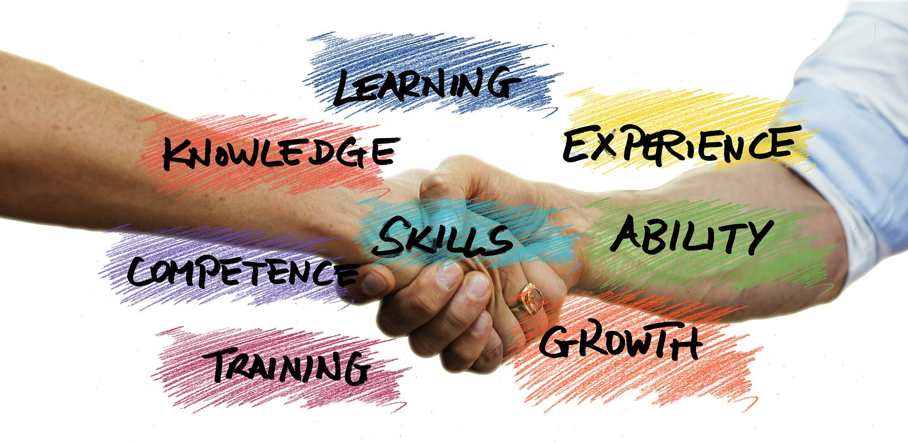
What are Business Plans
and why are they important?
A Business Plan is an essential tool that methodically thinks through the entire entrepreneurial planning process.
Many entrepreneurs do not actually complete a business plan unless required to by their bank or funding agency. This is a lost opportunity.
A properly prepared Business Plan should tell a story, make an argument and conservatively predict the future.
Business planning guides you through the process of setting goals, explaining objectives and then mapping out a document to achieve these goals and objectives. It does not need to be complicated.
Source: www.entrepreneurship.org/articles/2002/05/business-planning-building-an-effective-business-model

Slide 24
Reasons for a business plan
According to statistics *66% of all business start-ups will fail in their first five years and a staggering 80% of small businesses without a business plan will fail in their first 5 years **
* Bank of Ireland ** Paul Fagan, Action Coach*

Slide 25
Reasons for a business plan
Why business start-ups fail in their first five years?
Lack of planning on behalf of business owners.
Having a well structured business plan gives you more success of survival. It helps you think through the whole process
the value of a business plan is not only the plan itself, but the process of writing it.
To put down on paper the resources you need to get started and what
To convince yourself that it is worth doing
To show others that you have thought it through
To convince investors to give support
To give you targets to aim towards and measure yourself against

Slide 26
Myths and Realities of Business Planning – Debunked!
In developing a Business Plan and a Business Model, women in STEM entrepreneurs need to be aware that there are myths and misconceptions about the process…

Slide 27
#1 Myth: Business plans are written when a company needs to raise capital
REALITY:
Although most Business Plans are written in connection with the search for capital, a well-written Business Plan will serve a variety of beneficial purposes to the company, it’s founder and its team.
Use it as a management tool and road map for growth.
Use it to measure progress over time in achieving projected goals and objectives

Slide 28
#2 Myth: Business plans should be as detailed and slick as possible
REALITY:
Your reader will not have the time to review hundreds of pages of text. The plan must be concise, well-written and when used to seek funding should focus on the lender's or investor's principal areas of concern. Do not clutter it with irrelevant information.
Although a Business Plan ought to be presented professionally, an overly lavish presentation can have the opposite effect –substance over style wins every time. Interestingly, business plans prepared in Powerpoint can be very effective –more later!

Slide 29
#3 Myth: Business plans should emphasize ideas and concepts, not people
REALITY:
Many entrepreneurs fear that if the success of a company depends too heavily on any specific person, it can be a negative thing.
Although this is partially true, investors prefer to invest in a company that has great people. People buy people but so many business plans are bland and fail to capture the personality and spirit of the promoter – write with passion, that same passion that keeps you craving entrepreneurial success.

Slide 30
#4 Myth: Only the founding entrepreneur should prepare the business plan
REALITY:
Most entrepreneurs are highly skilled in a particular profession or area of business development/ management. This does not mean they necessarily possess the ability to prepare a Business Plan!
Ideally, the Business Plan should be developed by the founder but failing this, outside mentors and/or qualified experts should be sought. You must have true ownership of your plan and be in a position to defend and champion the assumptions in it.

Slide 31
#5 Myth: Optimism should prevail over realism
REALITY:
The Business Plan should demonstrate the enthusiasm of the founders of the company as well as generate excitement in the reader; however, it should be credible and accurate. If being used to seek funding, investors will want to know all of the company's strengths and its weaknesses. Previous failures should be tackled head on – admit the failure, explain the reasons why and what will be done differently second time around. As a general rule, investors will feel more comfortable investing in someone who has learned from previous business failures rather than a person who has never managed a company.

Slide 32
#6 Myth: Business plans are only for start-up companies.
REALITY:
A solid business plan can be the difference between just a business idea and a successful business. It allows you to set goals and determine how to realistically measure them. In the process of creating one, you develop an understanding of your market and the competition that is based on facts, not just hopes. Companies at all stages of development need to prepare and update Business Plans to plot their course and plan and track progress. This could include attracting new investment ,how you will launch a new product, a new market, take on board new employees, expand or sometimes contract a business

Slide 33
Business Model
As the document that tells the company's story, the Business Plan also helps shape and modify your company's Business Model, the elements of which will be driven by the answers to the following questions:

Slide 34
Business Model
Who are we? ( the Founder and the Team – if you are a sole entrepreneur, this team description should outline the skills and competencies of your external advisory team i.e. accountant, mentor, marketing, quality assurance and IT subcontractors etc )
Past business experience (What other work or business experiences, both positive and negative have led to this point and this business idea?)
What are you trying to do? (Mission)
What problem do you solve? (Faster/Better/Easier/Cheaper) Why can we do it more profitably?
How are you going to get it done? (Operations)
MODULE 5 WILL TAKE YOU THROUGH CHOOSING YOUR BUSINESS MODEL

Slide 35
SECTION 3:
Reducing the Risk of Start Up Failure
In this section you will learn how to deal with fear of failure from starting with nothing, making decisions based on money, how fear can be a motivator, and how your courage could be closer than you think.

Slide 36
Reducing the Risk of Start Up Failure
The fear of failing can be immobilizing – it can cause us to do nothing, and therefore resist moving forward.
What does a fear of failure look like? According to Mindtools.com…
A reluctance to try new things or get involved in challenging projects.
Self-sabotage – for example, procrastination, excessive anxiety , or a failure to follow through with goals.
Low self-esteem or self-confidence – commonly using negative statements such as "I'll never …….“
Perfectionism – A willingness to try only those things that you know you'll finish perfectly and successfully.
Failure can also teach us things about ourselves that we would never have learned otherwise. For instance, failure can help you discover how strong a person you are

Slide 37
Typical Causes of Failure:
Seth Godin’s list of failure causes!
Design failure
Failure of opportunity
Failure of trust
Failure of will
Failure of priorities
Failure to quit
Failure of respect
Failure to see
READ more from Seth Godin…..
How to Fail https://seths.blog/2011/04/how-to-fai/
Why Tons of Failure Is the Key to Success - https://www.inc.com/sonia-thompson/why-tons-of-failure-is-the-key-to-success-according-to-seth-godin.html
WATCH - How to Overcome the Fear of Failure https://www.youtube.com/watch?v=MAoX53n_ls0

Slide 38
“
If you push through that feeling of being scared, that feeling of taking risk, really amazing things can happen
”
MARISSA ANN MAYER
President and CEO, Yahoo!

Slide 39
Assess the reasons why businesses fail..
Building a business from the ground up is no easy task. And as many contend, definitely harder as a woman. Being a successful entrepreneur frequently involves a series of missteps and mistakes before finally nailing the right idea or business. Most entrepreneurs make mistakes along the way, and first-time entrepreneurs make the most.

Slide 40
Ways to reduce the fear of failing
Analyse all potential outcomes - Many people experience fear of failure because they fear the unknown. Remove that fear by considering all of the potential outcomes of your decision. Use tools to teach you how to map possible outcomes visually.
Learn to think more positively - Positive thinking is an incredibly powerful way to build self-confidence and neutralize self-sabotage - see Module 3
Look at the worse-case scenario - In many cases, however, this worst case may actually not be that bad, and recognizing this can help.
Have a contingency plan - Having a "Plan B" in place can help you feel more confident about moving forward.

Slide 41
Overcoming Fear - Personal Empowerment
Personal empowerment gives an individual the ability to:
Take control of their circumstances and achieve their own goals in their personal and working life.
Become more aware of their strengths and weaknesses and therefore be better equipped to deal with problems and achieve goals.
Enhance the contribution they make both as an individual and as a member of a team.
Take opportunities to enhance personal growth and a sense of fulfilment.
https://funacademy.fi/empower-women-and-girls-in-stem-2/
http://www.skillsyouneed.com/ps/personal-empowerment.html

Slide 42
Overcoming Fear - Personal Empowerment
Confidence is not something that can be learned like a set of rules; confidence is a state of mind. Positive thinking, practice, training, knowledge and talking to other people are all useful ways to help improve or boost your confidence levels.
Confidence comes from feelings of well-being, acceptance of yourself (self-esteem) and belief in your own ability, skills and experience.
http://www.skillsyouneed.com/ps/confidence.html

Slide 43
Overcoming Fear - Building Confidence
Planning and Preparation: People often feel less confident about new or potentially difficult situations. Perhaps the most important factor in developing confidence is planning and preparing for the unknown.
Learning, Knowledge and Training: Learning and research can help us to feel more confident about our ability to handle situations, roles and tasks principles.
Positive thought can be a very powerful way of improving confidence.
Experience: As we successfully complete tasks and goals, our confidence that we can complete the same and similar tasks again increases.
Be Assertive: Being assertive means standing up for what you believe in and sticking to your principles.

Slide 44
Overcoming Fear -
Why procrastination is not your friend
Here are the main reasons why procrastination sabotages your work:
Not working to a logical schedule? Panic sets in
Selling yourself short results in you underachieving, underachieving can lead to regret and self-loathing.
The Have-To-Dos may happen, but not the Want-To-Dos. A procrastinator type of career where panic is regularly present means that time is not allocated/allowed for undertakings that expand our experiences, make our lives richer.

Slide 45
“
For women, there can be a failure to launch. Typically, women want everything to be 99% perfect. If not, they might not launch. It all comes down to not being afraid. Courage is everything
”
DR ANGLE
CEO at Ixcela, Inc.(a biotech company
focused on specialized gut health treatment).

Slide 46
A Characteristic of Great Leaders is Courage!
CLICK TO SEE FULL VIDEO
It turns out that the key to having courage is all about your support system and knowing someone else has your back.
‘When know beyond a shadow of a doubt someone believes us gives us the courage to act, someone by our side, has the wind in our sail, we work extra hard because we want to prove their sacrifice for us was worth us…When we see a leader we admire acts with courage and that gives us the courage..’

Slide 47
Case Study: Interview with the founder Dr. Eris Cosmetics
POLAND
Title: Business possibilities and Obstacles met on her career path
Description: Dr Irena Eris describes her beginnings in business and how she went through all of the stages of business, from the very beginning to well-developed and prospering company. This video informs you about the business possibilities as well as obstacles which women can meet on carrier path.
Video: Interview with the founder Dr. Eris Cosmetics

Slide 48
Case Study: Interview with Ewa Dudek, e-commerce
POLAND
Title: Stubbornness Led Her to Her Business
Description: Interview with Ewa Dudek, creator of the first affiliate network in Poland for e-commerce. They have been on the market for 10 years, and the idea of ​​creating such a business was born thanks to the experienced, which Ewa gained while working in London. The beginnings were not the easiest, but success requires sacrifices and mistakes. Video provide an information about the obstacles which one can meet during the process of establishing and running her business.
Video 1 https://www.youtube.com/watch?v=lRS14j4Podg&list=PLENkEaHKvxkWrVTfrnWo3gFG5PUKsKOz_

Slide 49
Case Study: Women Engineer success stories
TURKEY

Slide 50
Welcome to the beginning of your Engineering Entrepreneurial journey!
Are you ready to start your STEM start-up journey?
Have you a strong business proposition and an even stronger resolve?
How can you make sure you are going to succeed?
What have other female entrepreneurs done in different situations and STEM fields?
How do you know you have what it takes to be an entrepreneur?
How can you overcome challenges such as gender inequality?
Do you have any doubts?

Slide 51
EXTRA LEARNING
In this section we provide you with some extra information on the topics covered so you can delve deeper

Slide 52
Do Not Make Any Decisions Based on Money. It’s the Worst Way to Make a Decision
Dealing with the Fear of Failure
CLICK TO SEE FULL VIDEO
Mellody Hobson’s 10 Rules for Success
‘Do not make any decisions based on money, none. It’s the worst way to make a decision. Which is know is so hard to say I mean I didn’t grow up with any money and I know so many of us have a lot of stake, …you say you don’t have the luxury of doing that, but I say you do….’’.
Mellody Hobson, President of Ariel (Investment Firm that manages over $10 billion in assets)
Source Free Enterprise

Slide 53
Failure Helps You Discover Yourself!
JK Rowling’s 10 Rules for Success
CLICK TO SEE FULL VIDEO

Slide 54
You are Responsible for Your Life
CLICK TO SEE FULL VIDEO
‘If you are sitting around waiting for someone to save you, fix you and even help you, you are wasting your time because only you have the power to take the responsibility to take your life forward’
Oprah Winfrey

Slide 55
CLICK TO SEE FULL VIDEO
How Folorunsho Alakija Started Her SME with Only 3 1/2 Months Wages
‘I never had any thought or inkling of plans of how to get into furniture manufacturing but I had a good plan…’ Folorunsho Alakija
According to Forbes , Folorunsho is one of the richest women on earth, with an estimated net worth of $1.7 billion.

Slide 56
What I Have Learned?
Being a female STEM entrepreneur is something new, exciting, scary and daring. The key is to be brave, build your courage.
The very basis for your STEM education and career is the platform for entrepreneurship, measured investigation, curiosity, clear methodologies. STEM women are experts at researching, assessing and delivering facts.
You are not alone, there are hundreds of female STEM entrepreneurs and inventors out there ready to give advice and tell you how they got over their challenges.
There are many different kinds of entrepreneurs, approaches and structures e.g. introverts, co-founders, accidental entrepreneurs and inventors
Taking my first step as an entrepreneur I must remember things will never be 100%.

Slide 57
Thank you
Any Questions?
@EMERGEPROJECTEU
https://www.facebook.com/EMERGEPROJECTEU/?ref=br_rs
http://www.emergeengineers.eu/project-partners/
http://www.emergeengineers.eu/
#EMERGE #femaleengineers #Erasmus+
#femaleentrepreneurs

